Slide 1
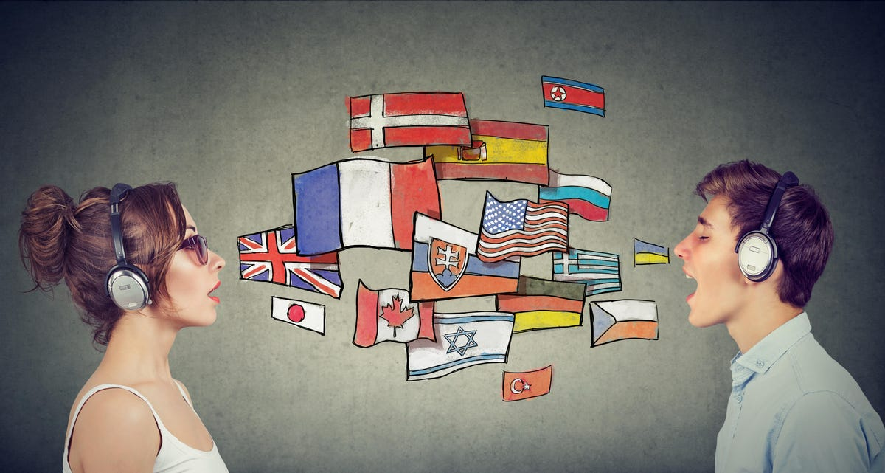
Guess the language (s) they speak!
You will get one point per language you guess
CELEBRITIES
WHO CAN SPEAK
MULTIPLE LANGUAGES

Slide 2
Guess the language (s) they speak!
You will get one point per language you guess
1. Shakira can speak 6 languages fluently. Can you guess them?
/6

Slide 3
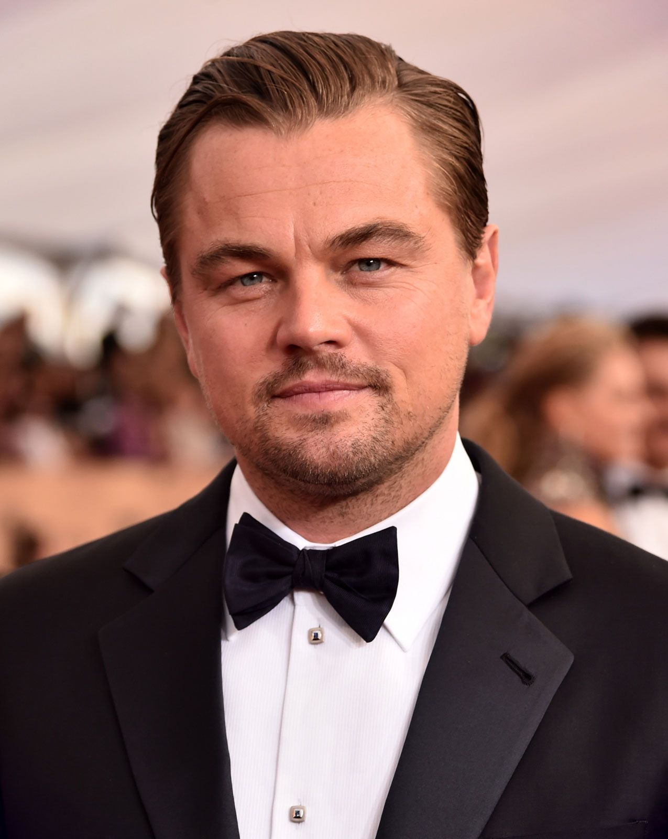
Guess the language (s) they speak!
You will get one point per language you guess
2. Global star Leonardo DiCaprio is well-known for his acting abilities, good looks and charm, but many are unaware of his linguistic abilities. He can speak 3 languages fluently!
/3

Slide 4
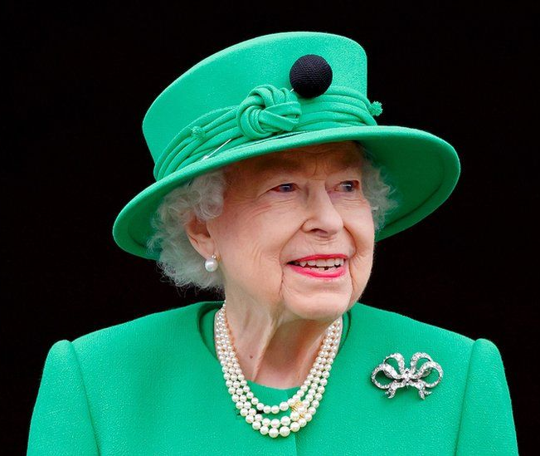
Guess the language (s) they speak!
You will get one point per language you guess
3. Apart from English, what other language can Queen Elizabeth speak fluently?
/1
Notes:
https://www.youtube.com/watch?v=3t9F6vk6Rl4&t=32s

Slide 5
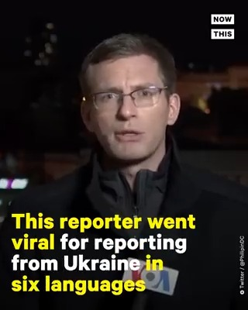
Guess the language (s) they speak!
You will get one point per language you guess
https://www.youtube.com/shorts/t0i_UqZIPow
4. This reporter went viral for reporting from Ukraine in six languages! Can you identify them?
Extra point if you can say them in order!
/7

Slide 6
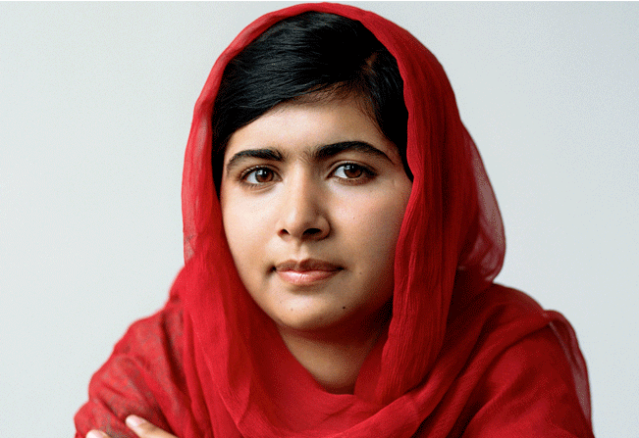
Guess the language (s) they speak!
You will get one point per language you guess
5. Malala Yousafzai, the world's youngest Nobel laureate in Pakistan knows four languages. Which ones?
/4

Slide 7
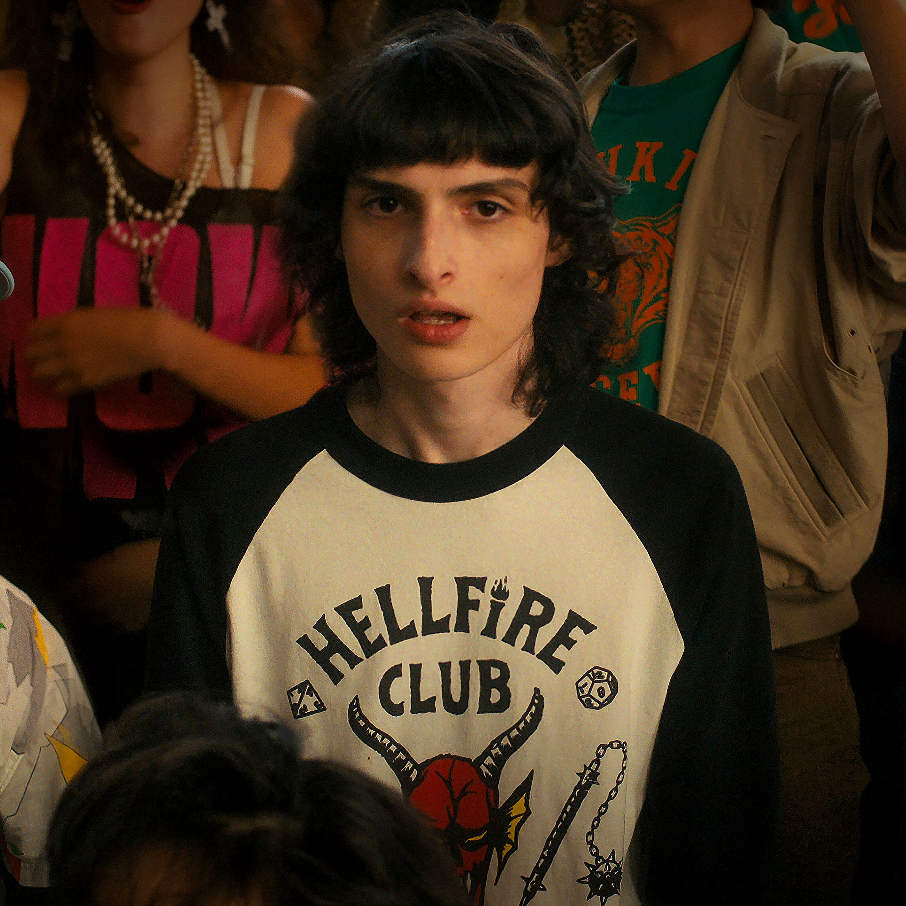
Guess the language (s) they speak!
You will get one point per language you guess
6.Finn Wolfhard (from Stranger Things) uses English as his official language but he is fluent in three more languages!
/3

Slide 8
Answers
1) Spanish, French, English, Italian, Portuguese, Arabic /6
2) English, Italian, German /3
3) French /1
4) English, Luxembourgish, Spanish, Portuguese, French, German (extra point if you guessed the order) /6 +1
5) Pashto, Urdu, English, Swahili /4
6) French, German, Spanish /3
/24

