Slide 1
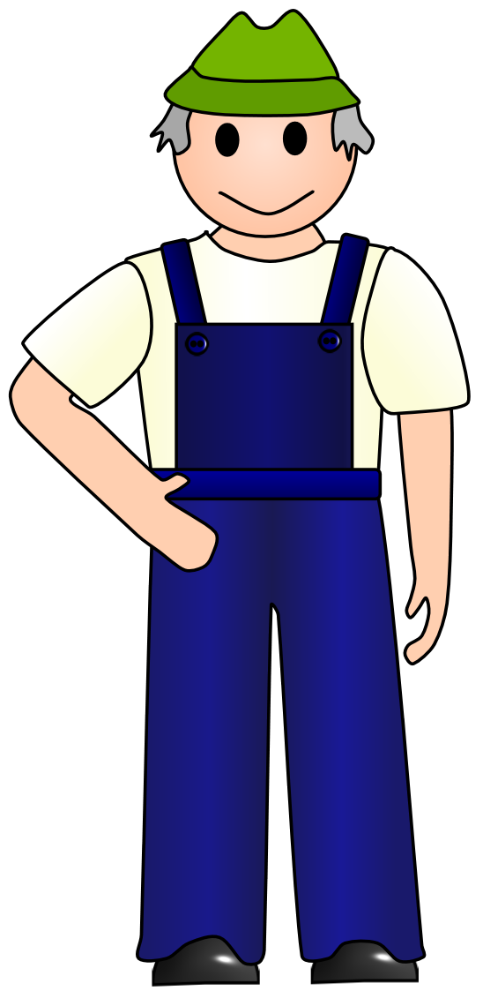

Old Macdonald had a farm...

Slide 2
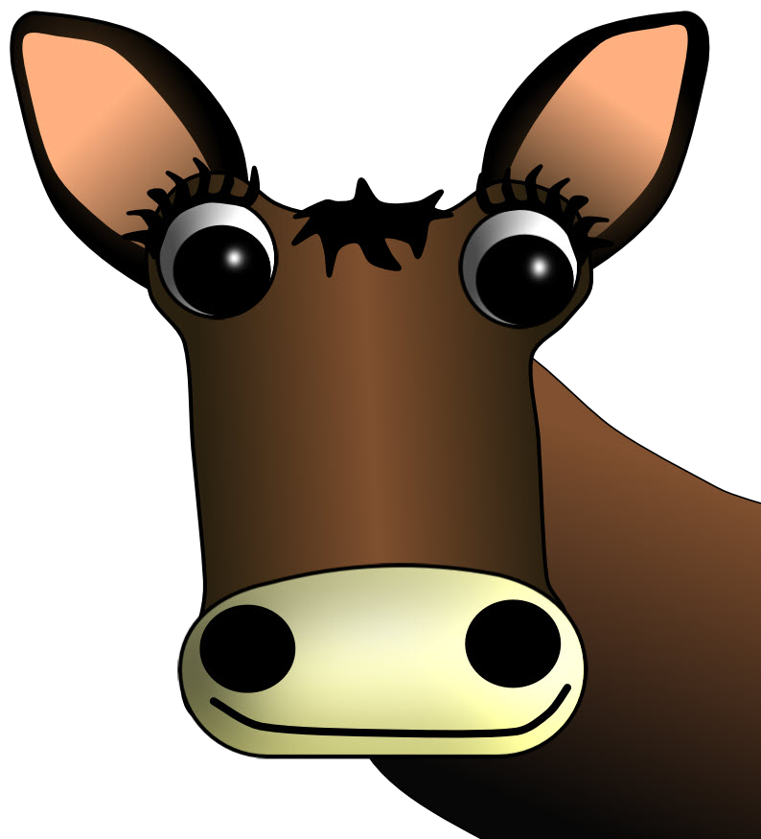
And on that farm he had a
cow

Slide 3


Slide 4

moo moo

Slide 5
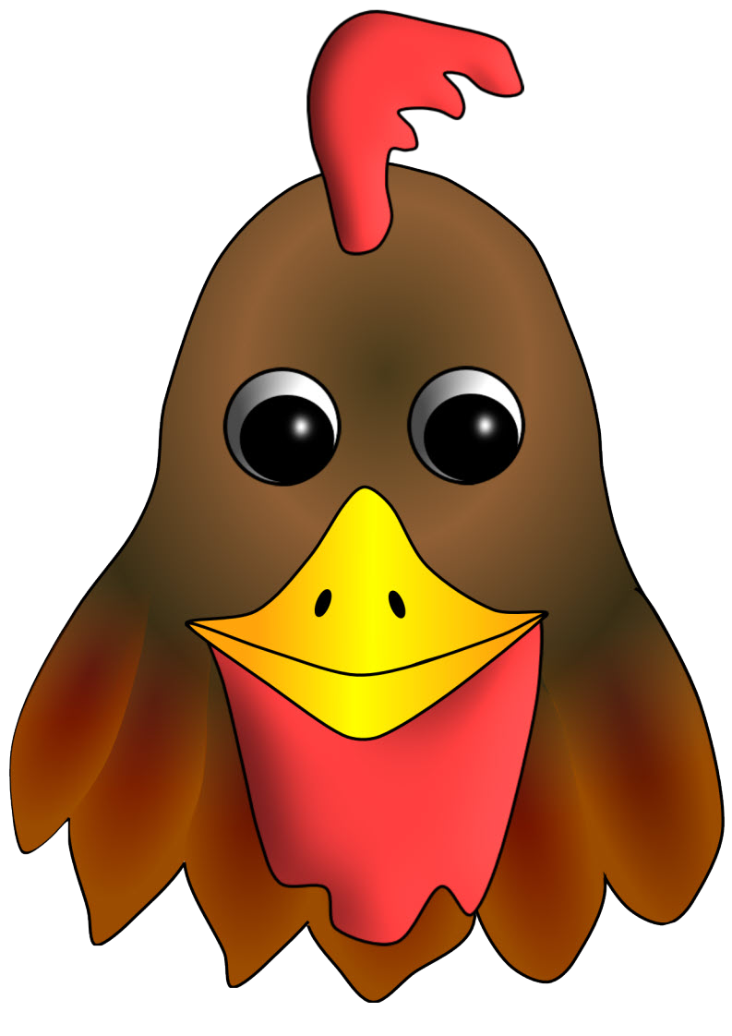
And on that farm he had a
hen

Slide 6
cluck cluck

Slide 7
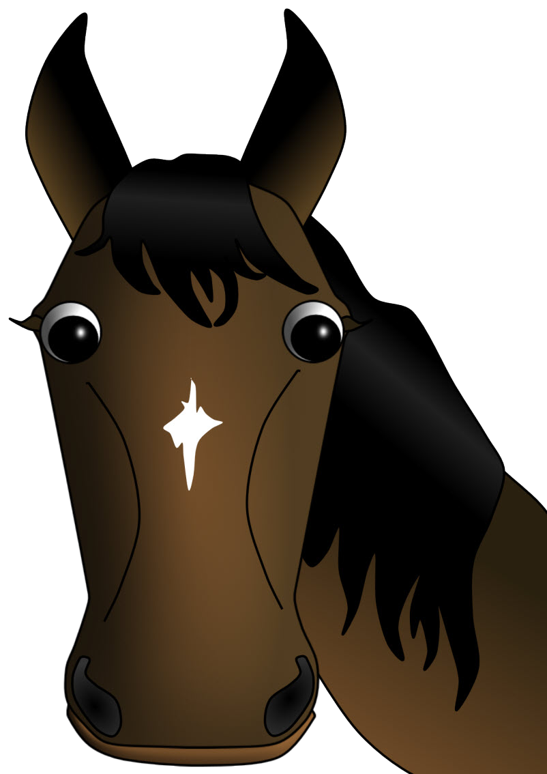
And on that farm he had a
horse

Slide 8

neigh neigh

Slide 9
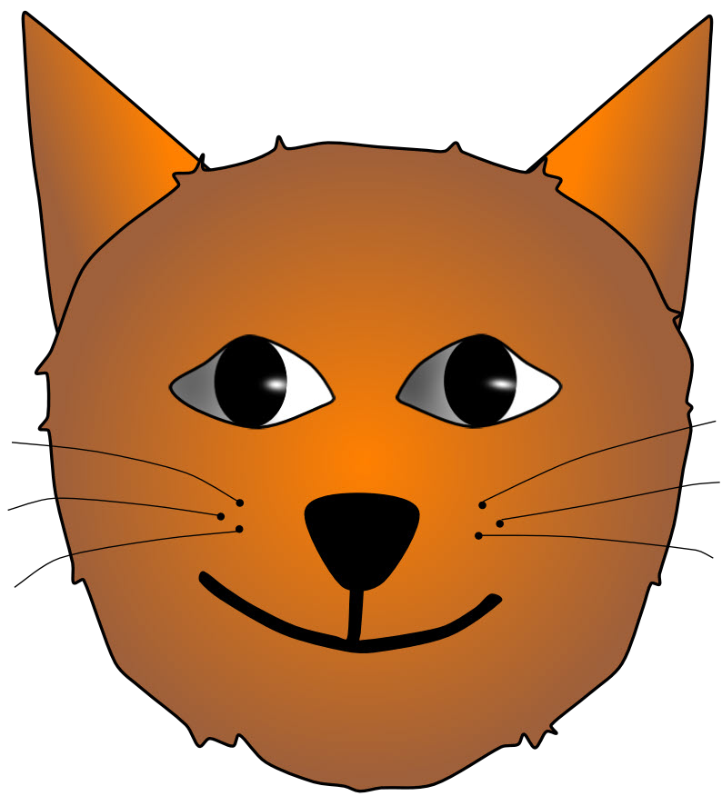
And on that farm he had a
cat

Slide 10
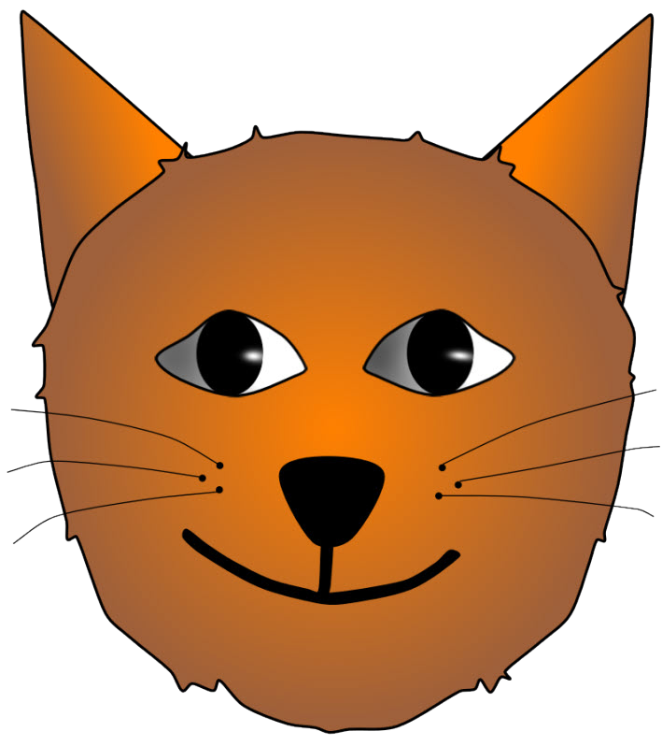
miaow miaow

Slide 11
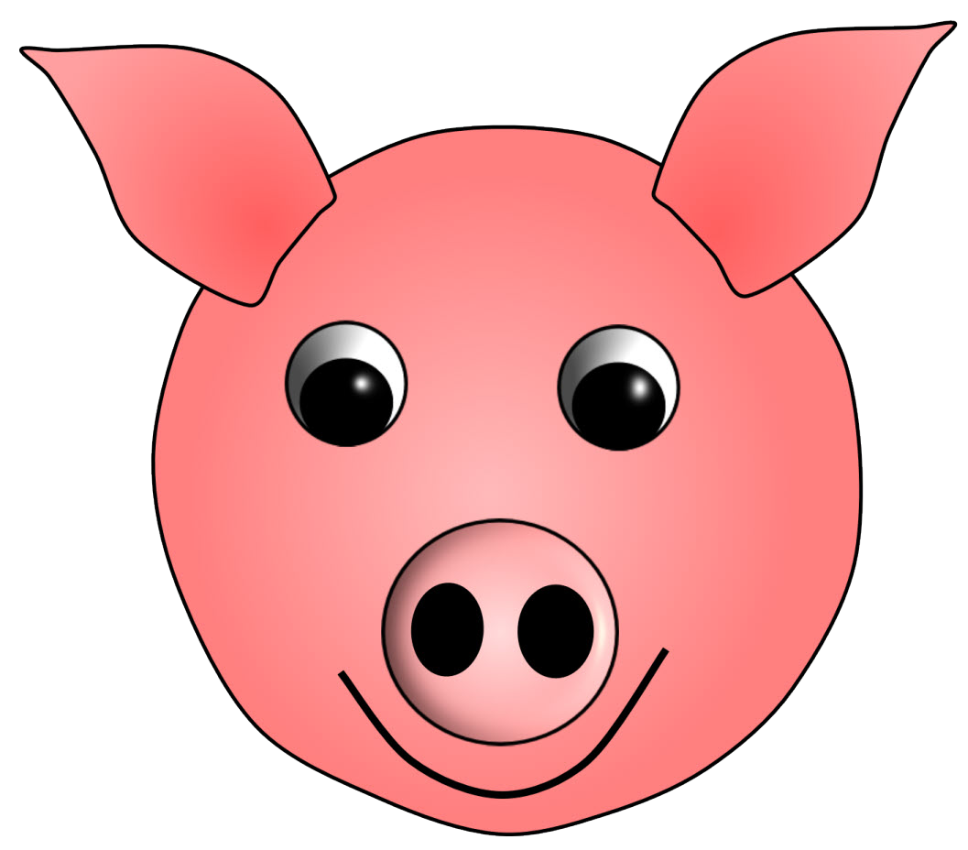
And on that farm he had a
pig

Slide 12
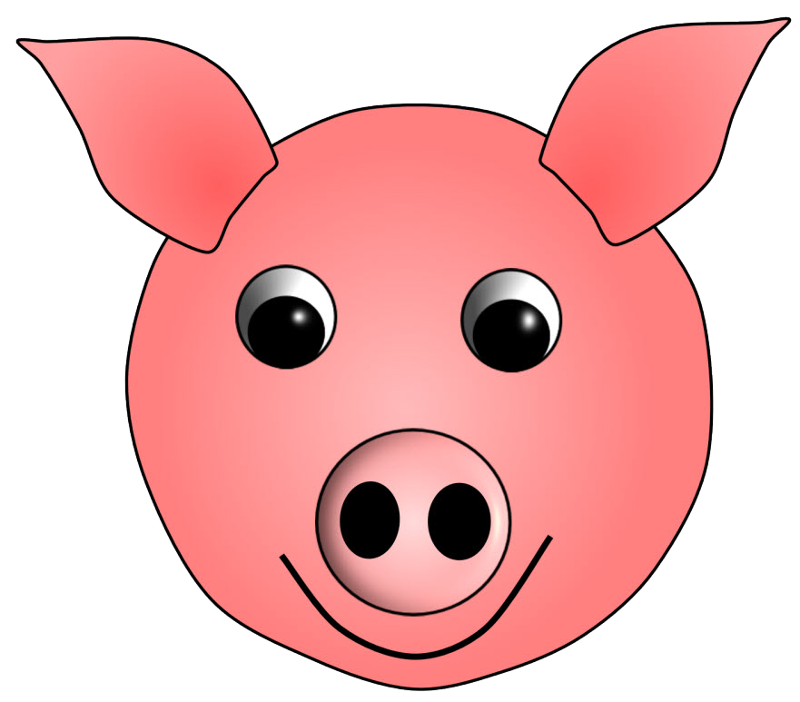
oink oink

Slide 13
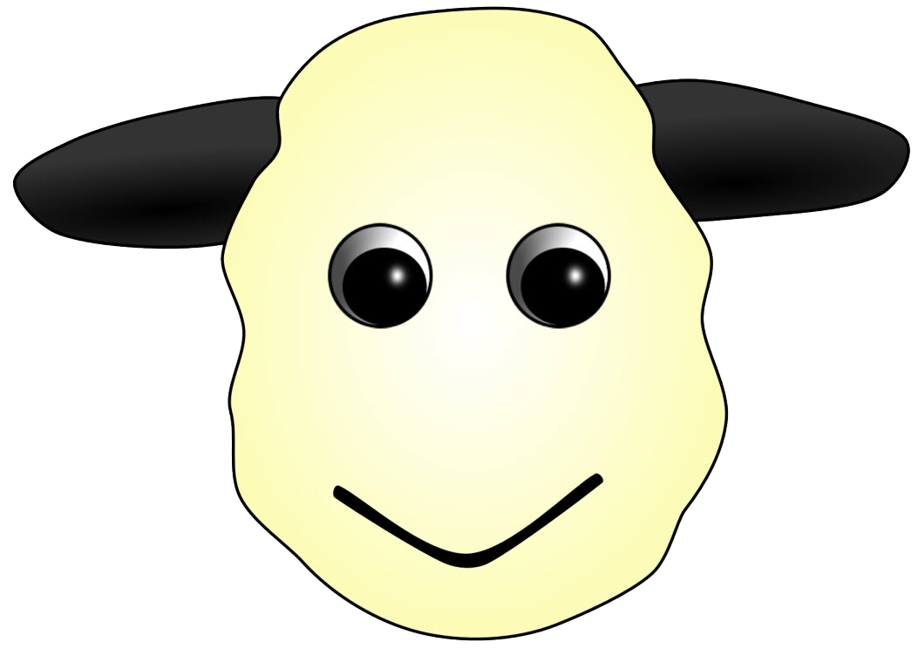
And on that farm he had a
sheep

Slide 14

baa baa

Slide 15
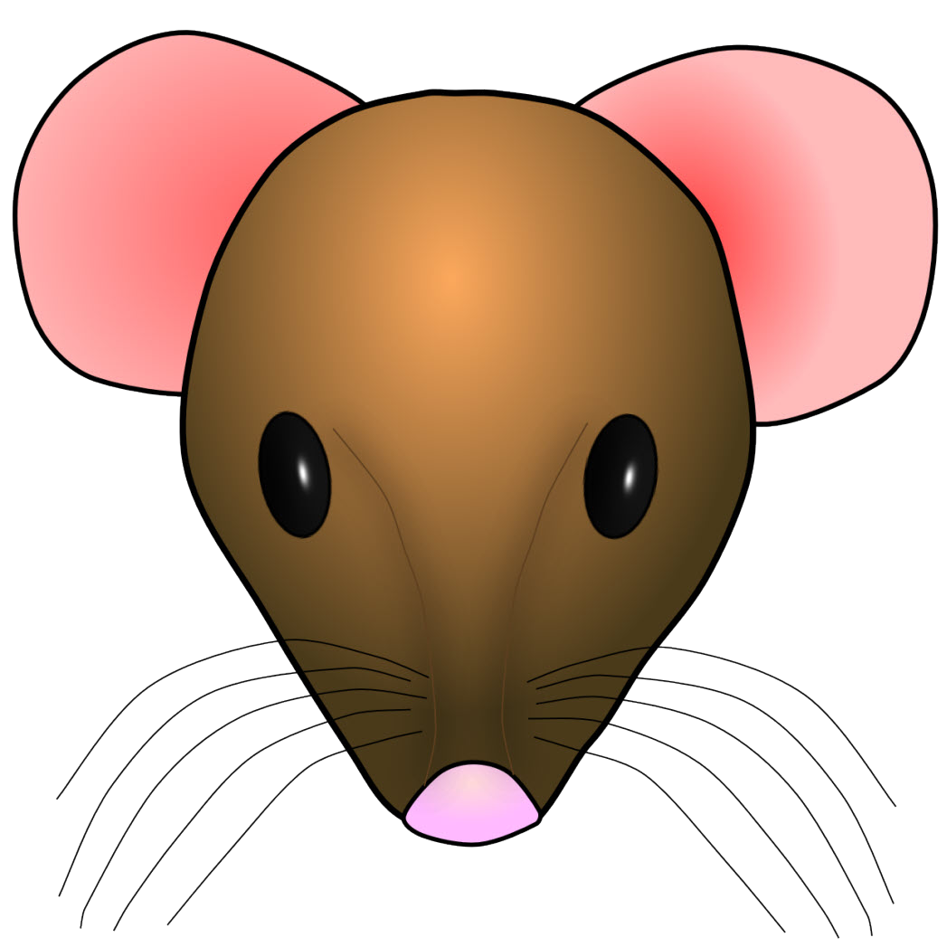
And on that farm he had a
mouse

Slide 16

squeak squeak

Slide 17
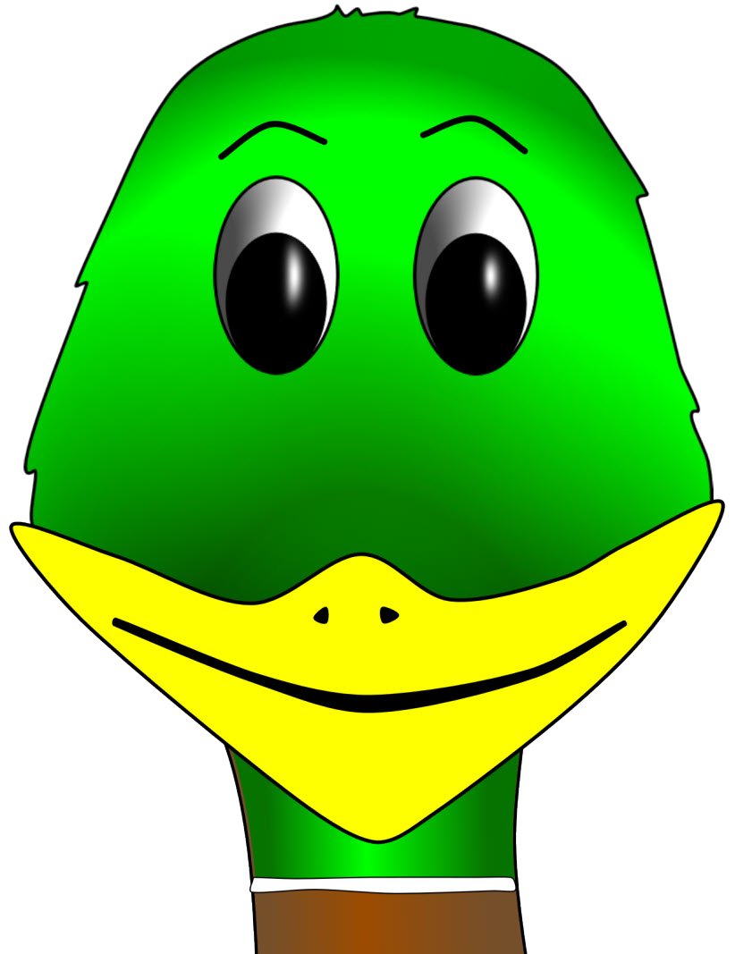
And on that farm he had a
duck

Slide 18

quack quack

Slide 19
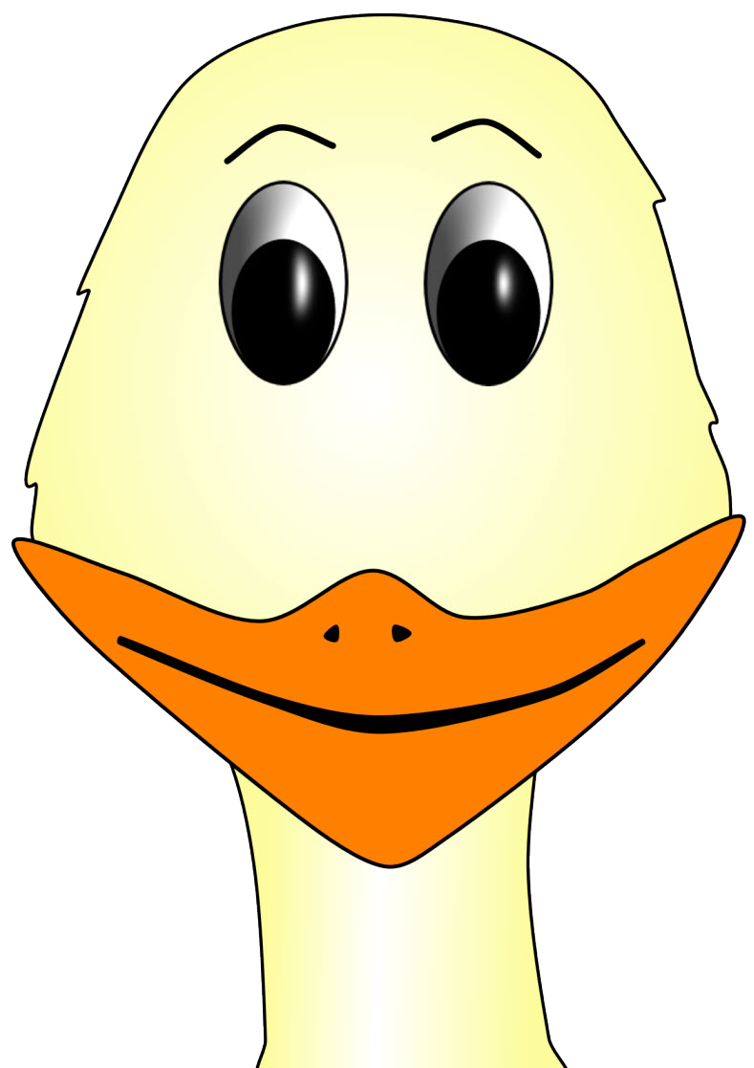
And on that farm he had a
goose

Slide 20

honk honk

