Slide 1
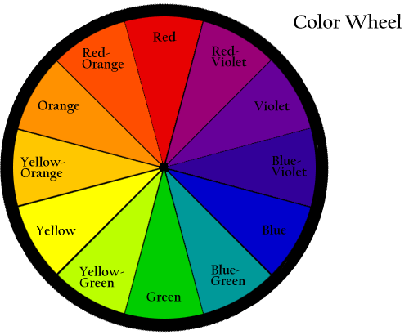
Colours and shapes!

Slide 3
What colour is it?
It's red!

Slide 4
What colour is it?
It's Blue!

Slide 5
What colour is it?
It's Green!

Slide 6
What colour is it?
It's Yellow!

Slide 7
What colour is it?
It's Purple!

Slide 8
What colour is it?
It's Orange!

Slide 9
What colour is it?
It's Pink!

Slide 10
Click on the Pink square!
Next!

Slide 11
Well done!

Slide 12
Click on the Yellow square!
Next!

Slide 13
Well done!

Slide 14
Click on the Blue Square!
Next!

Slide 15
Well done!

Slide 16
Click on the Yellow square!
Next!

Slide 17
Well done!

Slide 18
Click on the Orange square!
Next!

Slide 19
Well done!

Slide 20
Click on the Purple Square!
Next!

Slide 21
Well done!

Slide 22
Click on the Green square!
Next!

Slide 23
Well done!

Slide 24
Click on the Blue Square!
Next!

Slide 25
Well done!

Slide 26
Click on the Red Square!
Next!

Slide 27
Well done!

Slide 28
Click on the Purple Square!
Next!

Slide 29
Well done!

Slide 30
Click on the Pink square!
Next!

Slide 31
Well done!

Slide 32
Click on the Orange square!
Next!

Slide 33
Well done!

Slide 34
Click on the Red Square!
Next!

Slide 35
Well done!

Slide 36
Click on the Yellow square!
Next!

Slide 37
Well done!

Slide 38
Click on the Green square!
Next!

Slide 39
Well done!

Slide 40
Click on the Blue Square!
Next!

Slide 41
Well done!

Slide 42
Click on the Purple Square!
Next!

Slide 43
Well done!

Slide 44
Click on the Yellow square!
Next!

Slide 45
Well done!

Slide 46
Click on the Green square!
Next!

Slide 47
Well done!

Slide 48
Click on the Blue Square!
Next!

Slide 49
Well done!

Slide 50
Click on the Purple Square!
Next!

Slide 51
Well done!

Slide 52
Click on the Pink square!
Next!

Slide 53
Well done!

Slide 54
Click on the Orange square!
Next!

Slide 55
Well done!

Slide 56
Click on the Red Square!
Next!

Slide 57
Well done!

Slide 58
Click on the Pink square!
Next!

Slide 59
Well done!

Slide 60
Click on the Orange square!
Next!

Slide 61
Well done!

Slide 62
Click on the Red Square!
Next!

Slide 63
Well done!

Slide 64
Shapes!

Slide 67
What shape is it?
It’s a square!

Slide 68
What shape is it?
It’s a circle!

Slide 69
What shape is it?
It’s a triangle!

Slide 70
What shape is it?
It’s a heart!

Slide 71
What shape is it?
It’s a star!

Slide 72
What shape is it?
It’s a rectangle!

Slide 73
Click on the star!
Next!

Slide 74
Click on the circle!
Next!

Slide 75
Click on the square!
Next!

Slide 76
Click on the heart!
Next!

Slide 77
Click on the triangle!
Next!

Slide 78
Click on the rectangle!
Next!

Slide 79
Click on the star!
Next!

Slide 80
Click on the circle!
Next!

Slide 81
Click on the square!
Next!

Slide 82
Click on the heart!
Next!

Slide 83
Click on the triangle!
Next!

Slide 84
Click on the rectangle!
Next!

Slide 85
Click on the star!
Next!

Slide 86
Click on the circle!
Next!

Slide 87
Click on the square!
Next!

Slide 88
Click on the star!
Next!

Slide 89
Click on the circle!
Next!

Slide 90
Click on the square!
Next!

Slide 91
Click on the heart!
Next!

Slide 92
Click on the triangle!
Next!

Slide 93
Click on the rectangle!
Next!

Slide 94
Click on the heart!
Next!

Slide 95
Click on the triangle!
Next!

Slide 96
Click on the red rectangle!
Next!

Slide 97
Click on the purple circle!
Next!

Slide 98
Click on the green rectangle!
Next!

Slide 99
Click on the yellow triangle!
Next!

Slide 100
Click on the red circle!
Next!

Slide 101
Click on the yellow triangle!
Next!

Slide 102
Click on the red rectangle!
Next!

Slide 103
Click on the purple circle!
Next!

Slide 104
Click on the green rectangle!
Next!

Slide 105
Click on the red circle!
Next!

Slide 106
Click on the red rectangle!
Next!

Slide 107
Click on the purple circle!
Next!

Slide 108
Click on the green rectangle!
Next!

Slide 109
Click on the red circle!
Next!

Slide 110
Click on the yellow triangle!
Next!

Slide 111
Click on the red circle!
Next!

Slide 112
Click on the yellow triangle!
Next!

Slide 113
Click on the red rectangle!
Next!

Slide 114
Click on the purple circle!
Next!

Slide 115
Click on the green rectangle!
Next!

Slide 116
Click on the red circle!
Next!

Slide 117
Click on the yellow triangle!
Next!

Slide 118
Well done! Play again?

Slide 119
Play the game!
https://wordwall.net/resource/23526175/colour-shapes

Slide 120
Play the game!
https://www.skribbl.io
Words: red square, red triangle, red circle, red rectangle, red heart, red star, purple square, purple triangle, purple circle, purple rectangle, purple heart, purple star, yellow square, yellow triangle, yellow circle, yellow rectangle, yellow heart, yellow star, blue square, blue triangle, blue circle, blue rectangle, blue heart, blue star, pink square, pink triangle, pink circle, pink rectangle, pink heart, pink star, green square, green triangle, green circle, green rectangle, green heart, green star, orange square, orange triangle, orange circle, orange rectangle, orange heart, orange star,

