Slide 1
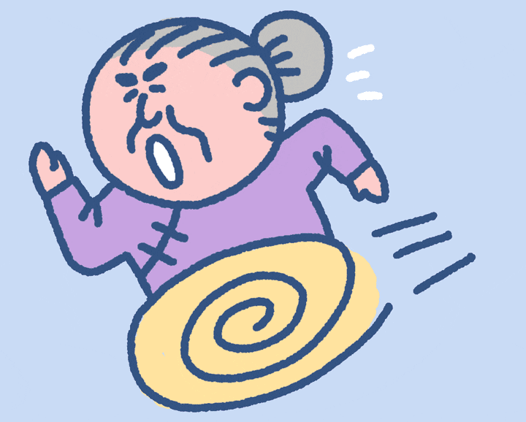
Get grandma home! Start

Slide 2
You got grandma home safely! Now she is happy!

Slide 3
You got grandma home safely! Now she is happy!

Slide 4
You got grandma home safely! Now she is happy!

Slide 5
You got grandma home safely! Now she is happy!

Slide 6
You got grandma home safely! Now she is happy!

Slide 7
You got grandma home safely! Now she is happy!

Slide 8
You got grandma home safely! Now she is happy!

Slide 9
You got grandma home safely! Now she is happy!

Slide 10
You got grandma home safely! Now she is happy!

Slide 11
You got grandma home safely! Now she is happy!

Slide 12
You got grandma home safely! Now she is happy!

Slide 13
You got grandma home safely! Now she is happy!

Slide 14
You got grandma home safely! Now she is happy!

Slide 15
You got grandma home safely! Now she is happy!

Slide 16
You got grandma home safely! Now she is happy!

Slide 17
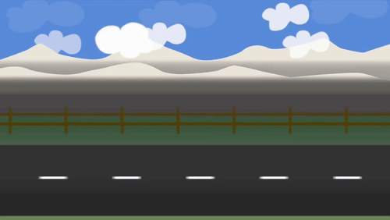
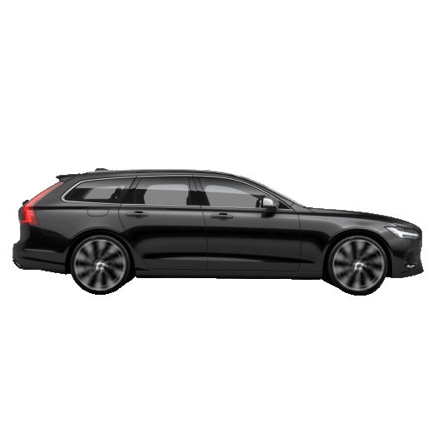
Grandma was driving ___ ____ ___ she could!
as fast as
faster than
fastest as

Slide 18
A butterfly can’t fly ___ ____ ___ a bat.
betterly than
as well as
more better than

Slide 19
A cat is ___ ____ ___ a lion.
not scary than
less scary than
scariest than

Slide 20
I don’t find maths __ _____ __ science.
is interesting than
as interesting as
more interestinger

Slide 21
A donkey _____ ____ ____ a cat.
is large than
is larger than
is as large as

Slide 22
He is not ___ ___ ___ I am.
funny as not
as funny as
isn’t funny as

Slide 23
He is ___ ___ ___ I am.
as tallest as
as tall as
as taller as

Slide 24
A tiger is about __ ___ ___ a lion.
as biggest as
as big as
as bigger than

Slide 25
A butterfly is ___ ___ ____ a rat.
colourfuller
most colourful than
more colourful than

Slide 26
I am ___ ___ _______ person in the room.
the most important
the importantest
the important than

Slide 27
Games are ___ ___ than tests.
more funner
more fun
funner

Slide 28
It was ___ ____ day of my life!
the worst
the bad
the baddest

Slide 29
A rose ___ ___ ___ a horse.
smells nice than
smell gooder than
smells nicer than

Slide 30
The hippo was ____ ____ the monkey.
fatter than
fattest than
fat than

Slide 31
John was _____ me!
as faster than
as fast as
as fast

Slide 32
He was ___ _____ football player on the team.
best
the best
the goodest

Slide 33
She is the _____ student in the class.
smarter than
smart
smartest

Slide 34
A rhino is ______ a horse
stronger
stronger than
strong than

Slide 35
He is _____ than me
big than
biggest
bigger

Slide 36
‘-est’ is used with...
comparatives
superlatives
both

Slide 37
‘-er’ is used with...
comparatives
superlatives
both

Slide 38
You lost. Now grandma is crying.

