Slide 1
In this simple activity, students are shown a word, phrase or sentence that disappears in 2 seconds! They need to remember
what they saw and write them down on a mini-whiteboard or paper. The fastest team to show the correct answer wins the round.

Slide 2
ESL WORD GAME
DISAPPEARING
WORDS!
Catch the words in 2 seconds!
Notes:
Thank you for downloading Disappearing Words game! If you like this game, please leave a rating in my store. Have fun teaching!

Slide 3
There
are
sandwiches

Slide 4
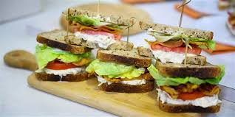
There are sandwiches

Slide 5
There are cakes

Slide 6
There are cakes

Slide 7
There
is
bread.

Slide 8
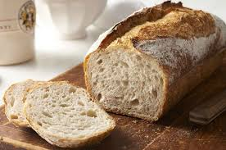
There is bread

Slide 9
is
There
milk

Slide 10
There is milk

Slide 11
There are
bananas

Slide 12
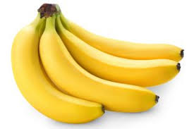
There are bananas

Slide 13
There is
cheese

Slide 14
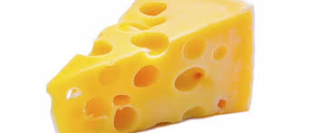
There is cheese

Slide 15
eat
bread
I always

Slide 16
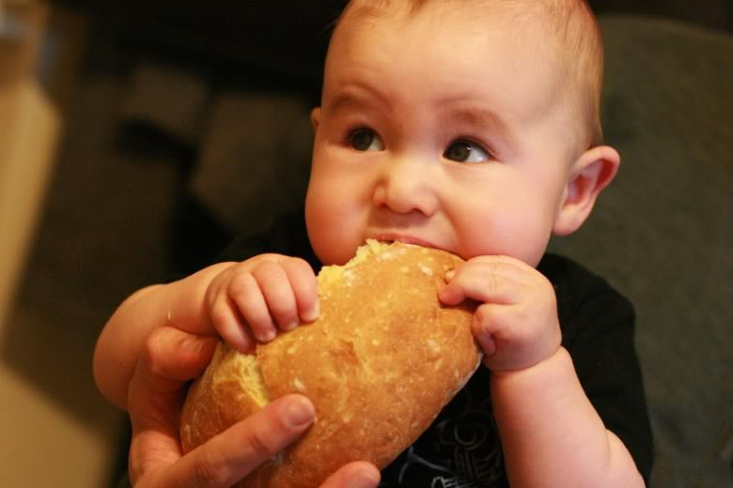
I always eat bread

Slide 17
I never
eat
cakes

Slide 18
I never eat cakes

Slide 19
I sometimes
juice
drink

Slide 20
I sometimes drink juice

Slide 21
I always
eat bananas

Slide 22
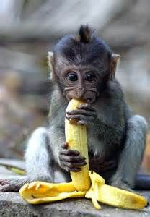
I always eat bananas

