Slide 1

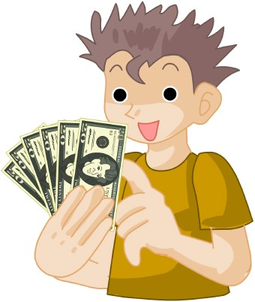
Who wants to win millions?
Hundred Dollar Questions

Slide 2
Writing
Speaking
Spelling
Is/Are/Am
Yes/No
$100
$200
$50
$50
$25
$200
$300
$75
$100
$50
$300
$400
$100
$150
$100
$400
$500
$150
$200
$150

Slide 3
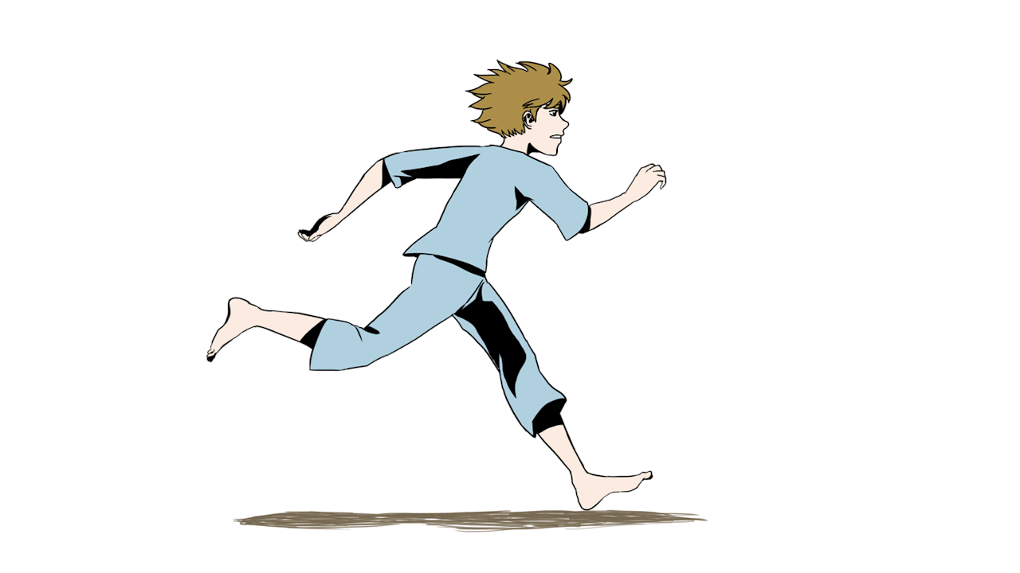
$100
___ is running.

Slide 4
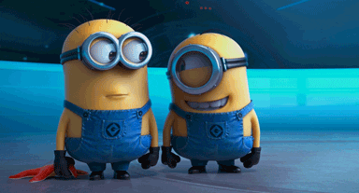
$200
___ are ____ing.

Slide 5

$300
___ ____ _____ing.

Slide 6
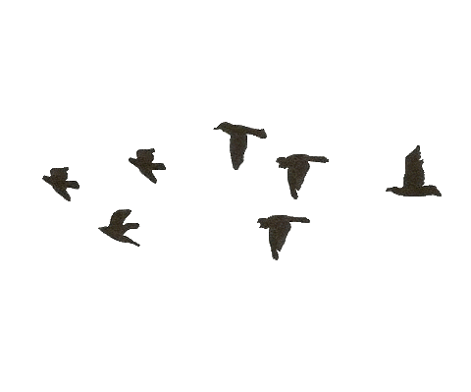
$400
______ ____ _______.

Slide 7
$200
What is he doing?

Slide 8
$300
What are they doing?

Slide 9
$400
What is she doing?

Slide 10
$500
What are they doing?

Slide 11
$50
_ _ _ _ _ _ _ _.

Slide 12
$75
_ _ _ _ _ _ _.

Slide 13

$100
_ _ _ _ _ _ _.

Slide 14
$150
_ _ _ _ _ _ _ _.

Slide 15
$50
He is/are/am running.

Slide 16
$100
They is/are/am laughing.

Slide 17
$150
We is/are/am flying

Slide 18
$200
I is/are/am sleeping.

Slide 19

$25
Is it crying?

Slide 20
$50
Is she sleeping?

Slide 21

$100
Are they running?

Slide 22
$150
Am I running.

