Slide 1
Mystery box
Synonyms

Slide 2
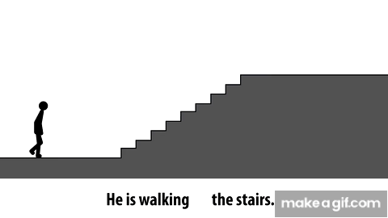
Team A
What is the missing preposition?
Right Wrong!

Slide 3
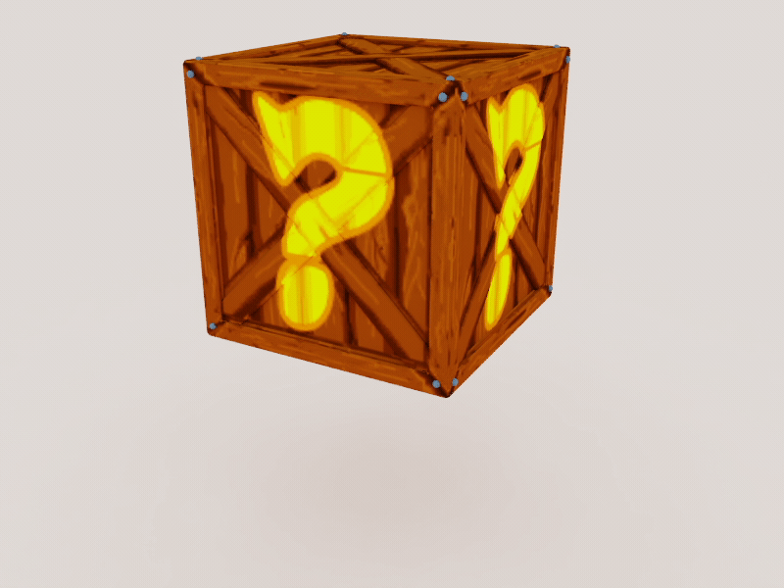
CORRECT!
Keep the box or...
Pass to the other team...

Slide 4
Open the box...
+1000 Points!

Slide 5
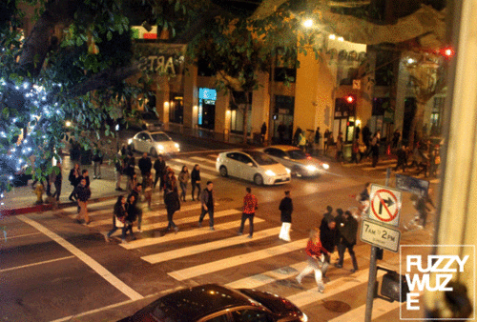
Team B
They are walking ____ the road.
Right Wrong!

Slide 6
CORRECT!
Keep the box or...
Pass to the other team...

Slide 7
Open the box...
+1000 Points!

Slide 8
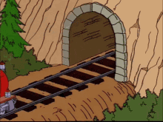
Team A
The train is going ____ the tunnel
Right Wrong!

Slide 9
CORRECT!
Keep the box or...
Pass to the other team...

Slide 10
Open the box...
-200 Points!

Slide 11
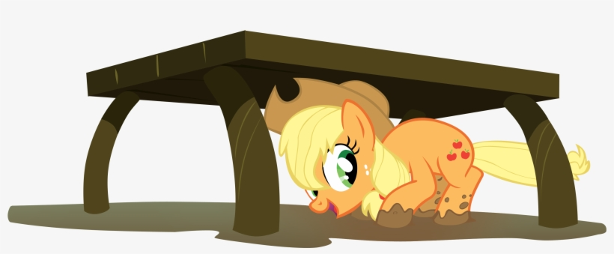
Team B
The pony is hiding ______ the table.
Right Wrong!

Slide 12
CORRECT!
Keep the box or...
Pass to the other team...

Slide 13
Open the box...
-600 Points!

Slide 14

Team A
The plane is flying ______ the city.
Right Wrong!

Slide 15
CORRECT!
Keep the box or...
Pass to the other team...

Slide 16
Open the box...
Double
points!

Slide 17

Team B
The bird is flying ___ the sky.
Right Wrong!

Slide 18
CORRECT!
Keep the box or...
Pass to the other team...

Slide 19
Open the box...
+100
Points

Slide 20

BONUS ROUND!
Both teams!
The ninja is running ______ the ground.
The first team to answer correctly get to open the special box!
Right Wrong

Slide 22
Open the box...
+500
Points

Slide 23

Team A
The rollercoaster is going _____.
Right Wrong!

Slide 24
CORRECT!
Keep the box or...
Pass to the other team...

Slide 25
Open the box...
-300 Points

Slide 26

Team B
The dog is getting _____ the bed.
Right Wrong!

Slide 27
CORRECT!
Keep the box or...
Pass to the other team...

Slide 28
Open the box...
+200
Points

Slide 29
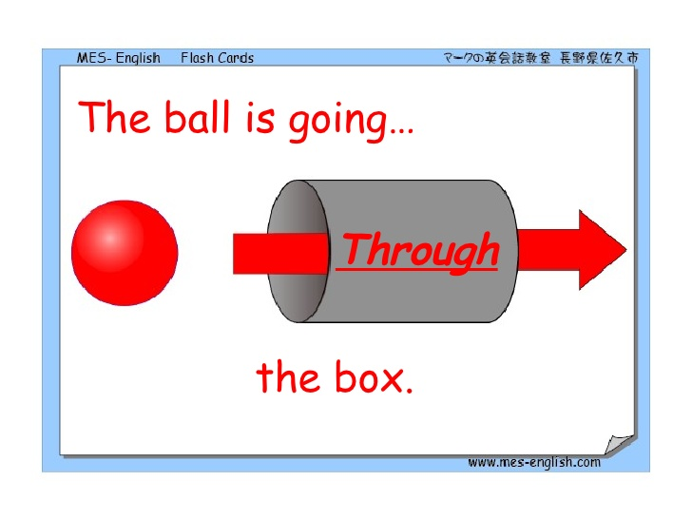
Team A
Give me the past tense for the word:
race
Right Wrong!

Slide 30
CORRECT!
Keep the box or...
Pass to the other team...

Slide 31
Open the box...
Halve
your points!

Slide 32
Team A
What is the missing pronouns?
Right Wrong!

Slide 33
CORRECT!
Keep the box or...
Pass to the other team...

Slide 34
Open the box...
+ 1 Point

Slide 35
CORRECT!
Keep the box or...
Pass to the other team...

Slide 36
Team B
____ are walking across the road.
Right Wrong!

Slide 37
Open the box...
+1300 Points!

Slide 38
CORRECT!
Keep the box or...
Pass to the other team...

Slide 39
Team A
___ is going into/through the tunnel
Right Wrong!

Slide 40
Open the box...
+100 Points!

Slide 41
CORRECT!
Keep the box or...
Pass to the other team...

Slide 42
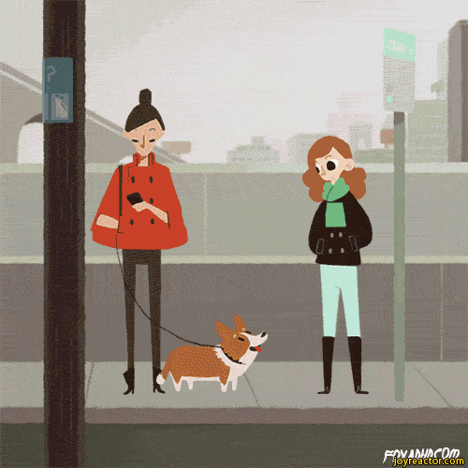
Team A
____ are waiting on the pavement for a bus.
Right Wrong!

Slide 43
Open the box...
-600 Points!

Slide 44
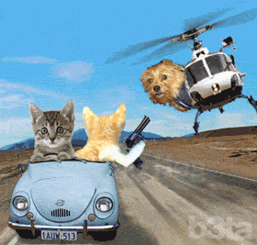
Team B
The helicopter is flying over head!
_____ are driving away!
Right Wrong!

Slide 45
CORRECT!
Keep the box or...
Pass to the other team...

Slide 46
Open the box...
-400 Points!

