Slide 1
In this simple activity, students are shown a word, phrase or sentence that disappears in 2 seconds! They need to remember
what they saw and write them down on a mini-whiteboard or paper. The fastest team to show the correct answer wins the round.

Slide 2
ESL WORD GAME
DISAPPEARING
WORDS!
Catch the words in 2 seconds!
Notes:
Thank you for downloading Disappearing Words game! If you like this game, please leave a rating in my store. Have fun teaching!

Slide 3
is
running
he

Slide 4
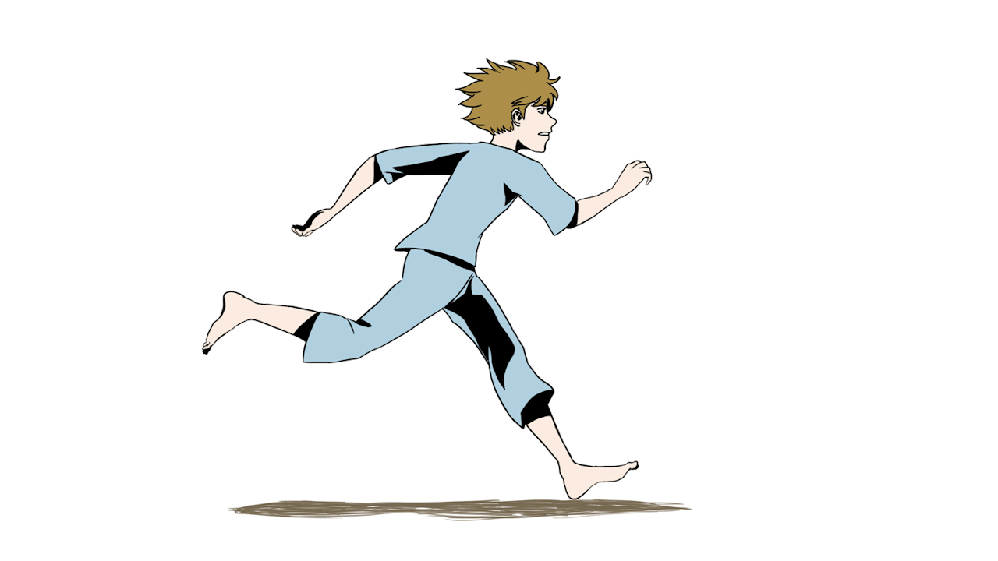
He is running

Slide 5
they are dancing

Slide 6
They are dancing

Slide 7
are
jumping
We

Slide 8
We are jumping

Slide 9
she
is
sleeping

Slide 10
She is sleeping.

Slide 11
are
flying
They

Slide 12
They are flying.

Slide 13
It is
eating.

Slide 14
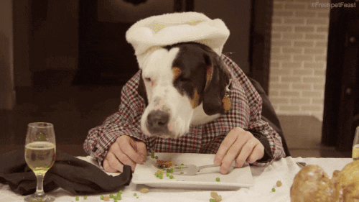
It is eating.

