Slide 1
Stop the zombies! Prepositions
Start

Slide 3
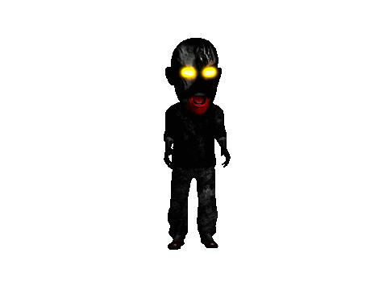
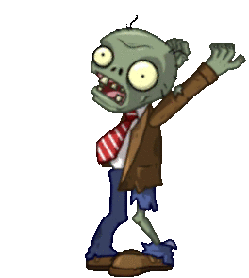
Shoot the zombie dancing on the chair!
Next!

Slide 4
Shoot the zombie under the chair!
Next!

Slide 5
Shoot the zombie running across the room!
Next!

Slide 6
Shoot the zombie in the coffin!
Next!

Slide 7
Shoot the zombie spinning around in the middle of the room!
Next!

Slide 8
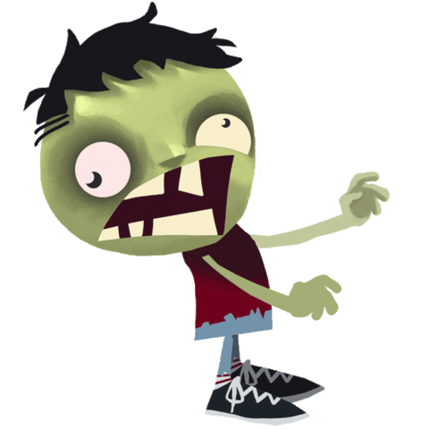
Shoot the zombie dancing on the sofa!
Next!

Slide 9
Shoot the zombie hanging upside down from the cieling!
Next!

Slide 10
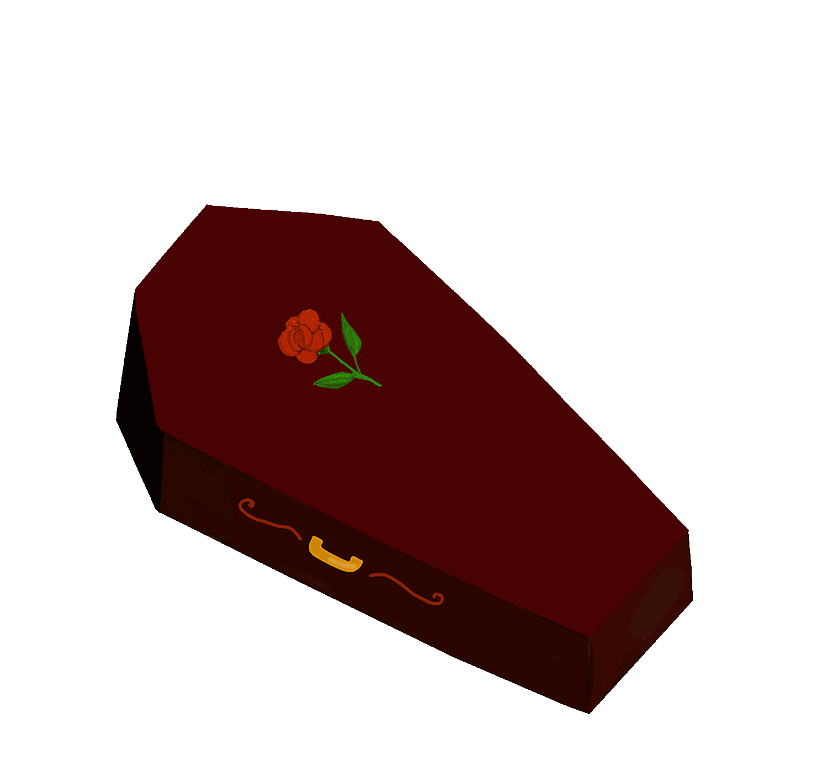
Shoot the zombie dancing in front of the fireplace!
Next!

Slide 11
Shoot the zombie dancing on the chair!
Next!

Slide 12
Shoot the zombie spinning around on the sofa!
Next!

Slide 13
Shoot the zombie dancing next to the plant!
Next!

Slide 14
Shoot the zombie dancing on the mantelpiece above the fire!
Next!

Slide 15
Shoot the zombie dancing next to the television!
Next!

Slide 16
Shoot the zombie dancing to the left of the fireplace!
Next!

Slide 17
Shoot the zombie in the coffin!
Next!

Slide 18
Shoot the zombie dancing to the right of the fireplace!
Next!

Slide 19
Shoot the zombie under the chair!
Next!

Slide 20
Shoot the zombie spinning around on the sofa!
Next!

Slide 21
Shoot the zombie running across the room!
Next!

Slide 22
Shoot the zombie spinning around on the chair!
Next!

Slide 23
Shoot the zombie dancing on the chair!
Next!

Slide 24
Shoot the zombie in the coffin!
Next!

