Slide 1
Hidden Picture What are they doing?

Slide 2
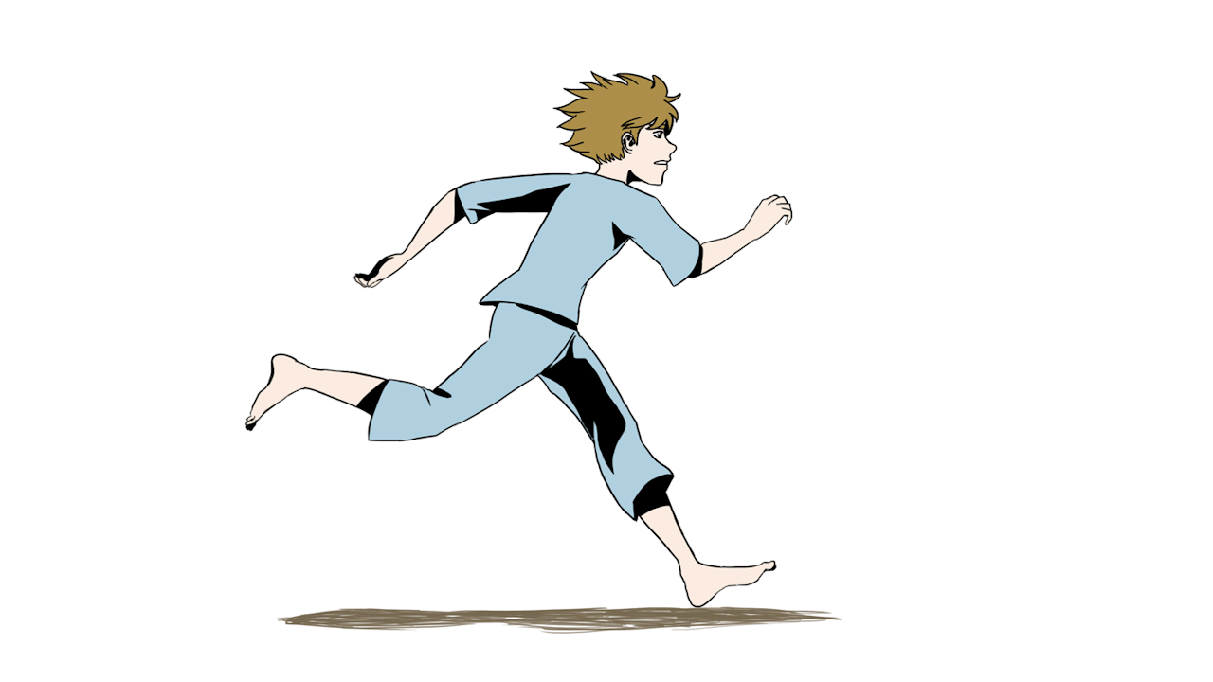
He is running
Remove

Slide 3
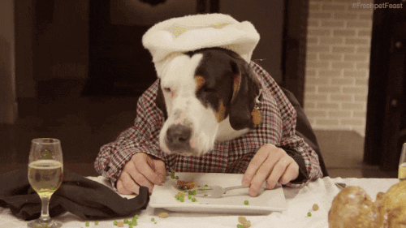
It is eating.
Remove

Slide 4
They are
jumping
Remove

Slide 5
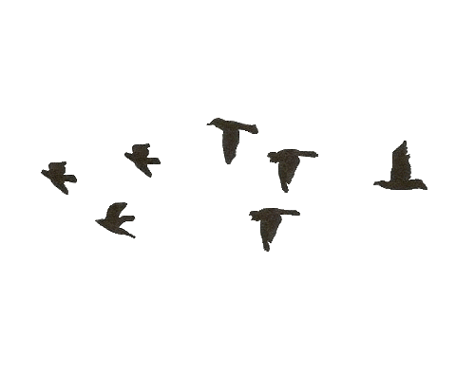
They are flying
Remove

Slide 6
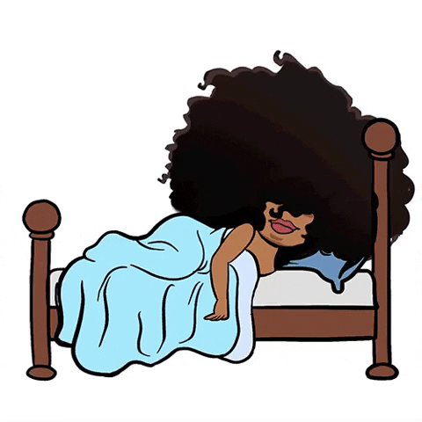
She is sleeping
Remove

Slide 7
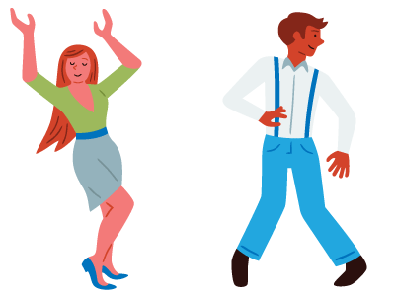
They are
dancing
Remove

Slide 8
It is eating.
Remove

Slide 9
She is sleeping
Remove

Slide 10
They are
jumping
Remove

Slide 11
They are
dancing
Remove

Slide 12
He is running
Remove

Slide 13
They are flying
Remove

Slide 14
You win!
Well done!

