Slide 1
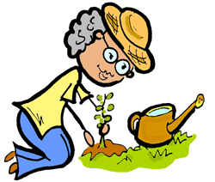
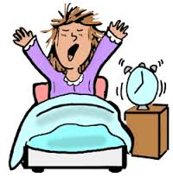
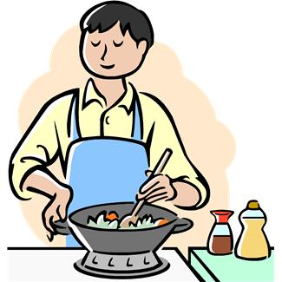
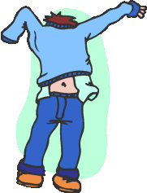
Action verbs
1

Slide 2
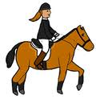
Action verbs
Ride a bike
Ride a horse
cycle
2

Slide 3
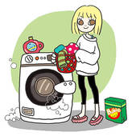
Action verbs
Do the washing
wash up
Clean dishes
3

Slide 4
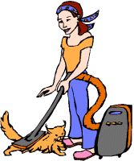
Action verbs
dust
hoover
vacuum
4

Slide 5
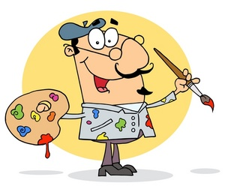
Action verbs
paint
read
speak
5

Slide 6
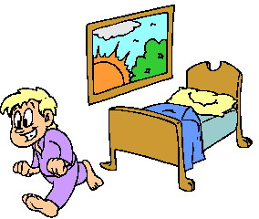
Action verbs
Do gym
Get up
Wake up
6

Slide 7
Action verbs
run
watch
sing
7

Slide 8
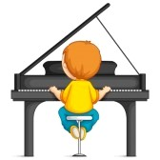
Action verbs
Play piano
Play the piano
Piano play
8

Slide 9
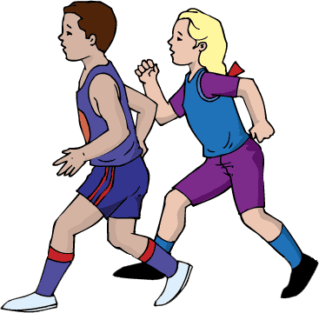
Action verbs
hike
walk
run/jog
9

Slide 10
Action verbs
Make the bed
Make the sleep
Do the bed
10

Slide 11
Action verbs
cook
cooker
oven
11

Slide 12
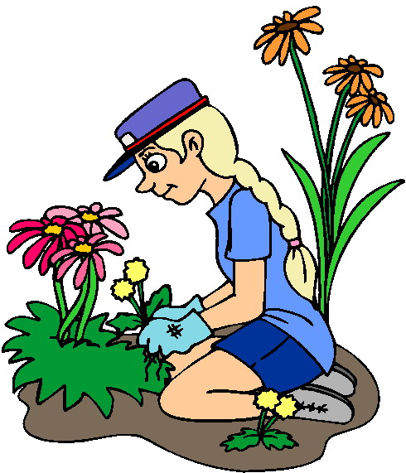
Action verbs
write
garden
wash
12

Slide 13
Action verbs
Wake up
Do stretching
Get up
13

Slide 14
Action verbs
Have dinner
Have
breakfast
Have a snack
14

Slide 15
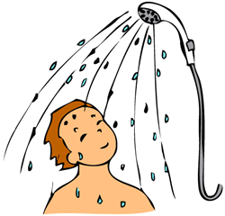
Action verbs
Have a
shower
Have a
bath
swim
15

Slide 16
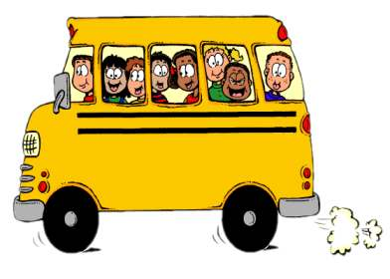
Action verbs
Drive a car
Take the
bus
Run a coach
16

Slide 17
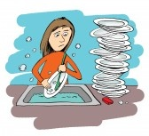
Action verbs
Do the
washing
Wash up
Do the
Washing up
17

Slide 18
Action verbs
Clean my
teeth
Brush my
tooth
Wash my
tooth
18

Slide 19
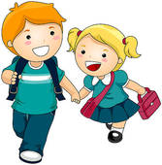
Action verbs
Play sports
go on
holidays
Go to
school
19

Slide 20
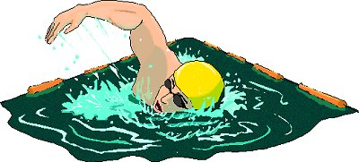
Action verbs
dive
crawl
swim
20

Slide 21
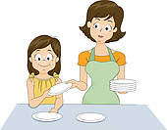
Action verbs
Set the
table
Lay the
table
Clear the
table
21

Slide 22
Action verbs
Work a car
Drive a
car
Run a car
22

Slide 23
Action verbs
Wash the
car
clean the
auto
Wash down
23

Slide 24
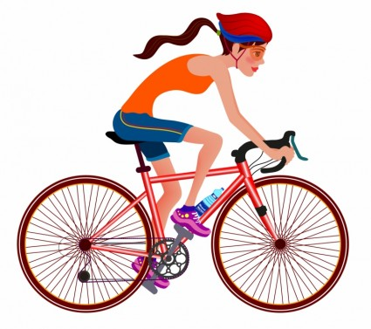
Action verbs
cycle
ride a bike
bike
24

Slide 25
Action verbs
Do diy jobs
Play
work
25

Slide 26
Action verbs
Watch tv
Play /work
on the
computer
Write a
report
26

Slide 27
Action verbs
listen
look
smell
27

Slide 28
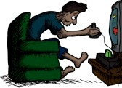
Action verbs
play
video games
sleep
work
28

Slide 29
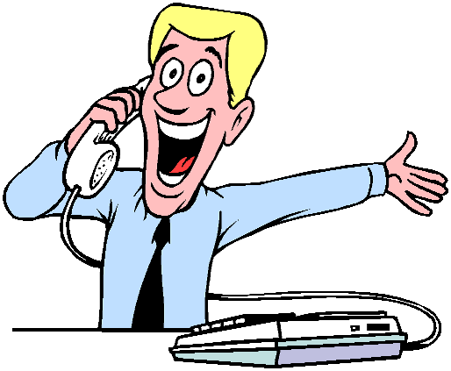
Action verbs
phone
watch
think
29

Slide 30
Action verbs
sew
knit
make
30

Slide 31
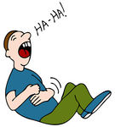
Action verbs
cry
laugh
shout
31

Slide 32
Action verbs
write
read
learn
32

Slide 33
Action verbs
dream
listen
speak
33

Slide 34
Action verbs
want
Look for
refuse
34

Slide 35
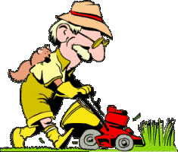
Action verbs
cut the
grass
Mow the
lawn
Sweep grass
35

Slide 36
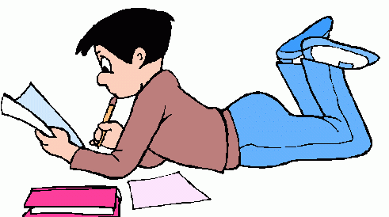
Action verbs
do
homework
Do
housework
Do
write
36

Slide 37
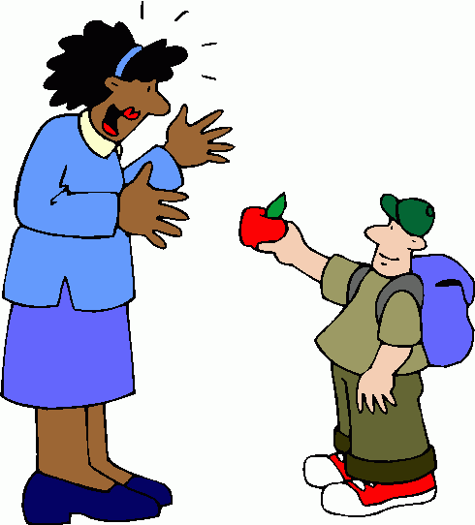
Action verbs
take
give
steal
37

Slide 38
Action verbs
make
cut
do
38

Slide 39
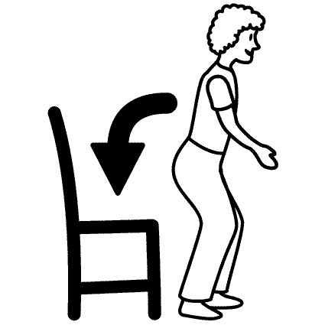
Action verbs
stand up
Lie down
Sit down
39

Slide 40
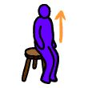
Action verbs
wake up
Stand up
Get up
40

Slide 41
Action verbs
have a rest
wait
Work in
class
41

Slide 42
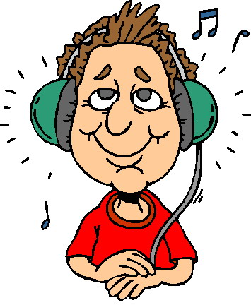
Action verbs
play
music
Listen
To music
sing
42

Slide 43
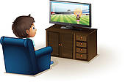
Action verbs
work
Watch tv
Watch pc
43

Slide 44
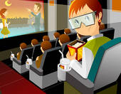
Action verbs
go to
school
Go to the
cinema
Go to the
pool
44

Slide 45
Action verbs
cry
smile
laugh
45

Slide 46
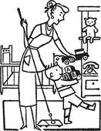
Action verbs
vacuum
Tidy the
house
Leave a
mess
46

Slide 47
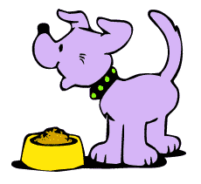
Action verbs
Feed the
Pet
Walk the
dog
Leave the
pet
47

Slide 48
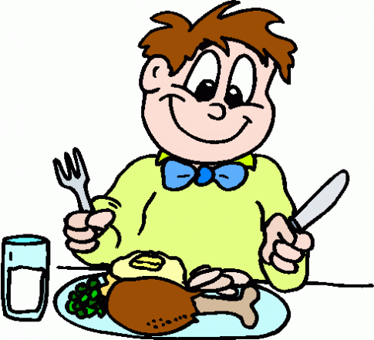
Action verbs
eat
cook
walk
48

Slide 49
Action verbs
slide
drink
throw
49

Slide 50
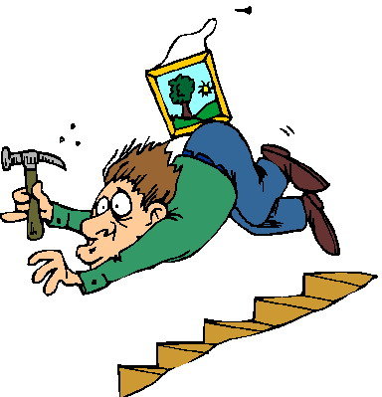
Action verbs
smoke
Go down
fall
50

Slide 51
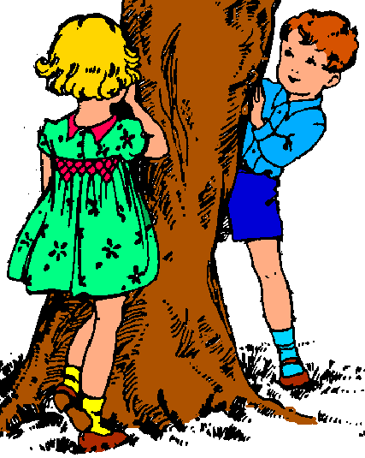
Action verbs
run
seek
hide
51

Slide 52
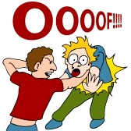
Action verbs
chat
sympathize
fight
52

Slide 53
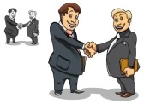
Action verbs
observe
meet
leave
53

Slide 54
Action verbs
take
break
let
54

Slide 55
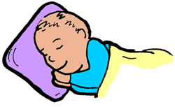
Action verbs
sleep
dream
work
55

