Slide 1
GAME ON ADVERBS OF MANNER

Slide 2
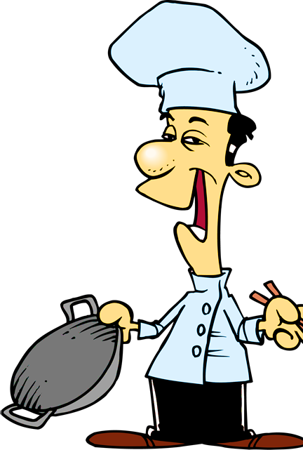
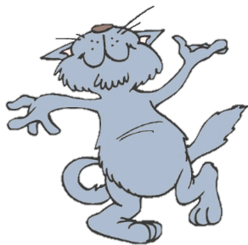
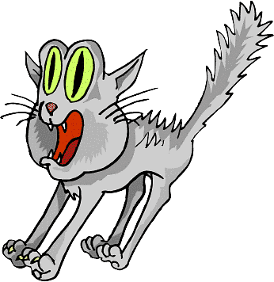
He skipped ____________
down the road to school.
You got it!
NEXT
happily
happy

Slide 3
She sings beautifully.
She is a _________ singer.
You got it!
NEXT
good
well

Slide 4
They planned their holidays in Spain very __________ .
You got it!
NEXT
carefully
careful

Slide 5
My sister is a ________
girl. She is friendly with everyone.
You got it!
NEXT
nice
nicely

Slide 6
I don’t want to go with him.
He drives too ________ .
You got it!
NEXT
fast
well

Slide 7
They could see the movie because they finished their work very ________ .
You got it!
NEXT
quickly
quick

Slide 8
They are fantastic dancers.
They dance really _______ .
You got it!
NEXT
well
good

Slide 9
Please, turn the radio down. It’s too ________ .
You got it!
NEXT
loud
loudly

Slide 10
This bus is too _______ .
We will be late for school.
You got it!
NEXT
slow
slowly

Slide 11
This dog is ________.
He can’t stand a hungry cat.
You got it!
NEXT
angry
angrily

Slide 12
I can’t hear her.
She speaks too ________ .
You got it!
NEXT
quietly
quiet

Slide 13
This street is too noisy.
I’m getting _________ .
You got it!
EXIT
nervous
nervously

