Slide 1
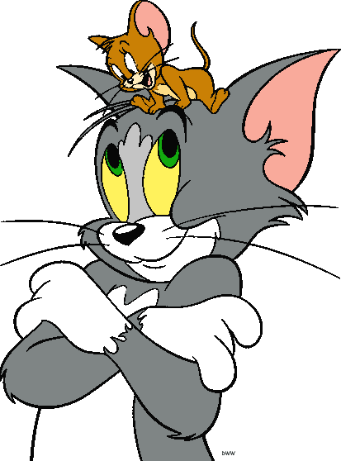
Comparatives

Slide 2
Make up sentences
my house, His house, smaller, than, is.
is, his garden, bigger, Ann’s garden, than.
flowers, the, Her, beautiful, most, are.
His house is smaller than my house.
Ann’s garden is bigger than his garden.
Her flowers are the most beautiful.

Slide 3
Make up sentences
the, sea, is, The, ocean, larger, than.
best, pupil, the, is, He.
the, February, shortest, is, month.
The ocean is larger than the sea.
He is the best pupil.
February is the shortest month.

Slide 4
What do you think? Answer the questions.
Who is smaller?
Jerry is smaller than Tom.

Slide 5
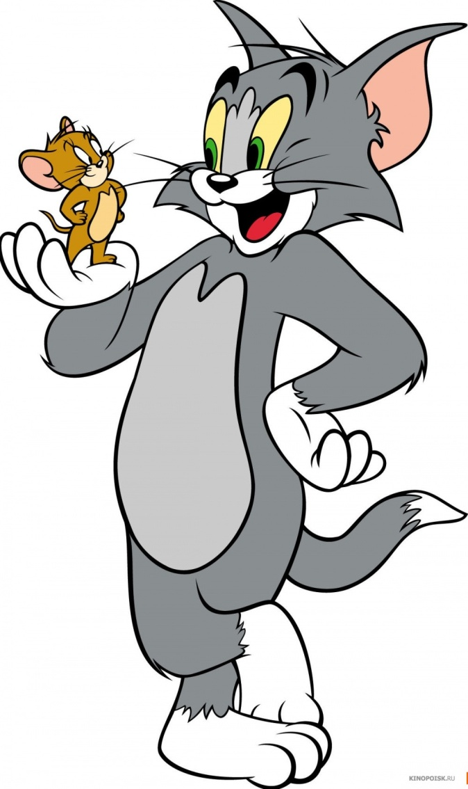
What do you think? Answer the questions.
Who is taller?
Tom is taller than Jerry.

Slide 6
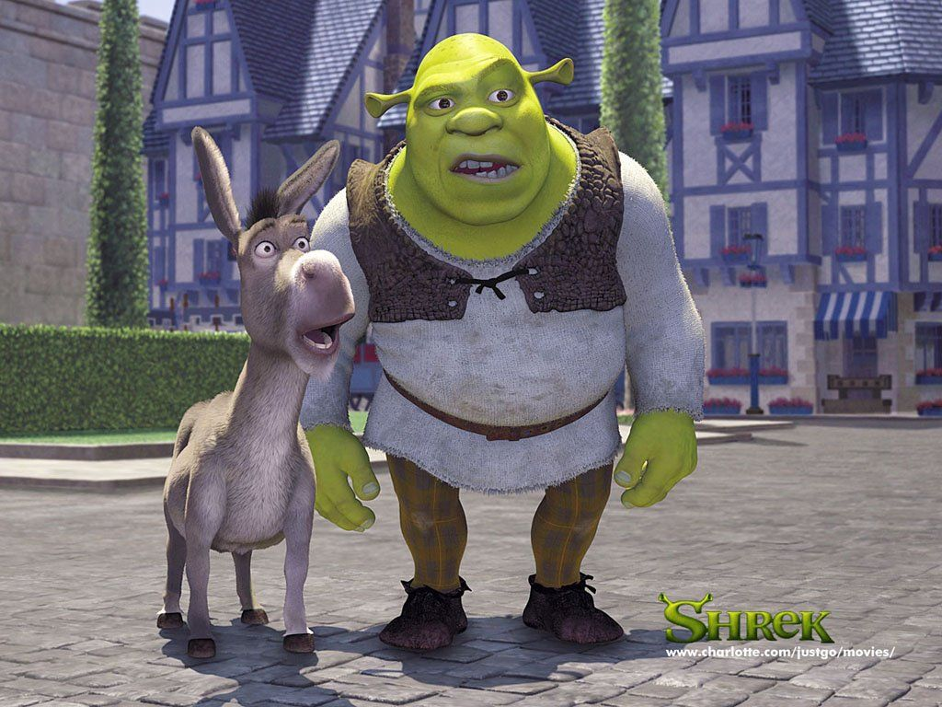
What do you think? Answer the questions.
Who is bigger?
Shrek is bigger than Donkey.

Slide 7
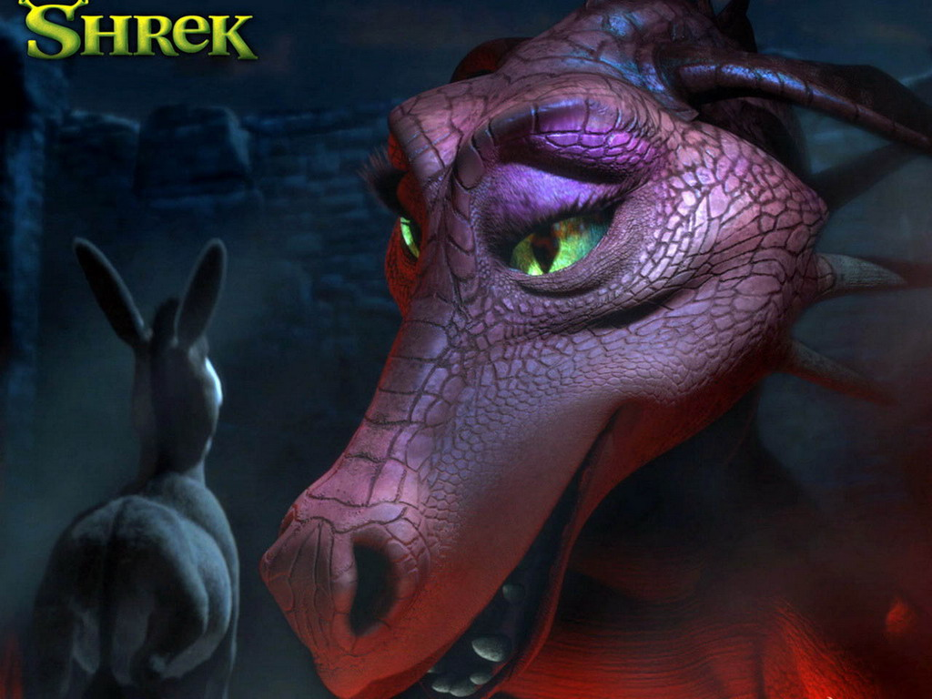
What do you think? Answer the questions.
Who is more beautiful?
Dragon is more beautiful than Donkey.

Slide 8
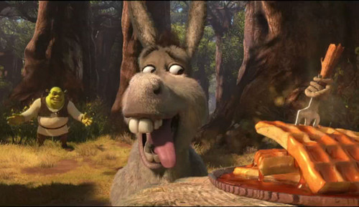
What do you think? Answer the questions.
Who is hungrier?
Donkey is hungrier than Shrek.

Slide 9
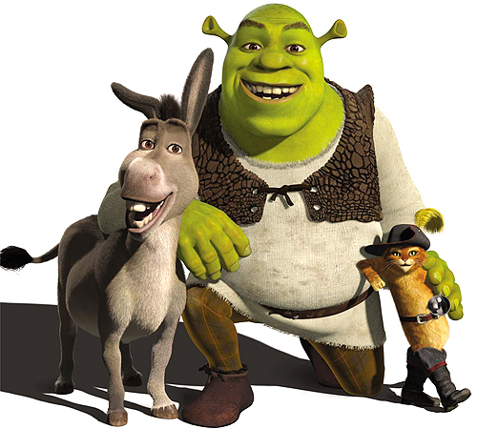
What do you think? Answer the questions.
Who is stronger?
Shrek is stronger than Donkey and Cat.

Slide 10
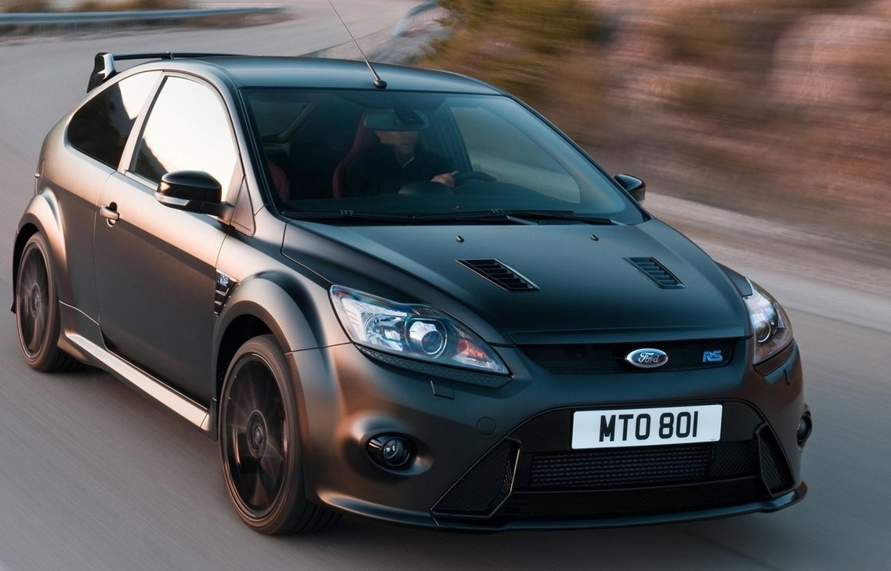
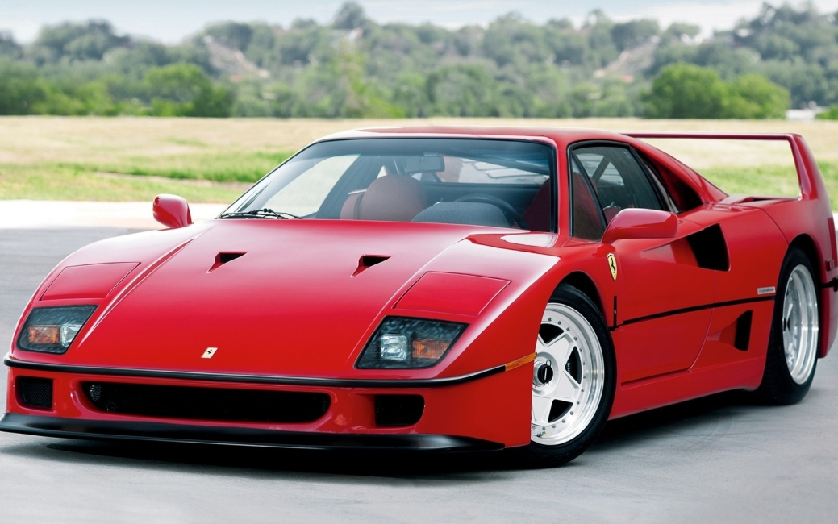
What do you think? Answer the questions.
Which car brand is more expensive?
Audi is more expensive than Ford Focus.

