Slide 1
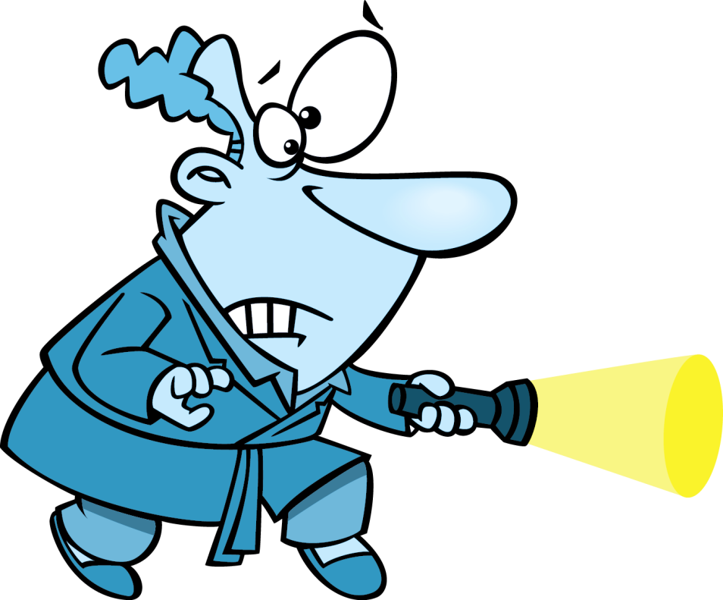
GUESS
AND
ACT

Slide 2
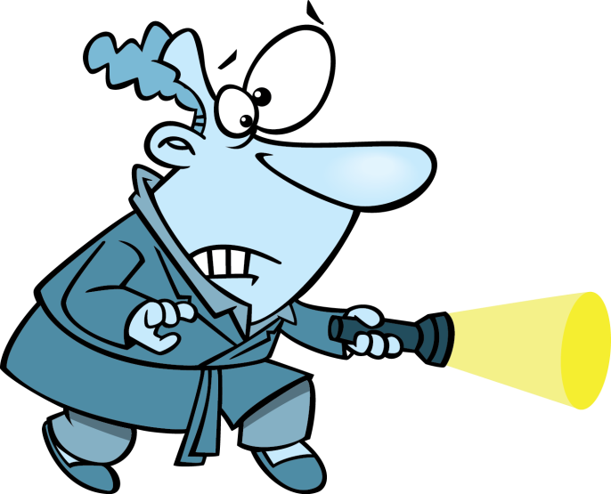
Click on the man with a torch and guess the hidden verb
1/10
CHECK

Slide 3
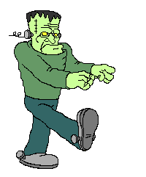
1/10
WALK
Walk like Frankenstein around the classroom
CHECK

Slide 4
Click on the man with a torch and guess the hidden verb
2/10
CHECK

Slide 5
2/10
OPEN
Open the door of the classroom
CHECK

Slide 6
Click on the man with a torch and guess the hidden verb
3/10
CHECK

Slide 7
3/10
CLOSE
Close the door of the classroom
CHECK

Slide 8
Click on the man with a torch and guess the hidden verb
4/10
CHECK

Slide 9
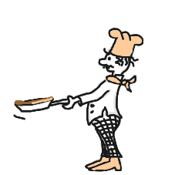
4/10
COOK
Act like cooking a pancake
CHECK

Slide 10
Click on the man with a torch and guess the hidden verb
5/10
CHECK

Slide 11
5/10
SMILE
Smile to your classmates
CHECK

Slide 12
Click on the man with a torch and guess the hidden verb
6/10
CHECK

Slide 13
6/10
DRINK
Mime the action
CHECK

Slide 14
Click on the man with a torch and guess the hidden verb
7/10
CHECK

Slide 15
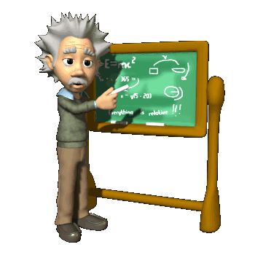
7/10
WRITE
Write your name on the blackboard
CHECK

Slide 16
Click on the man with a torch and guess the hidden verb
8/10
CHECK

Slide 17
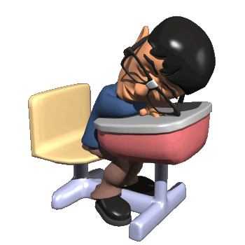
8/10
SLEEP
Mime the action
CHECK

Slide 18
Click on the man with a torch and guess the hidden verb
9/10
CHECK

Slide 19
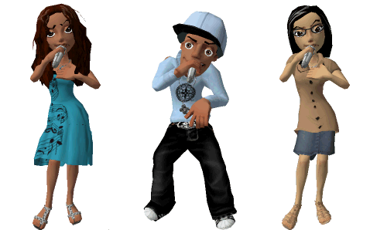
9/10
SING
Sing a song in English
CHECK

Slide 20
Click on the man with a torch and guess the hidden verb
10/10
CHECK

Slide 21
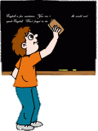
10/10
CLEAN
Clean the blackboard
EXIT
CHECK

