Slide 1
PREPOSITIONS OF MOVEMENT
FILL IN THE GAPS

Slide 2
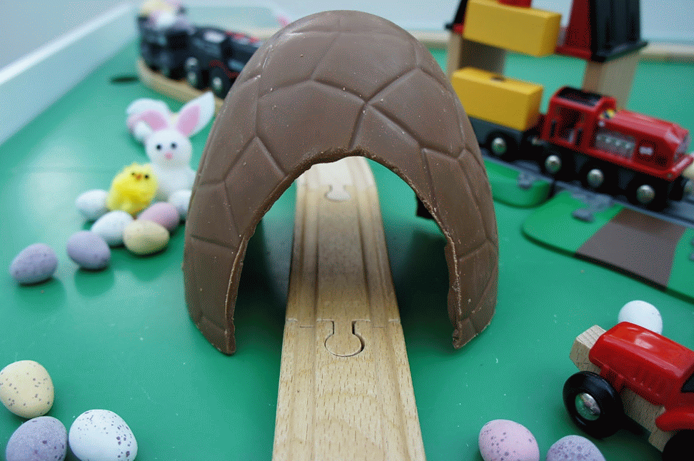
THE TRAIN IS GOING … THE TUNNEL
THROUGH

Slide 3
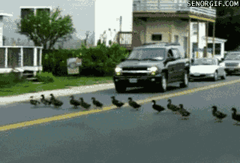
THE DUCKS RAN … THE ROAD
ACROSS

Slide 4
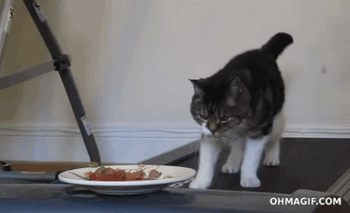
THE CAT IS GOING … THE FOOD
TOWARDS

Slide 5
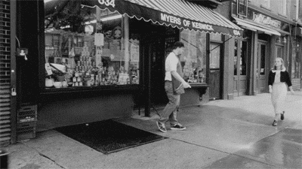
THE GIRL WENT … THE GUY
PAST

Slide 6
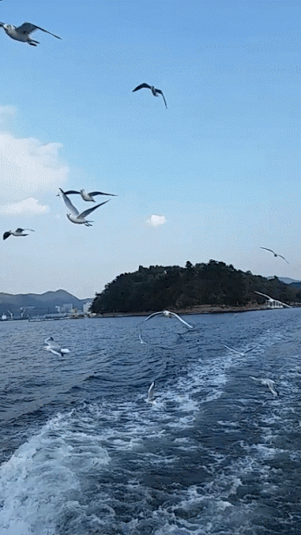
THE BIRDS ARE FLYING … THE RIVER
OVER

Slide 7
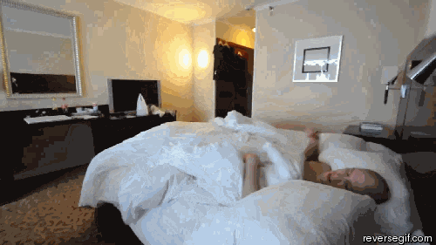
HE JUMPED … HIS BED
OUT OF

Slide 8
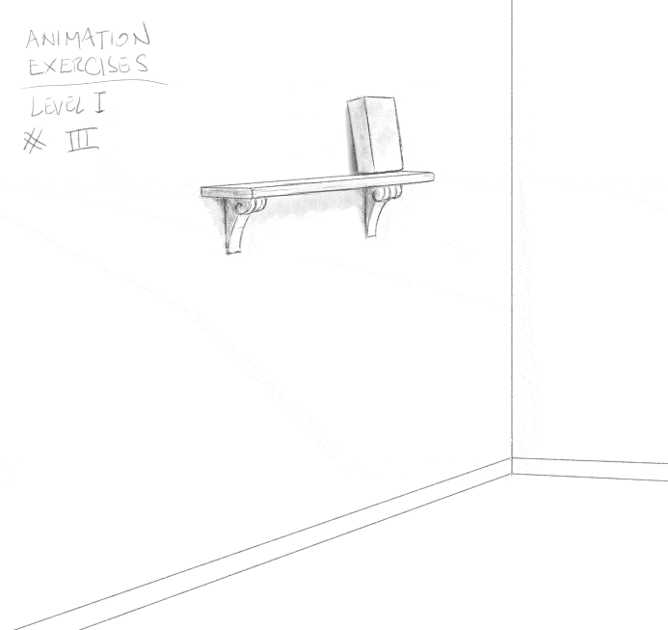
IT FELL … THE GROUND.
ONTO

Slide 9
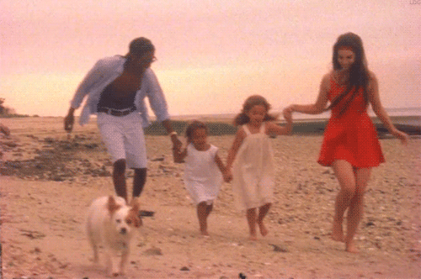
THEY ARE WALKING … THE BEACH.
ALONG

Slide 10
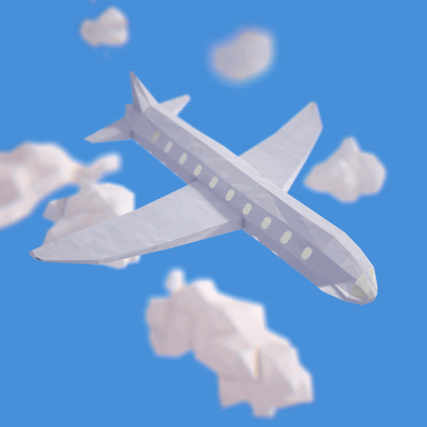
THE PLANE IS GOING …
DOWN

Slide 11
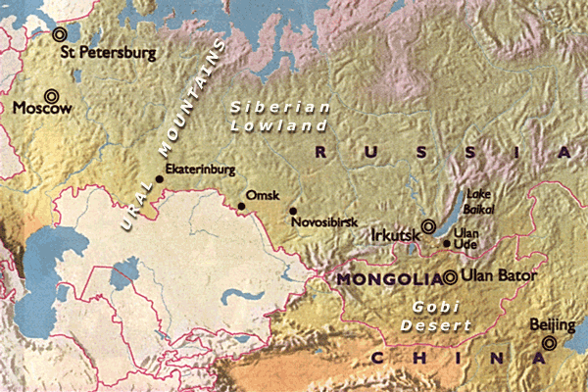
THE TRANS-SIBERIAN TRAIN GOES … BEIJING …. PETERSBURG.
FROM
TO

