Slide 1
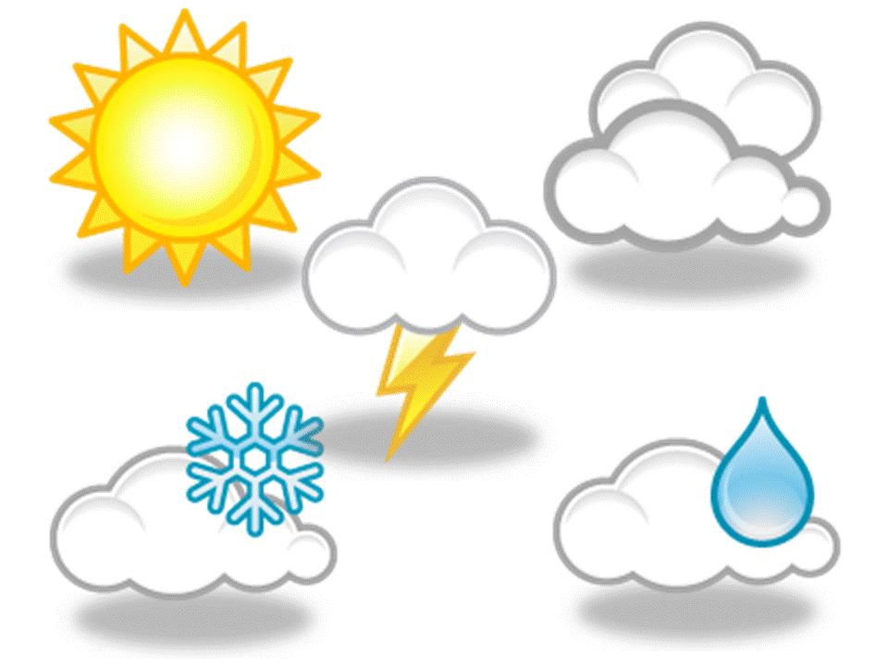
Weather game

Slide 2
windy
Remove

Slide 3
cold
Remove

Slide 4
rainy
Remove

Slide 5
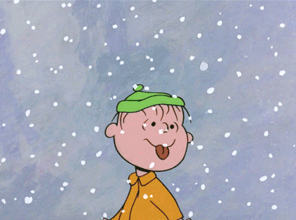
snowy
Remove

Slide 6
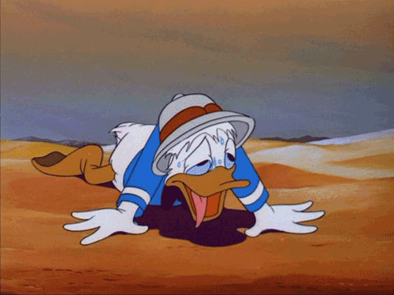
hot
Remove

Slide 7
cloudy
Remove

Slide 8
sunny
Remove

Slide 9
SEASONS
Pory roku

Slide 10
spring
Remove

Slide 11
summer
Remove

Slide 12
autumn
Remove

Slide 13
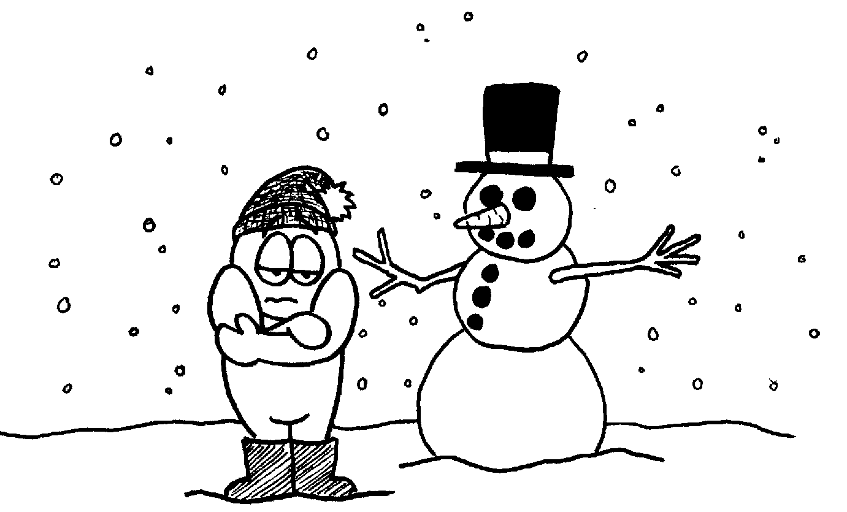
winter
Remove

