Slide 1
Content Creator Pre-Interview Task

Slide 2
Content Creator Pre-Interview Task - Instructions
Choose one of the following (sets of) course book pages. Make a copy of this workbook with the following naming convention: ‘FirstName_LastName_LessonA/B/C_Content Creator Pre-Interview Task’
You may delete the slides for the Lesson Tasks you don’t choose.
Plan a complete age appropriate F2F lesson for the page(s) that could be taught across ila. You must include complete slides and instructions in the speaker notes section. You do not need to submit a formal, ‘CELTA-style’ lesson plan. Include your slides in this workbook. You may link to supplementary documents/activities if desired.
Answer the questions matching the lesson that you prepared. Write your answers on the slides provided.

Slide 3
Content Creator Pre-Interview Task

Slide 4
Lesson A

Slide 5
Lesson A
Prepare a lesson for Grammar Friends 2 pg. 64 & 65
Full book for reference: Grammar Friends 2
Focus on the presented language point. You can assume learners have attended lessons for previous language points.

Slide 6
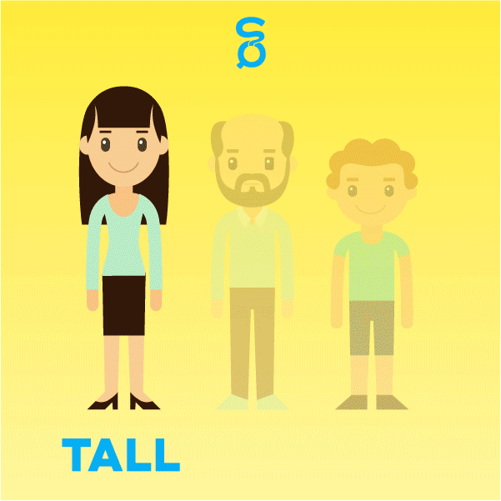
Who is taller/shorter?
Notes:
Get students to come up to the board two at a time. Ask the students “Who is taller?” and then “Who is shorter?”. Send the shorter person to the left and the taller person to the right, then bring up two more and repeat. Get students to sort themselves into height order along the wall. Optional extra: When students are finished, explain that one student is “The tallest in the room,” and one student is “The shortest in the room,” thus giving them an introduction into Superlatives.

Slide 7
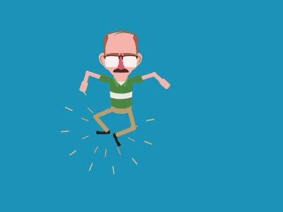
Who can jump higher?
Notes:
Bring up two students at a time to the board. Get them to put their legs together and jump straight up (make a point of telling them that the jumping style illustrated is not allowed!). Roughly mark on the board where each student was able to jump to, then ask them “Who can jump higher?”. The student who jumped higher stays on and then a new student comes up. Repeat until all students have jumped.
Optional extra: At the end, you can explain that [the final student] can jump the highest in the class, thus giving them an introduction to superlatives. Optional extra: Change the language to ‘Further’ and repeat the game by seeing which student can jump further.
Safety precautions: Be careful that students are not too close together and likely to bump into each other. Also, ensure they are jumping straight up with legs together, not leaping across the room.

Slide 8
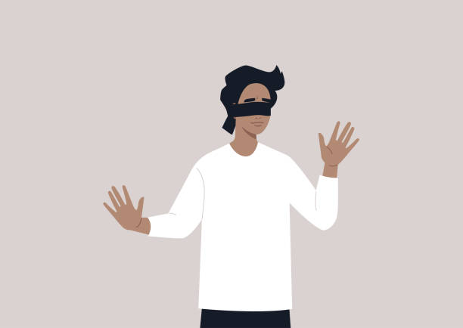
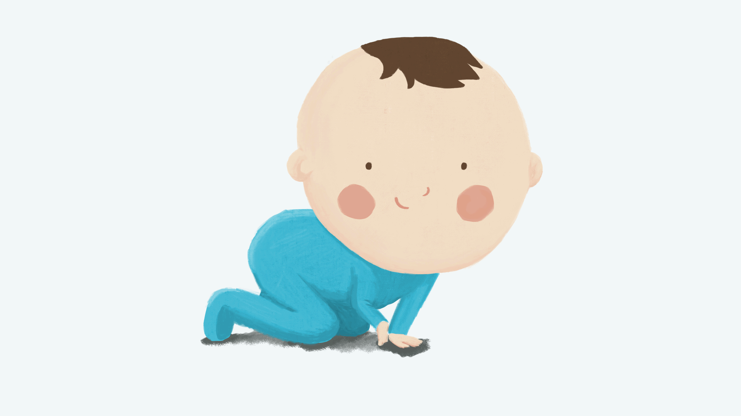
Quiet race!
Who is quieter?
Who is louder?
Notes:
One student must sit or stand in the centre of the room with their eyes closed. They will have three softballs (or balls of scrunched up paper) in their hands. Two other students must crawl towards the student from other ends of the room as quietly as they can. The student in the centre must try to hit one of them with a softball.
After a student has been hit, revise the language by asking the class: “Who was quieter?” “Who was louder?” If no student is hit after all three balls have been thrown, or one of the students manages to touch the middle students’ chair, the teacher may declare “They are both as quiet as each other.” Additional preparation: Making the students carry bells, a tambourine, a maraca, or some scrunched-up paper under their palms adds an element of comedy to the game and may make it easier for the middle student to hear them.

Slide 9
Next activity!
Notes:
Link: https://wheeldecide.com/index.php?id=654720
Set out enough chairs for everyone, then take one away.
The student that is standing must spin the wheel, then people must change chairs if they fit the criteria specified.
Each time the wheel is spun, that choice should disappear (this can be disable in ‘Advanced options’ if you wish to play longer. Keep playing until all choices have disappeared.
Safety precaution: Ensure there is plenty of space between the chairs and enough room to play safely. Tell students to raise the desks so they are not in the way, and tell them not to run. Ensure the floor is not slippery, and desks have been cleared. Ensure there is no loose paper, pencils or other things on the floor that may lead to a student slipping. Some students may become over-excited, do not allow them to push or force their way into a chair (or remove somebody from it)

Slide 10
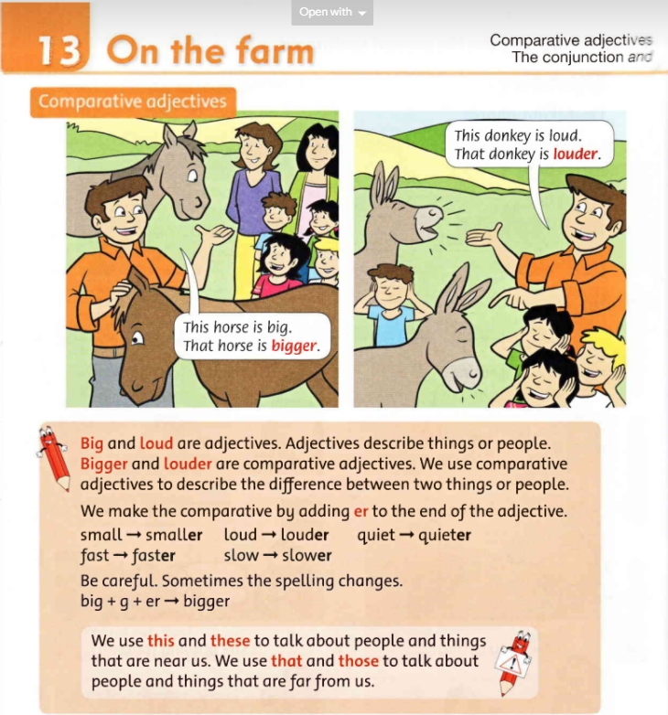
Notes:
Instruct students to turn to page 64. Explain the grammar using the pictures and text onscreen.

Slide 11
Board Race!
Notes:
Put groups into teams of three. Print off the text as many times as necessary, and cut it into 4 pieces, each containing two short sentences. Hand out one of the four pieces to each team, Students must circle the comparative adjective, whilst one of the team members runs up with it, and gives it to the teacher, who checks it and hands the second one back. At the end, you can explain that “Team B was the fastest” or “Team B was faster than team A”.

Slide 12
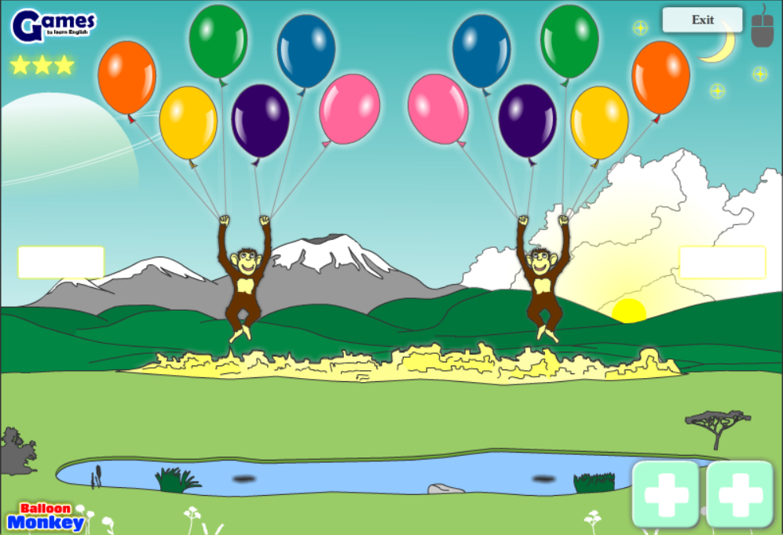
Monkey balloon!
Next activity!
Notes:
Download the game here: https://drive.google.com/file/d/1e8VnBauMcZyeI1OG0sv3cxRgHfa3DM51/view?usp=sharing
Split the class into two teams.
Each team has to try to pop all of the balloons holding up the other team’s monkey.
Adjust the stars to make it easier.
Each time a student answers correctly, they are allowed to come up and ‘Shoot’ the other team’s balloons.
Use this game to go through the next questions on the next slides.

Slide 13
Notes:
Play ‘Monkey balloon’ as you go through these questions

Slide 14
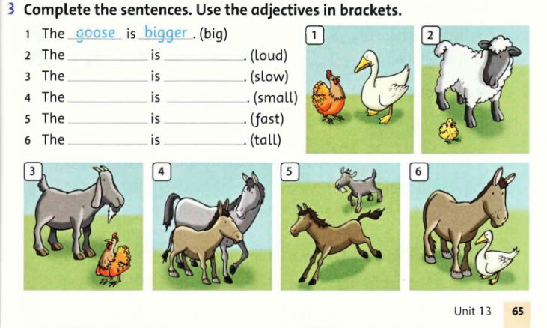
Notes:
Play ‘Monkey balloon’ as you go through these questions.
If you run out of questions and neither team has won, reduce the level of stars (to make the game easier) and then ask some questions about the different people in the room (Example: “Who is taller? The teacher or _____”

Slide 15
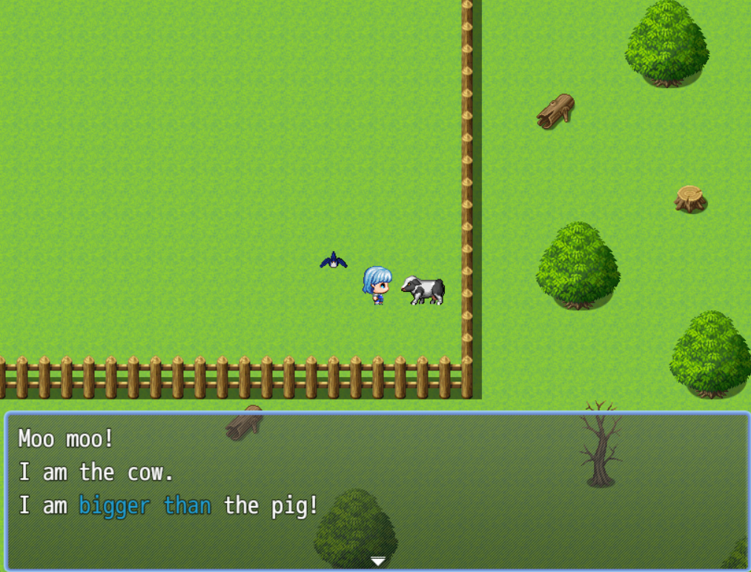
Play the Comparatives Game!
Link: https://christopheraxe.itch.io/comparatives
Notes:
Click the link to play the game: https://christopheraxe.itch.io/comparatives
The game is best played in fullscreen mode.
Allow each student to have a turn at the ‘Find the animals’ game (or play as a class), then allow each student to play the ‘Horse racing’ game.
Optional extra: Students can play together at break-time as well, or may play on their phones individually.

Slide 16
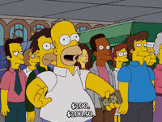
Comparatives Quiz Auction!
Notes:
Preparation: Break the class into teams. Hand out mini-whiteboards (or paper) and $5 in fake money to each team. They must write down their answers to the questions in the video on the next slide, and place an amount of money on the board. If they win, double their stake. If they lose, take it.

Slide 17
Notes:
Pause the video at appropriate times to give students a chance to answer. If students lose all of their money, give them some more (and explain that it will be deducted from their final winnings, but they can still play).

Slide 18
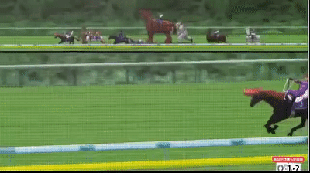
Crazy Horses!
Betting game
Notes:
Using the money they have accumulated in the last game, students can bet on horses in each race. First, use the spinner to choose a race at random, then allow the students to choose one of the horses from 1-8 (or sometimes 1-9). Each student wins 8x their stake if they win. Each race is about 2-3 minutes long, so you can do as many as you think is suitable for your class. This is just a bit of fun, but you can use it as an opportunity to ask students things like “Which horse was faster?”

Slide 19
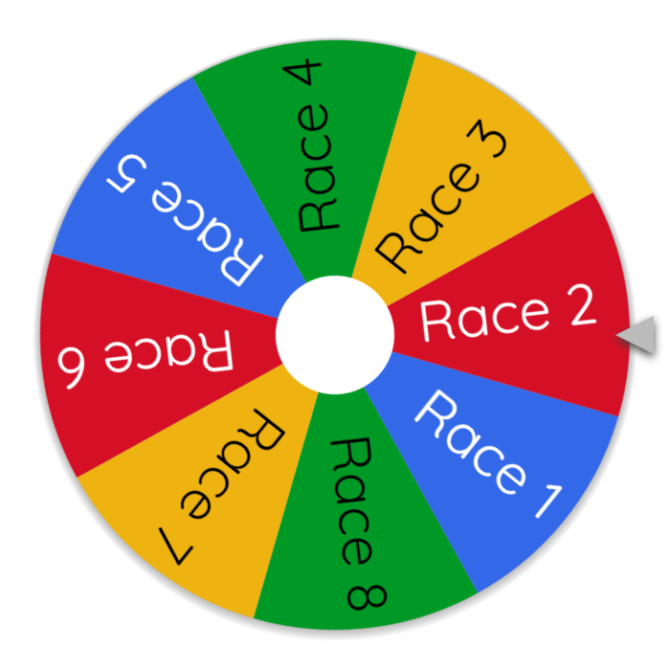
Spin the wheel!
Race 1
Race 2
Race 3
Race 4
Race 5
Race 6
Race 7
Race 8
Next activity!
Notes:
First, spin the wheel to choose a race at random. Then click the boxes on the left to jump to the associated video.

Slide 20
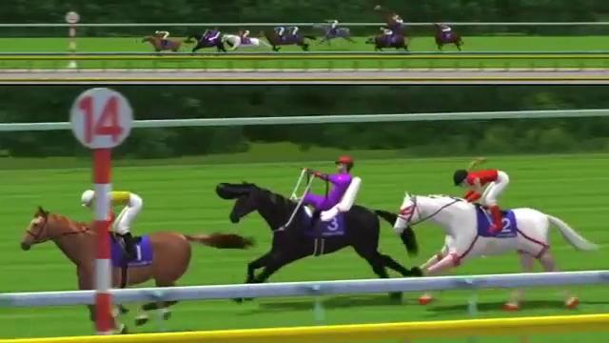
Choose another race!
Notes:
Pause the video when the horses line up, then get students to place their bets on the horse they think will win.

Slide 21
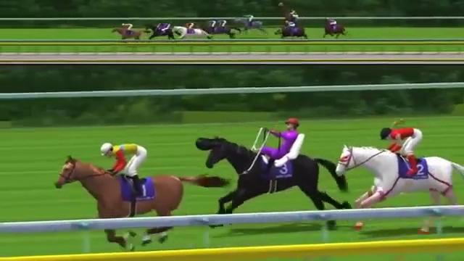
Choose another race!
Notes:
Pause the video when the horses line up, then get students to place their bets on the horse they think will win.

Slide 22
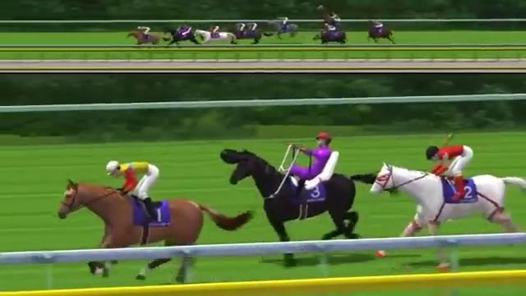
Choose another race!
Notes:
Pause the video when the horses line up, then get students to place their bets on the horse they think will win.

Slide 23
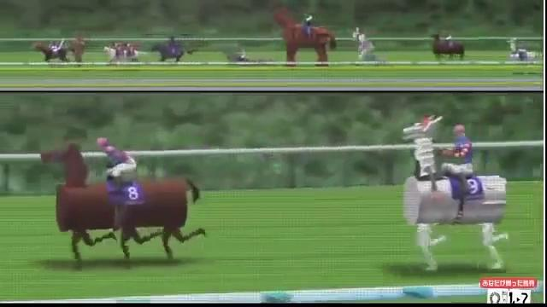
Choose another race!
Notes:
Pause the video when the horses line up, then get students to place their bets on the horse they think will win.

Slide 24
Choose another race!
Notes:
Pause the video when the horses line up, then get students to place their bets on the horse they think will win.

Slide 25
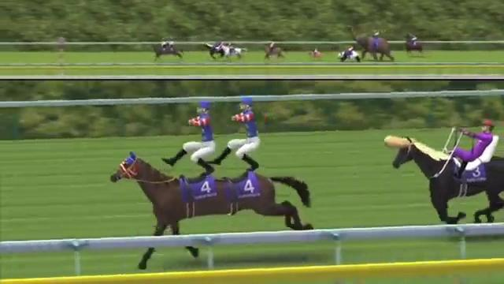
Choose another race!
Notes:
Pause the video when the horses line up, then get students to place their bets on the horse they think will win.

Slide 26
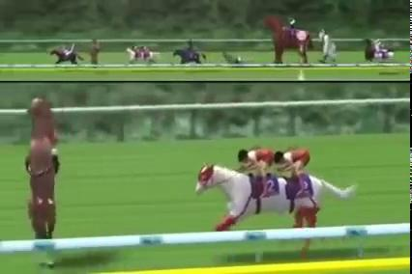
Choose another race!
Notes:
Pause the video when the horses line up, then get students to place their bets on the horse they think will win.

Slide 27
Choose another race!
Notes:
Pause the video when the horses line up, then get students to place their bets on the horse they think will win.

Slide 28
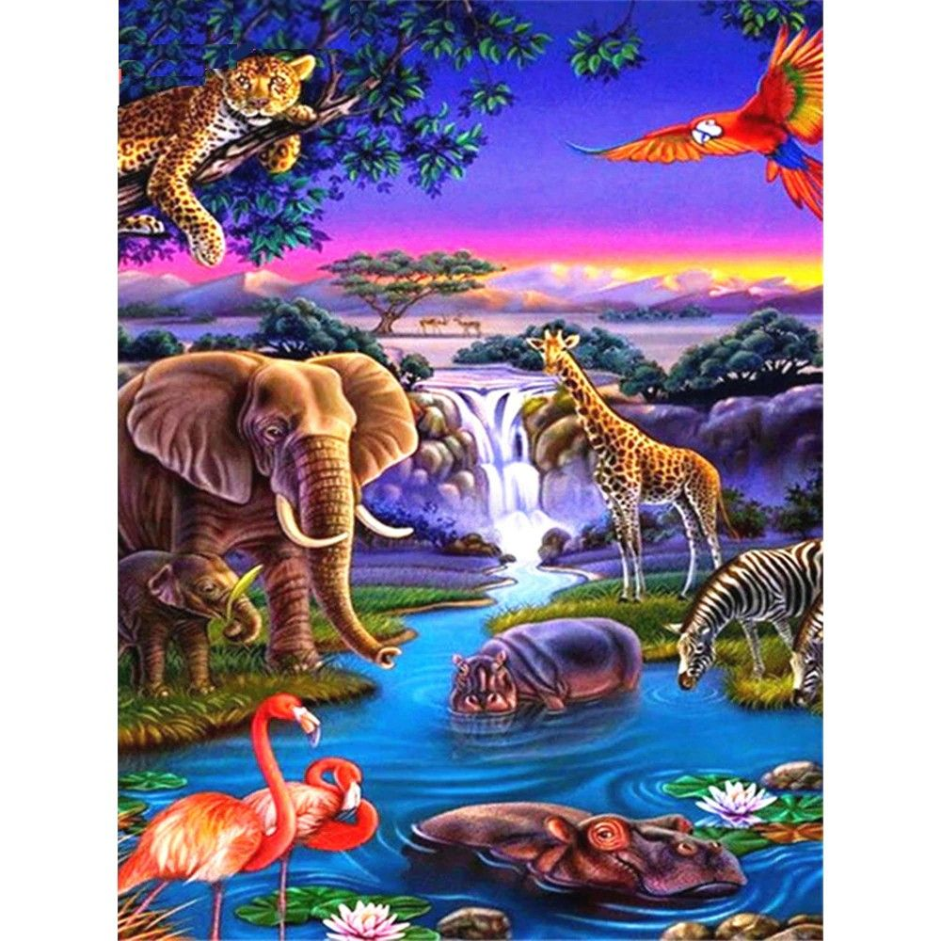
Compare the animals!
Next activity!
Notes:
This can be done as a writing or speaking task.
Students must look at the picture and compare the different animals. For example: “The Giraffe is taller than the Zebra”, “The baby elephant is smaller than the mummy elephant.”, “The parrot is more beautiful than the hippo.” For more advanced students, they may say “The leopard climbs better than the hippo.” or “The leopard is the fastest animal.”

Slide 29
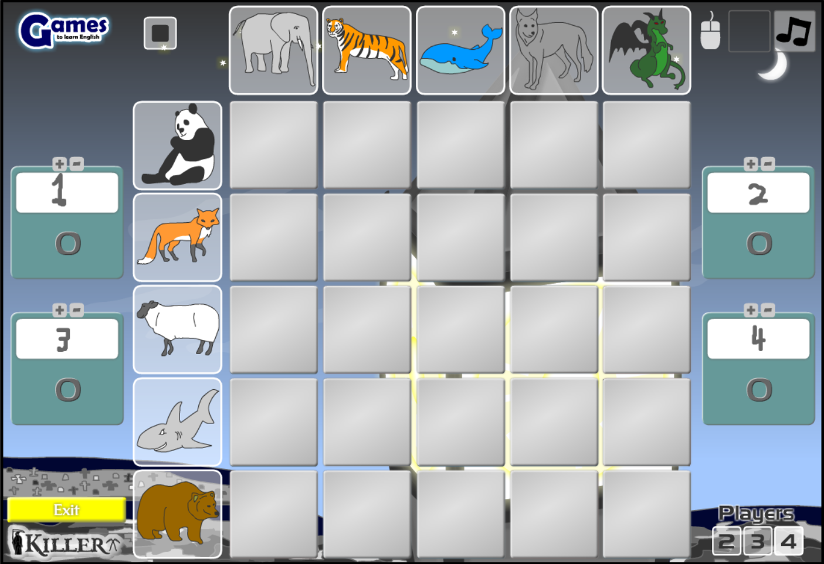
Killer!
Next activity!
Notes:
Click the image to download the game! (https://drive.google.com/file/d/1mUYT82f6xV5HLAKjMHlr2SWuEtGP-08r/view?usp=sharing) This is a good speaking task to end the lesson with. Students must be put into four teams. Set content to ‘Animals’. Each person must then choose two animals, one from the horizontal axis and one from the vertical axis, and say a sentence to compare them (For example: “The lion is more dangerous than the cat”). The corresponding square will then be selected. If they have something good, it will go to their team. If they get something bad, they can choose which of the other three teams it goes to. Continue until all 25 squares are gone.

Slide 30
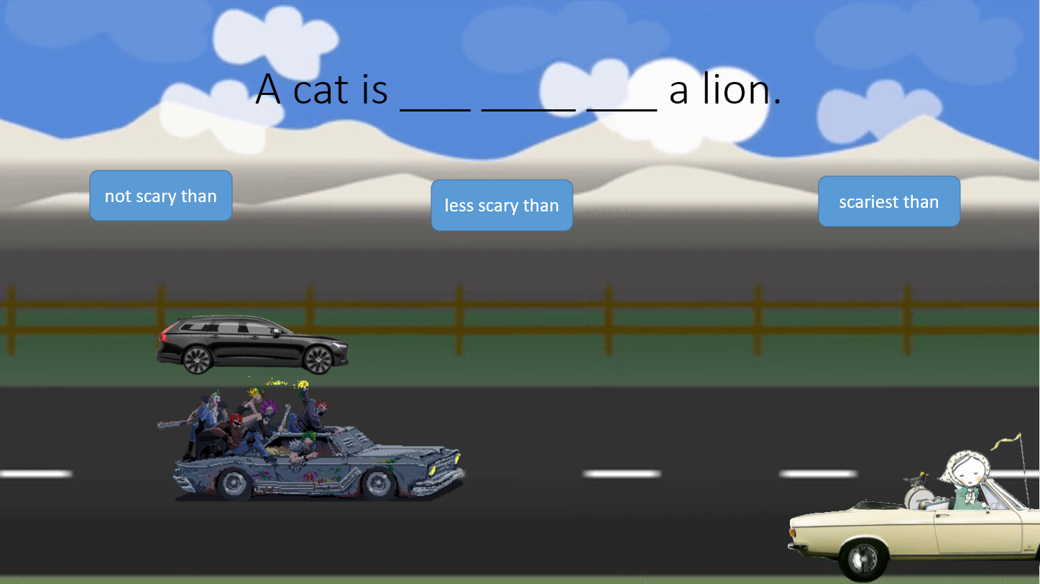
Bonus: Downloadable games!
Download and open with Flashplayer
Notes:
These are some additional games that can be downloaded and played if students are very fast learners, or if you have time left at the end (or during breaktime). Powerpoint games must be downloaded and played - they will not work on Google slides. If you need to leave the classroom at break-time, downloading a few games and then turning the internet off can ensure students are able to play educational games unattended, if they choose.

Slide 31
Lesson A Question 1
What anticipated problems do you foresee that a teacher using your lesson may encounter? What additional steps could be taken to mitigate these problems?
Answer here:
If teachers do not read the instructions on downloading carefully, they may try to open things incorrectly. For this reason, I have put large illustrations to show what is needed to run each game.
I also anticipate that the physical activities, such as the board race, change chairs and others may lead to over-excited students bumping into each other or tripping over, so I have included specific instructions on how to manage health & safety in the classroom.

Slide 32
Lesson A Question 2
Imagine you were planning a lesson for the same language point covered here, but for a group of teen learners. What would you do differently?
Answer here:
I would make the games more expansive, so as to incorporate superlatives, and ‘exceptions to the rule’ (more fun, further, better, worse, etc). I would also incorporate a stronger written and spoken element as a production task.
Instead of the ‘describe the picture’ task on slide 28, I would have series of short videos in which students would have to make comparisons for each one on what they see. I would find a way to turn it into a game.

Slide 33
Lesson A Question 3
Imagine you are planning a receptive skills lesson for the same age group as this lesson. What would you do differently, and what would you do the same?
Answer here:
I would keep the games as they are, but include another video task. I would find a video (maybe a clip from an animated movie such as ‘The Incredibles’ or some kind of superhero movie where powers can be compared) and write a number of questions on the board, such as “Who is faster? Who is stronger?” and then play the video and ask questions.
I would possibly break the video up into sections and ask questions at the end of the video, with fake prize money that can be redeemed for a reward (or a turn on a game) at the end of the lesson.

Slide 34
Lesson A Question 4
How would you modify this lesson to be successful if taught online?
Answer here:
Obviously the physical games would have to be dropped. However, spin the wheel could be modified to a game in which students raise their hands instead (or stand up/sit down).
I would incorporate a ‘Show and tell’ game, where students had to go and find an object, then find something ‘Bigger’, then find something ‘Older’, etc.
I would include more games from Wordwall, Blooket, Kahoot, Quizlet, GamesToLearnEnglish, ESLGamesPlus, and Skribbl.
I’d also expand the game that I made myself in order to incorporate more features.

