Slide 1
Sentence Auction
Complete the sentences

Slide 2
It’s so practical to carry…
fit and healthy.
I think you’ve caught
a money belt when you’re on a trip.
It’s a good idea for you to get some
to work after a long holiday.

Slide 3
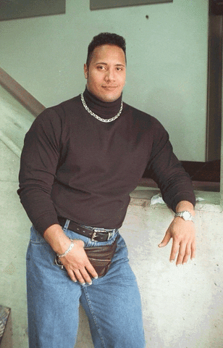
It’s so practical to carry a money belt when you’re on a trip.

Slide 4
I enjoy…
Back to work after a long holiday.
I hate to go
for the hospital.
Do you know where it is?
I have to give up
tax-free shopping.

Slide 5
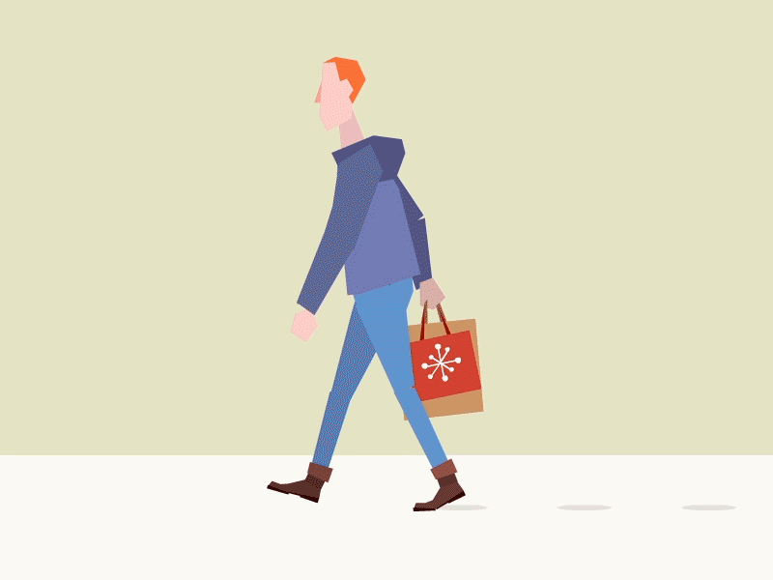
I enjoy tax-free shopping.

Slide 6
You must go through…
rest to get better soon.
I don’t drink fizzy drinks to keep
the center of the town to get to the City Hall.
I’ve broken
fit and healthy.

Slide 7
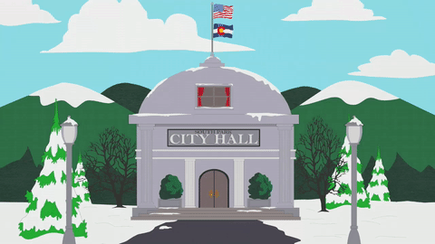
You must go through the center of the town to get to the City Hall.

Slide 8
I don’t drink fizzy drinks to keep…
fit and healthy.
I think you’ve caught
a money belt when you’re on a trip.
It’s a good idea for you to get some
to work after a long holiday.
I hate to go back
for the hospital.
Do you know where it is?

Slide 9
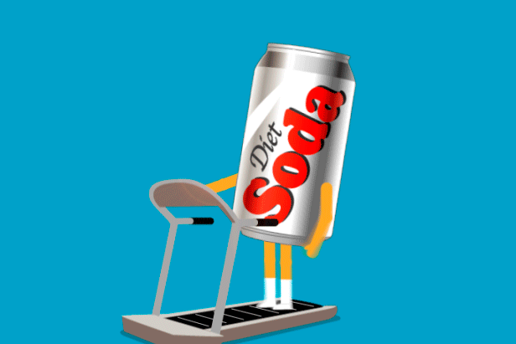
I don’t drink fizzy drinks to keep healthy.

Slide 10
I’ve broken…
my job because I have no time for myself.
I enjoy doing
my left arm twice.
You must go through.
I’m looking for the library.
rest to get better soon.

Slide 11
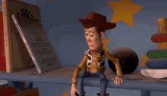
I’ve broken my left arm twice.

Slide 12
I think you’ve caught…
my job because I have no time for myself.
I enjoy doing
my left arm twice.
the flu
I’m looking for the library.
to work after a long holiday
rest to get better soon.

Slide 13
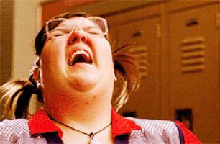
I think you’ve caught the flu.

Slide 14
It’s a good idea for you to get some…
my job because I have no time for myself.
I enjoy doing
my left arm twice.
the flu
I’m looking for the library.
to work after a long holiday
rest to get better soon.

Slide 15
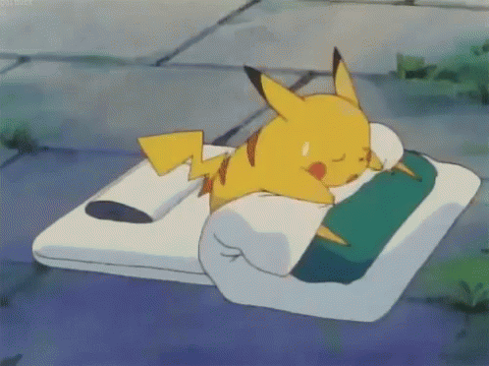
It’s a good idea for you to get some rest to get better soon.

Slide 16
I hate to go back…
my job because I have no time for myself.
I enjoy doing
my left arm twice.
the flu
I’m looking for the library.
to work after a long holiday
rest to get better soon.

Slide 17
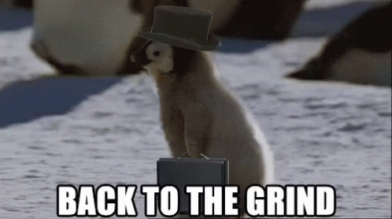
I hate to go back to work after a long holiday.

Slide 18
I have to give up…
my job because I have no time for myself.
I enjoy doing
my left arm twice.
the flu
I’m looking for the library.
to work after a long holiday
rest to get better soon.

Slide 19
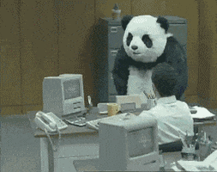
I have to give up my job because I have no time for myself.

Slide 20
I’m looking…
fit and healthy.
I think you’ve caught
a money belt when you’re on a trip.
It’s a good idea for you to get some
to work after a long holiday.
I hate to go back
for the hospital.
Do you know where it is?

Slide 21
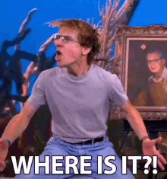
I’m looking for the hospital.

