Slide 1
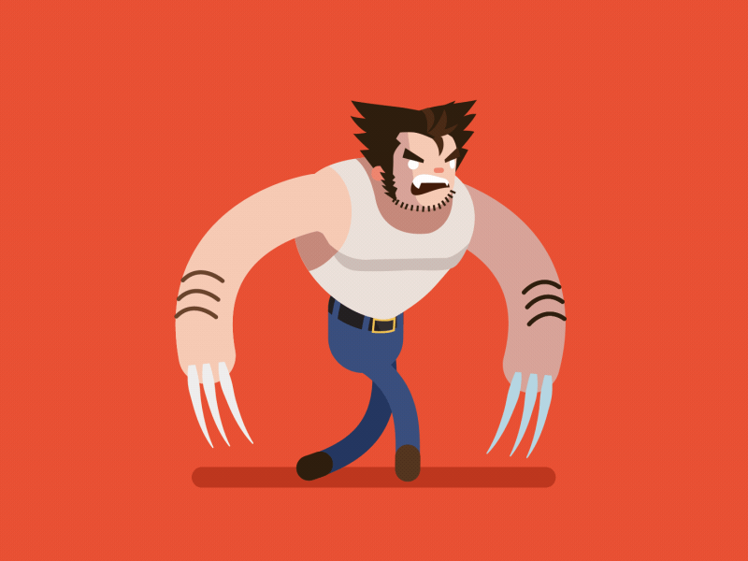
Wolverine has much sharp claws on his hands.
Wolverine has many sharp claws on his hands.

Slide 2
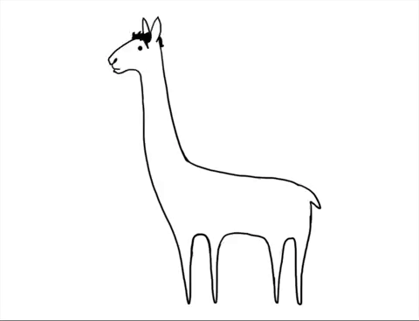
The llama has so many hair
The llama has so much hair

Slide 3
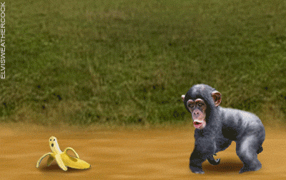
Monkeys like to eat much banana.
Monkeys like to eat many bananas.

Slide 4
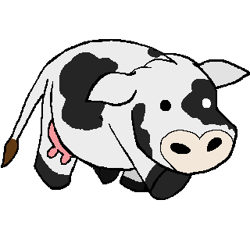
Cows make so many milk.
Cows make so much milk.

Slide 5
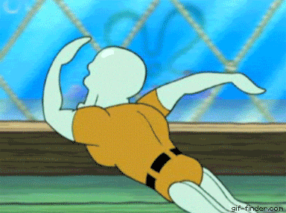
The sea monster has much legs.
The sea monster has many legs.

Slide 6
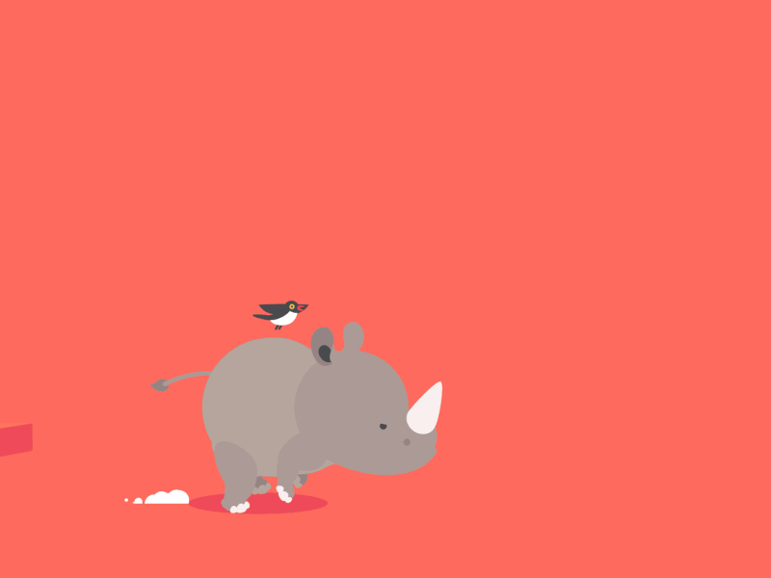
Rhinos don't have much wings.
Rhinos don't have any wings.

Slide 7
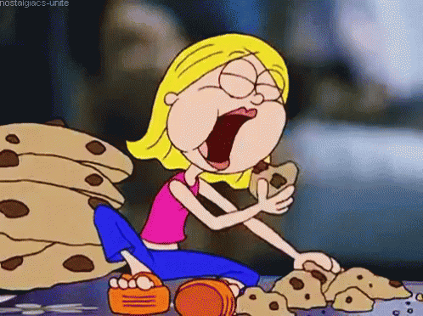
The woman ate much cookie.
The woman ate many cookies.

Slide 8
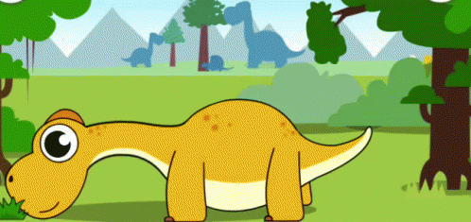
Herbivores eat so many grasses.
Herbivores eat so much grass.

Slide 9
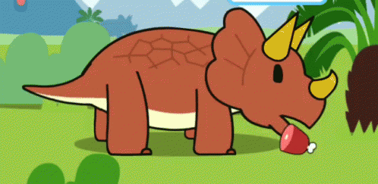
The dinosaur didn't like to eat many meat.
The dinosaur didn't like to eat any meat.

Slide 10
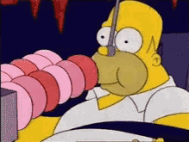
Homer eats much doughnuts.
Homer eats many doughnuts.

Slide 11
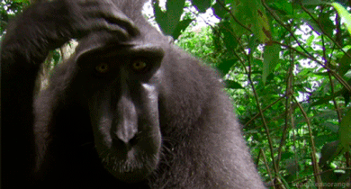
The monkey has so any hair.
The monkey has so much hair.

Slide 12
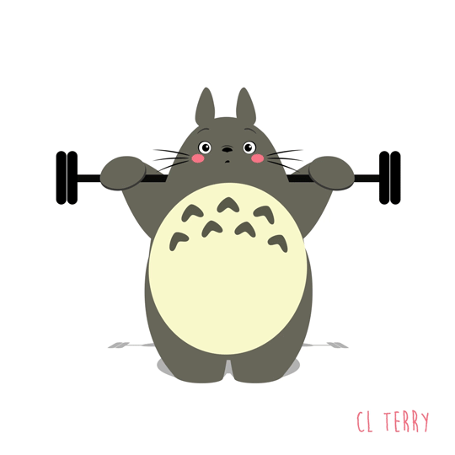
The bunny can lift so many weight.
The bunny can lift so much weight.

Slide 13
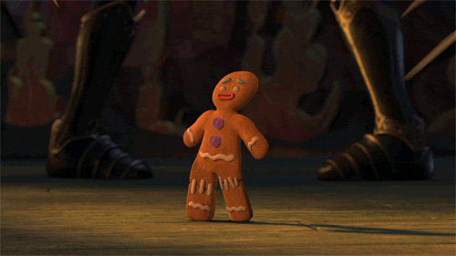
There were lot of sword.
There were lots of swords.

Slide 14
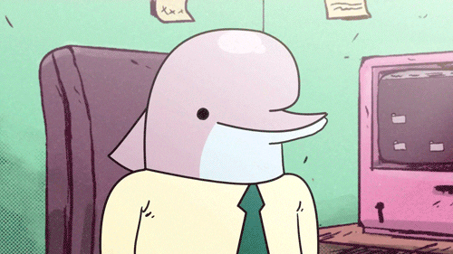
The dolphin laughs too many.
The dolphin laughs too much.

Slide 15
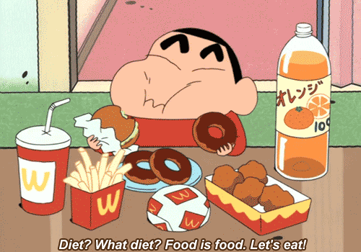
The boy ate three doughnut.
The boy ate three doughnuts.

Slide 16
The boy ate two burger.
The boy ate two burgers.

Slide 17
The boy ate so many junk food.
The boy ate so much junk food.

Slide 18
The boy drank a lot orange juice.
The boy drank a lot of orange juice.

Slide 19
The boy drank much bottle of juice.
The boy drank a bottle of orange juice.

Slide 20
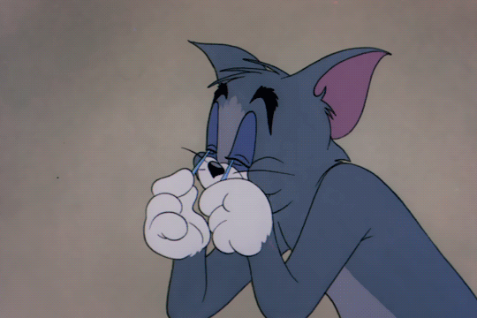
The cat got few sleep.
The cat got little sleep.

Slide 21
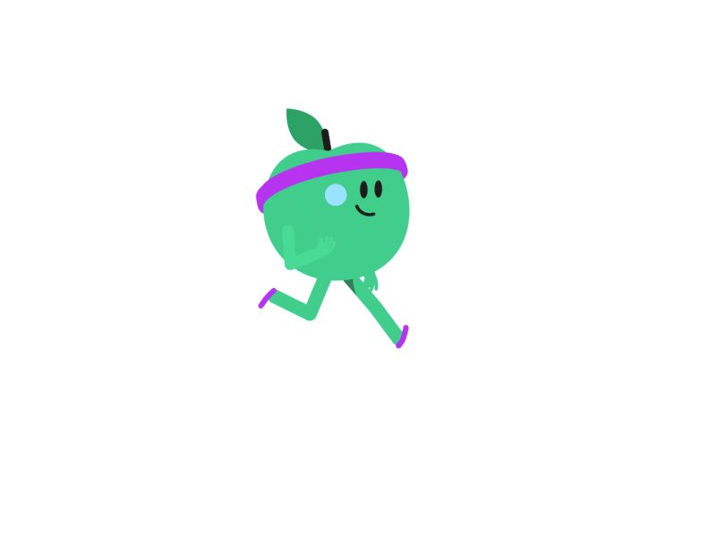
The apple does much different exercises.
The apple does many different exercises.

Slide 22
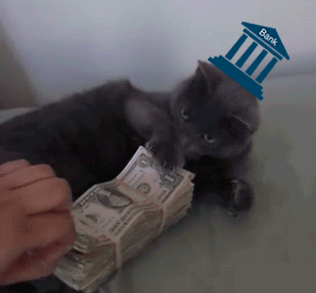
The cat has so many money.
The cat has so much money.

Slide 23
The cat has so much dollar.
The cat has so many dollars.

Slide 24
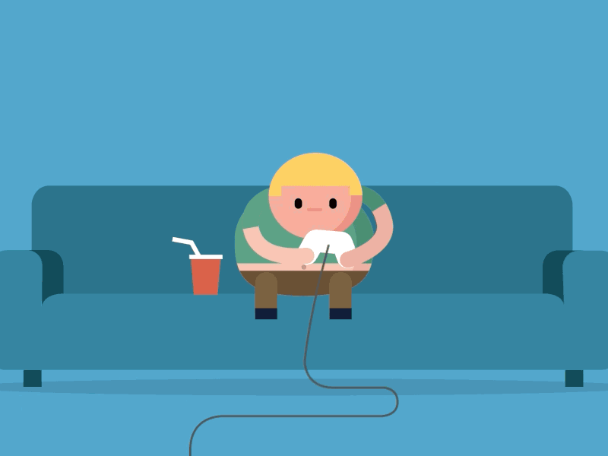
The boy plays much game and drinks a few juice.
The boy plays many games and drinks a little juice.

