Slide 1
Canada
SHOW

Slide 2
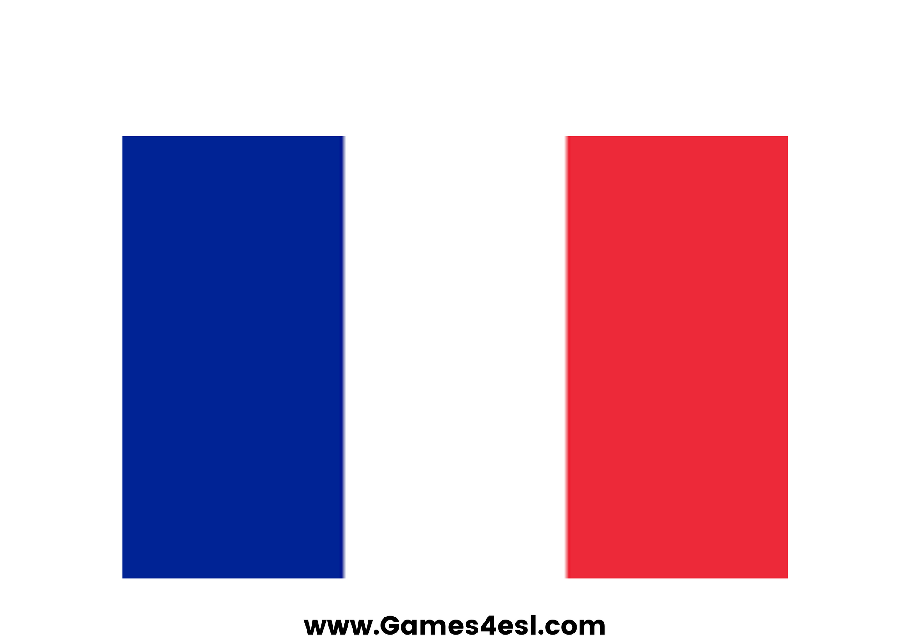
France
SHOW

Slide 3
Spain
SHOW

Slide 4
America
SHOW

Slide 5
Australia
SHOW

Slide 6
Germany
SHOW

Slide 7
Brazil
SHOW

Slide 8
England
SHOW

