Slide 1
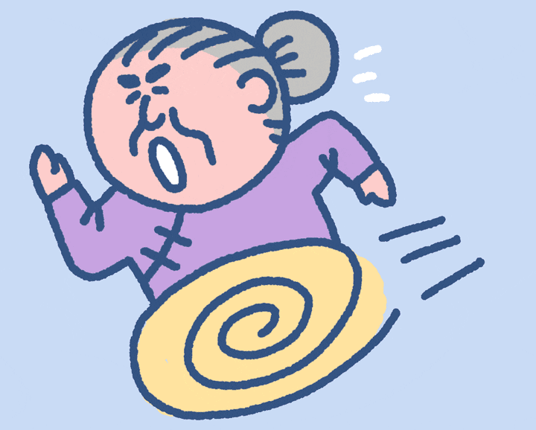
Get grandma home! Start

Slide 2
You got grandma home safely! Now she is happy!

Slide 3
You got grandma home safely! Now she is happy!

Slide 4
You got grandma home safely! Now she is happy!

Slide 5
You got grandma home safely! Now she is happy!

Slide 6
You got grandma home safely! Now she is happy!

Slide 7
You got grandma home safely! Now she is happy!

Slide 8
You got grandma home safely! Now she is happy!

Slide 9
You got grandma home safely! Now she is happy!

Slide 10
You got grandma home safely! Now she is happy!

Slide 11
You got grandma home safely! Now she is happy!

Slide 12
You got grandma home safely! Now she is happy!

Slide 13
You got grandma home safely! Now she is happy!

Slide 14
You got grandma home safely! Now she is happy!

Slide 15
You got grandma home safely! Now she is happy!

Slide 16
You got grandma home safely! Now she is happy!

Slide 17
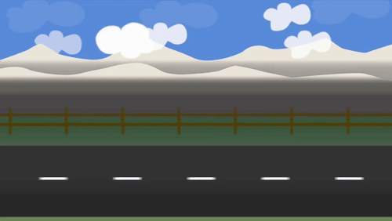
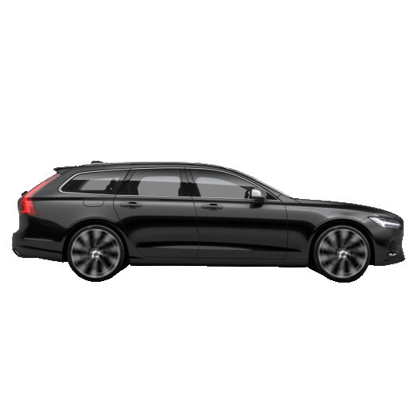
Grandma ____ almost at home!
was
were
were to

Slide 18
The best student ____ working hard!
were to
were
was

Slide 19
The children ____ _____!
were laughed
were laughing
was laugh

Slide 20
He ____ at home, he was outside!
was
wasn't
was

Slide 21
How many dogs were _____?
bark
barking
barked

Slide 22
There ____ some oranges.
any
were
was

Slide 23
We ____ ______ for bananas.
was looked
were looking
was looking

Slide 24
How many people ____ ______?
is wait
were waiting
was waiting

Slide 25
John and Steve ___ ______ Bun Cha!
wasn't eating
was ate
were eating

Slide 26
I ____ feeling thirsty
was
didn't
were

Slide 27
He was happy, so he was ______!
smiled
smiling
smile

Slide 28
She wasn’t _____ happy, she was angry!
feeling
feel
felt

Slide 29
I was ____ . Brrr! Only a few people were walking.
freeze
froze
freezing

Slide 30
We were _____ food in the fridge. It wasn't empty
putting
puts
putted

Slide 31
John was _____when he fell!
run
running
ran

Slide 32
We weren’t _____ tired, even though it was a long day.
get
getting
got

Slide 33
I wasn’t ____ to school, I was at home!
goes
go
going

Slide 34
Were you _____ at the pub last night?
drink
drinking
drinked

Slide 35
I ____ _____bored
were
was got
was getting

Slide 36
'They', 'we', and 'you' can be used with...
was
were
both

Slide 37
I, He, She and It can be used with...
was
were
both

Slide 38
You lost. Now grandma is crying.

