Slide 1
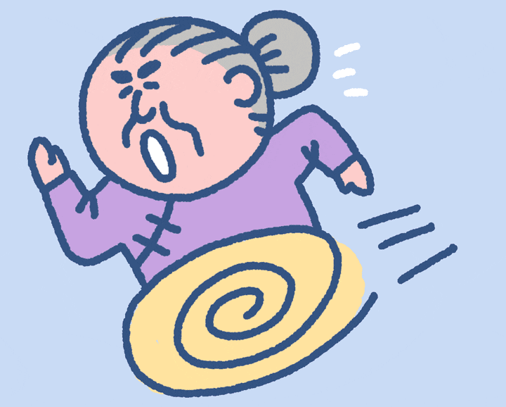
Get grandma home! Start

Slide 2
You got grandma home safely! Now she is happy!

Slide 3
You got grandma home safely! Now she is happy!

Slide 4
You got grandma home safely! Now she is happy!

Slide 5
You got grandma home safely! Now she is happy!

Slide 6
You got grandma home safely! Now she is happy!

Slide 7
You got grandma home safely! Now she is happy!

Slide 8
You got grandma home safely! Now she is happy!

Slide 9
You got grandma home safely! Now she is happy!

Slide 10
You got grandma home safely! Now she is happy!

Slide 11
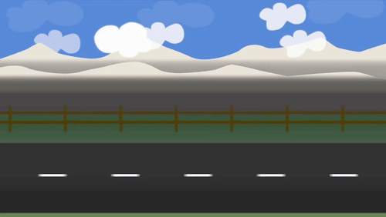
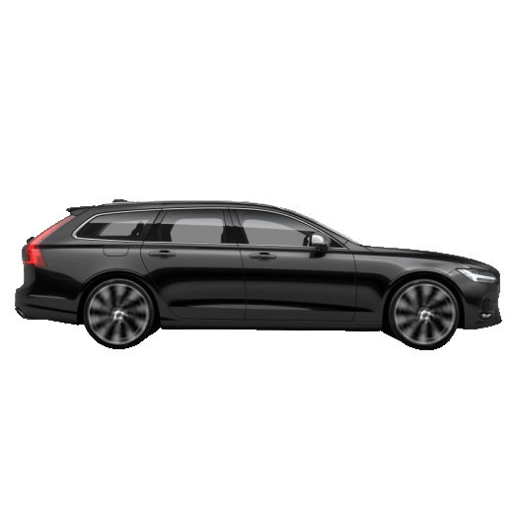
Grandma ____ almost at home!
was
were
were to

Slide 12
The best student ____ working hard!
were to
were
was

Slide 13
The children ____ laughing!
some
were
was

Slide 14
He ____ at home, he was outside!
was
wasn't
was

Slide 15
How many dogs ___ there in your house?
a
were
was

Slide 16
There ____ some oranges.
any
were
was

Slide 17
There _____ any bananas.
all
weren't
wasn't

Slide 18
How many keyboards ____ there?
is
were
was

Slide 19
John and Steve ___ eating Bun Cha!
wasn't
was
were

Slide 20
I ____ thirsty
was
didn't
were

Slide 21
He had no friends. He ____ very lonely
weren't
was
were

Slide 22
She ____ happy, she was angry!
wasn't
was
weren't

Slide 23
It was freezing. Brrr! Only a few people _____ walking.
wasn't
was
were

Slide 24
There ____ food in the fridge. It wasn't empty
was
lots of
wasn't

Slide 25
John _____ running when he fell!
weren't
was
were

Slide 26
We _____ tired, even though it was a long day.
was
weren't
not

Slide 27
I ____ at school, I was at home!
a
were
wasn't

Slide 28
____ you at the pub last night?
none
were
was

Slide 29
I ____ getting bored
were
many of
was

Slide 30
'They', 'we', and 'you' can be used with...
was
were
both

Slide 31
I, He, She and It can be used with...
was
were
both

Slide 32
You lost. Now grandma is crying.

