Slide 1
Gunslingers
Start

Slide 2
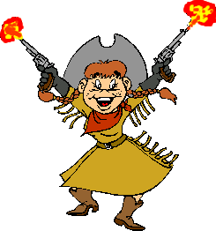
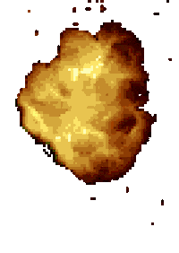
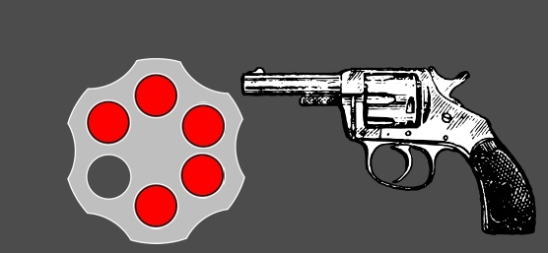
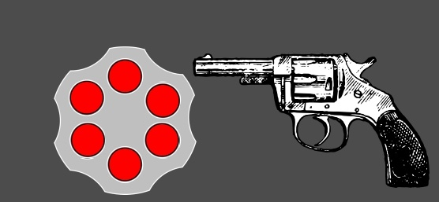
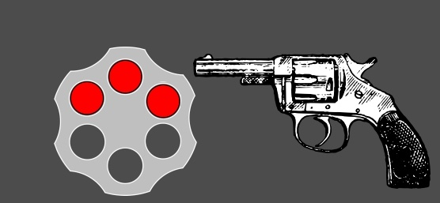
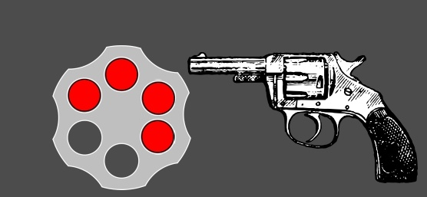
Have you got ____ bananas?
much
any
none
There are too ____ people in the room!
many
some
much
Could I have _____ bread?
many
some
got
I would like ____ water please
some
any
many

Slide 3
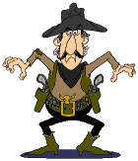
Have you got ____ cheese left?
many
much
hello
Is there ____ juice in the fridge?
many
stuff
any
There are so _____ trees!
many
much
any
I haven't seen ____!
any
have
well

Slide 4
There are ______ people!
many of
so much
a lot of
The is very _____ water left.
not much
little
not of
There are ___ apples in the bowl.
no
any
much
There isn't _____ in this sandwich
much
some
many

Slide 5
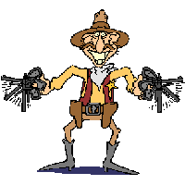
There are ______ drinks in the fridge
any
some
much
There aren't ____ carrots left.
any
much
must
I must say I think very ____ of him
little
not much
few
There are a ____ grapes on the vine.
few
little
much

Slide 6
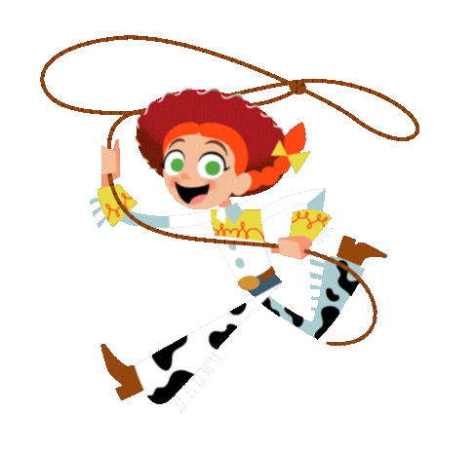
There is quite ______ bread left.
much
a lot of
many
I can't find her ____where
any
some
many
There is water _____where
all
every
many
The sea has so ______ water!
much
many
any

Slide 7
Do you have ___ questions for me?
much
any
little
We haven't got ____ time!
much
many
with
How ____ do you weigh?
much
many
any
How much ____ is it?
much
many
must

Slide 8
You win.

Slide 9
You got shot!

