Slide 1
Start

Slide 2
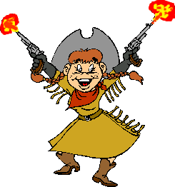
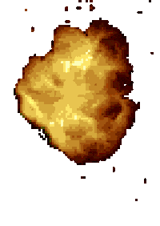
He ____ smiling and laughing
can
was
were
We _____ drinking and eating.
were
was
did
They _____ laughing and joking.
were
was
did
I ____ eating a sandwich and thinking.
was
is
were

Slide 3
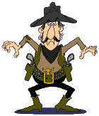
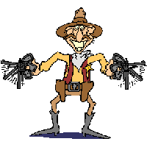
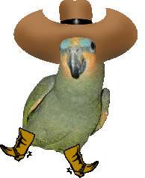
I was _____ and dancing.
sing
singing
sang
I was ______ up in the air a lot.
jumps
jumping
jump
They were _______ and laughing.
was smile
smile
smiling
John and Steve were _______.
did talk
talking
talked

Slide 4
He ____ smiling and laughing
can
was
were
We _____ drinking and eating.
were
was
did
They _____ laughing and joking.
were
was
did
I ____ eating a sandwich and thinking.
was
is
were

Slide 5
I was _____ and dancing.
sing
singing
sang
I was ______ up in the air a lot.
jumps
jumping
jump
They were _______ and laughing.
was smile
smile
smiling
John and Steve were _______.
did talk
talking
talked

Slide 6
You win.

Slide 7
You got shot!

