Slide 1
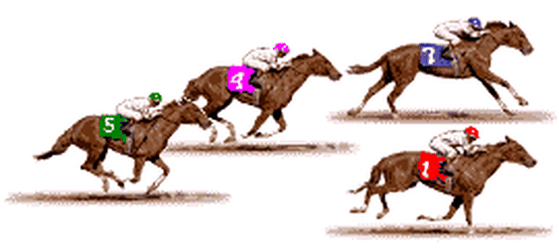
Horse racing Start!

Slide 2
You won the race!

Slide 3
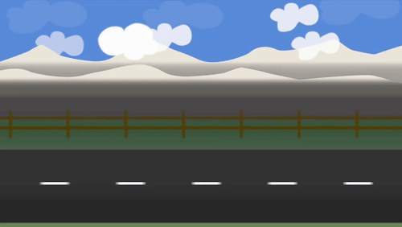
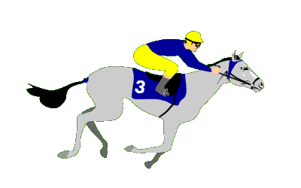
I ______ the horse racing game
completed
complete
completing

Slide 4
I had nearly ____ the race
winned
won
wins

Slide 5
Our horse ____ ahead of the others
runs
runned
ran

Slide 6
The horses _______ behind us.
galloped
gallop
galloping

Slide 7
I ____ a ghost in the attic!
seen
saw
seed

Slide 8
The hot air balloon ____ over the building.
floats
floated
float

Slide 9
The dog ___ on the mat.
sit
sat
sitting

Slide 10
Yesterday, he ___ the forks on the table
puts
putted
put

Slide 11
I _____ out of bed this morning.
jumping
jumped
jimp

Slide 12
The plane ____ over the mountain.
flew
jumped
flied

Slide 13
He ______ over a wire.
fall
trip
tripped

Slide 14
Two weeks ago, I ____ down a hole.
fall
fell
falls

Slide 15
His work is unique. It cannot be ________.
duplicate
duplicated
duplicating

Slide 16
He was _____ in the nose!
punched
pinch
punch

Slide 17
The rooster stood on the roof and _____ loudly.
crowed
crow
crew

Slide 18
The plant ____ all the way up the drainpipe!
grow
grew
growed

Slide 19
The dog ____ at the cat because it sat in it’s bed!
barks
barking
barked

Slide 20
The jelly _____ on the plate!
wobbles
wobbled
wobbling

Slide 21
She ____ looking beautiful in her dress.
was
were
did

Slide 22
He ___ looking funny in his oversized shoes!
did
were
was

Slide 23
We ____ feeling a bit sick after we ate the fish at that restaurant in town.
were
was
is

Slide 24
The dog ____ barking up the tree all day!
were
was
did

Slide 25
They ____ running in the marathon last week.
was
did
were

Slide 26
The children ____ studying in the library.
is
was
were

Slide 27
The best student in class ___ sat in their chair.
were
was
did

Slide 28
The worst students in class ___ drinking fizzy drinks and eating junk food.
were
was
did

Slide 29
The teacher __ standing in front of the board.
did
was
were

Slide 30
I ____ to Thailand over the holiday!
go
goes
went

Slide 31
I ____ at school because I was sick!
were
wasn’t
Weren’t

Slide 32
We _____ at school because it was snowing.
Weren’t
Wasn’t
were

Slide 33
The ground was wet because it ____ on Thursday.
rained
rains
rain

Slide 34
I ____ some money on the shelf, behind the tin of beans.
right
left
leaved

Slide 35
I ___ asleep on the sofa again.
went
falled
fell

Slide 36
He _____ when it saw the mouse behind her bag.
screams
screamed
screamt

Slide 37
Last night I ____ that we lived under a waterfall.
dreaming
dreams
dreamt

Slide 38
You lose. Now your horse is crying.

