Slide 1
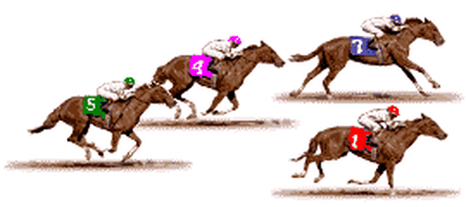
Horse racing Start!

Slide 2
You won the race!

Slide 3
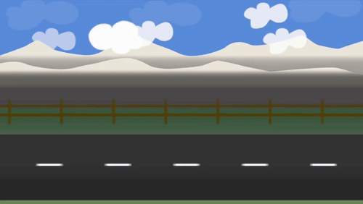
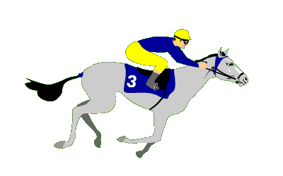
That girl owns it. It is ____.
hers
her
ours

Slide 4
It belongs to that boy. It is ____.
ours
hers
his

Slide 5
Is this pen ____?
yours
him
she

Slide 6
That's not yours, it's ____.
my
mine
your

Slide 7
Take this, it is ____.
you
yours
us

Slide 8
We have it, it's ____.
yours
ours
us

Slide 9
It belongs to them. It is ____.
ours
they
theirs

Slide 10
It is yours. It belongs to ___.
him
you
us

Slide 11
It is theirs. It belongs to ____.
them
him
we

Slide 12
It belongs to ___. It is hers.
theirs
his
her

Slide 13
It is his. It belongs to ___.
them
him
her

Slide 14
It is ours. It belongs to ___
we
us
yours

Slide 15
It is mine. It belongs to ___.
me
my
you

Slide 16
It is yours. It belongs to ___.
you
we
him

Slide 17
It is ours. It belongs to ___.
you
us
we

Slide 18
It belongs to me. It is ____.
yours
my
mine

Slide 19
It belongs to you. It is ____.
you
yours
ours

Slide 20
It belongs to us. It is ___.
ours
yours
we

Slide 21
It belongs to her. It is ___.
hers
his
she's

Slide 22
It belong to him. It is ___.
ours
hers
his

Slide 23
GAME OVER - YOU LOSE

