Slide 1
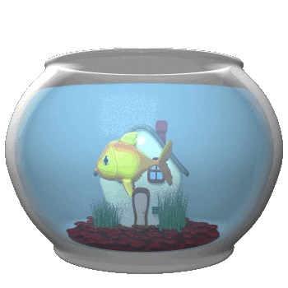
Living things!

Slide 2

Next

Slide 3
Next lesson

Slide 4

Next

Slide 5
Next lesson

Slide 6

Next

Slide 7
Next lesson

Slide 8

Next

