Slide 2
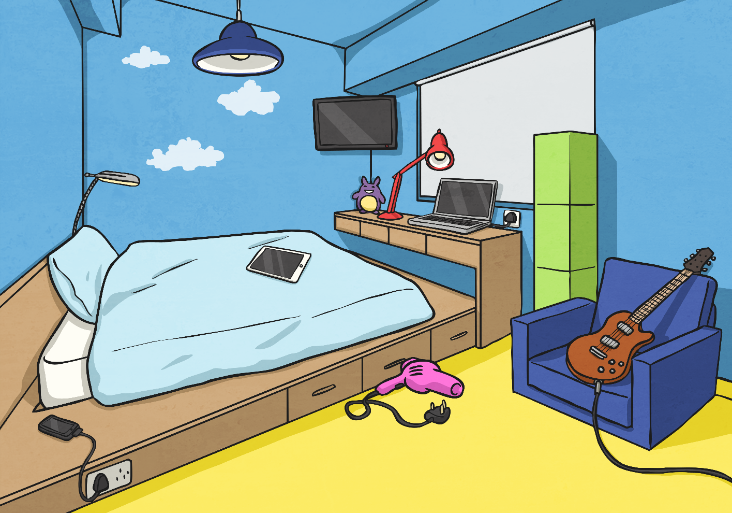
Where Is Everything?
Look at this bedroom scene. Talk to your partner and describe where everything is.

Slide 3
Where Is Everything?
Look at this bedroom scene. Talk to your partner and describe where everything is.
×
The lamp is in front of the window
2
×
3
The desk is under the window
×
4
1
The guitar is on the chair
×
The phone is next to the bed.

Slide 4
Preposition Mind Map
How many different words or phrases (prepositions) can you think of to describe time, place or movement?
across
under
before
below
at six o’clock
through
after
Prepositions
toward
on
in
above
beside
off
above
during
with

Slide 5
Preposition Or Not?
Keeping in mind that ‘a preposition is a word or phrase used to describe a place, time or movement’ sort the following words into the correct circles:
Prepositions
Not Prepositions
angry
before lunch
after school
and
under
through
threw
beside
decide
in

Slide 6
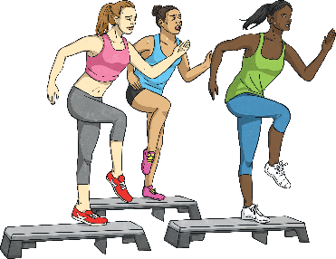
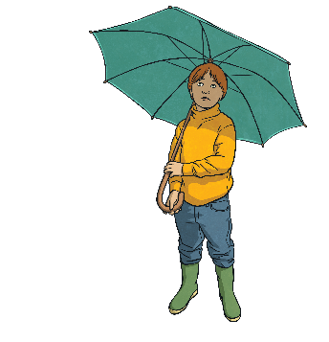
Preposition Or Not?
Read the sentences below and spot the preposition which describes the place, time or cause.
The scissors were left next to the pencil case.
The scissors were left next to the pencil case.
Hamid and Salma wrote in their books.
Hamid and Salma wrote in their books.
The ladies stepped on blocks.
The ladies stepped on blocks.
I sheltered beneath my umbrella.
I sheltered beneath my umbrella.

Slide 7
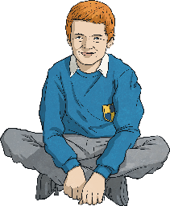
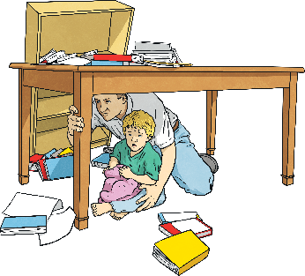
Add a Preposition
Read the sentences below and add a preposition which describes the place, time or cause.
above
The girl held her arms her head.
next to
Go and sit Stan.
Joe was the bath when the phone rang.
in
They hid the table an earthquake.
under
during

Slide 8
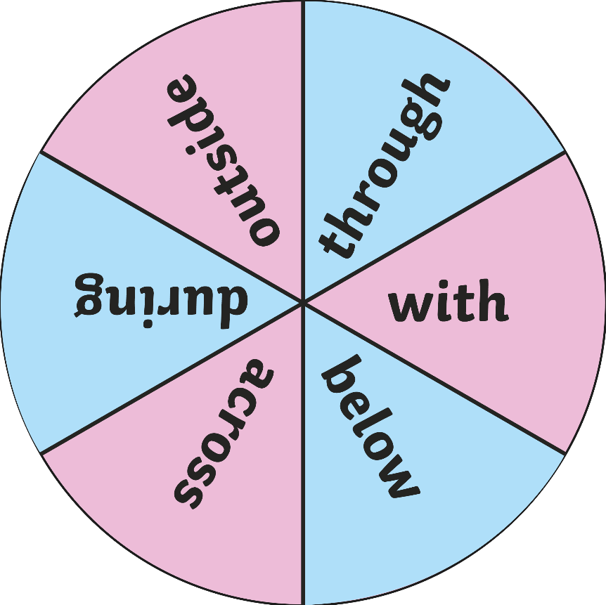
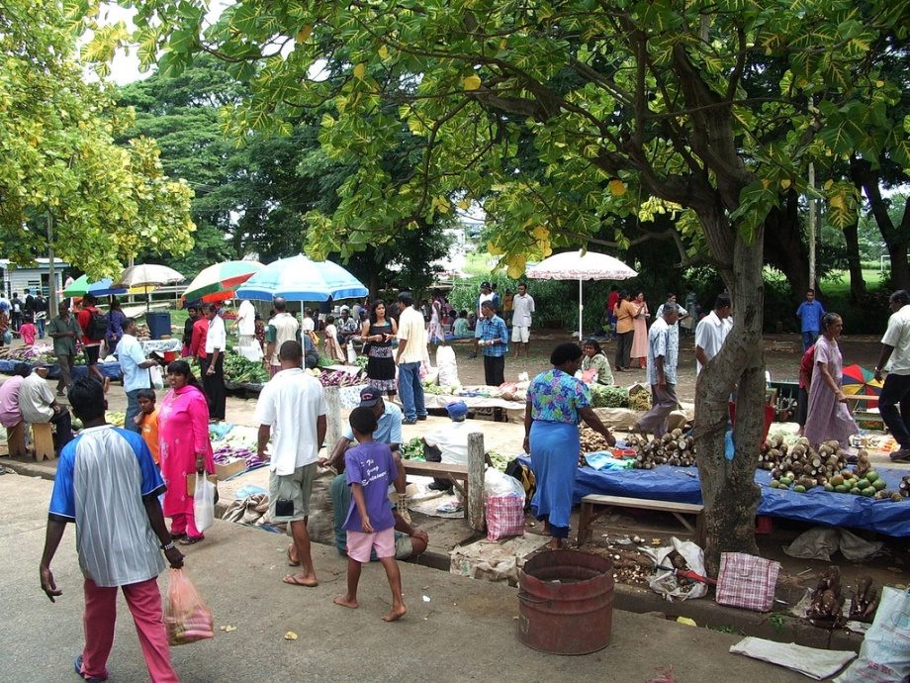
Add a Preposition
Spin the spinner to choose a preposition. On your whiteboards, write your own sentence about this picture to include that preposition.
Spin
Photo courtesy of jaredw_1986 (@flickr.com) - granted under creative commons licence – attribution

Slide 9
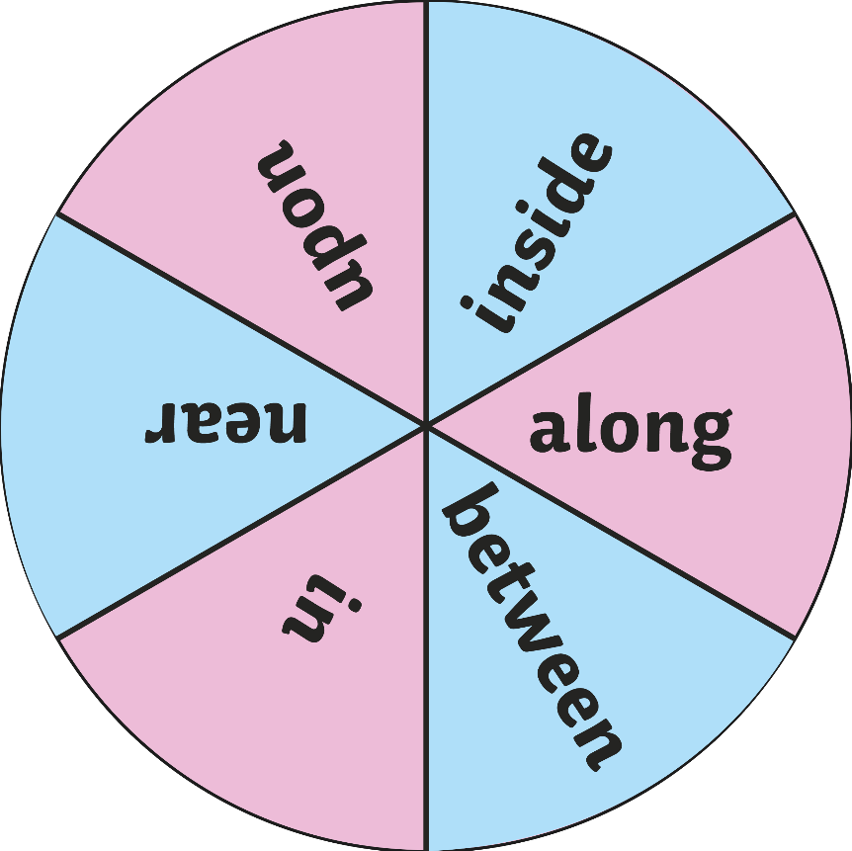
Add a Preposition
Spin the spinner to choose a preposition. On your whiteboards, write your own sentence about this picture to include that preposition.
Spin
Photo courtesy of exmoornp (@flickr.com) - granted under creative commons licence – attribution

Slide 10
The Preposition Police
Read the following passage of text. How many prepositions can you see? Write them on your whiteboard.
Could you change the prepositions to a different preposition and still have the sentence make sense?
Show answers
George took his dog Sally for a walk along the canal. Sally waited beside the road. They walked across the road. Together, they went through a tunnel and over a stile. George threw Sally’s ball toward the tall grass and it landed in the river. Sally swam through the water and dived underneath the surface to get the ball. She ran back to George and dropped the ball in front of him for another turn. She dropped it from her mouth when she returned next to him. After sunset, they went home and snuggled on the couch beneath a cosy blanket.
Hide answers
George took his dog Sally for a walk along the canal. Sally waited beside the road. They walked across the road. Together, they went through a tunnel and over a stile. George threw Sally’s ball toward the tall grass and it landed in the river. Sally swam through the water and dived underneath the surface to get the ball. She ran back to George and dropped the ball in front of him for another turn. She dropped it from her mouth when she returned next to him. After sunset, they went home and snuggled on the couch beneath a cosy blanket.

Slide 11
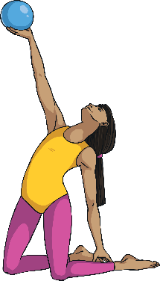
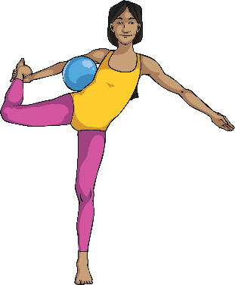
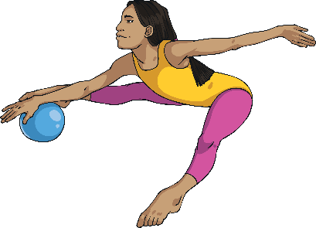
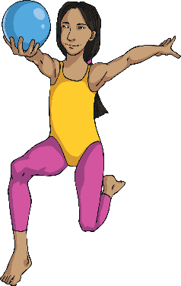
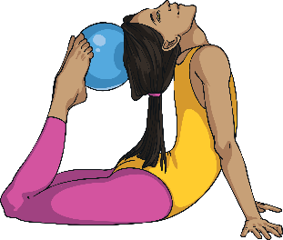
It’s Your Turn
Look at the pictures below. Write a sentence to go with each picture, using a different preposition each time.
Share your sentences with a partner.

