Slide 1
Stop the monsters
Past tense

Slide 2
I haven't got ____ left!
any
some
none

Slide 3
Would you like ___ water?
many
some
many

Slide 4
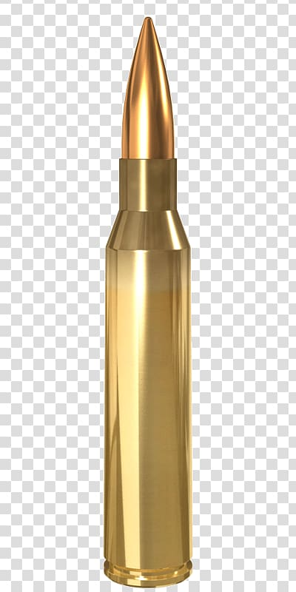
Have we got ____ water?
eat
any
many

Slide 5
He has ____ money in his pocket.
any
some
many

Slide 6
There were so _____ birds!
many
any
some

Slide 7
It didn't cost ____ money.
many
some
much

Slide 8
I haven't got ___thing!
some
much
any

Slide 9
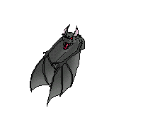
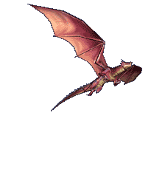
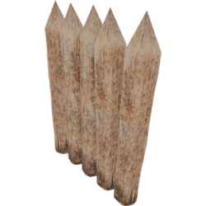
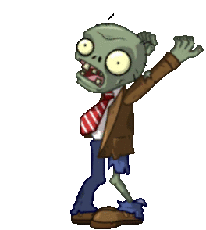
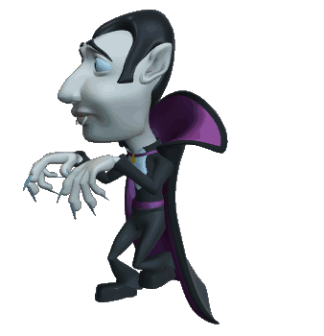
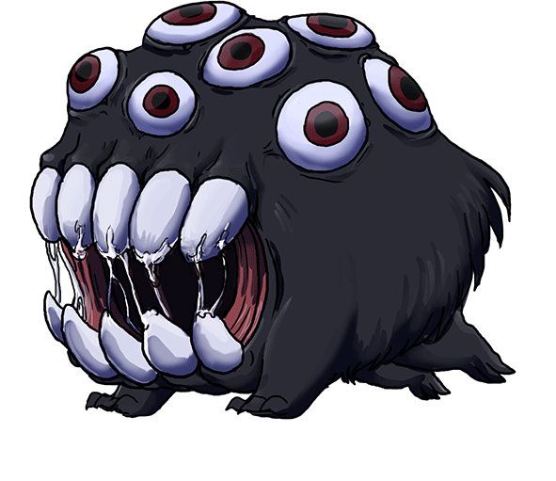
Shoot the monsters!

Slide 10
You lose!

Slide 11
You win

Slide 12
Can I have ____ more?
some
many
much

Slide 13
There weren't ___ left.
none
any
much

Slide 14
There was too ____ water!
some
much
many

Slide 15
How ____10's are in 100?
much
many
any

Slide 16
I didn't get ____ sleep last night!
any
many
some

Slide 17
There was ____ sand in my shoes!
many
any
some

Slide 18
I didn't really do ____.
some
any
much

Slide 19
You win!

Slide 20
Shoot the monsters!

