Slide 1
Stop the monsters
Past tense

Slide 2
I ____ to the park yesterday
went
goed
gone

Slide 3
I ____ a bird this morning
seeing
saw
sees

Slide 4
I ____ a whole pizza to myself!
eated
ate
eating

Slide 5
I didn't _____ to class yesterday.
going
go
went

Slide 6
I didn't ___ the movie.
like
likes
liked

Slide 7
I really___ this book.
enjoyt
enjoys
enjoyed

Slide 8
It _____ over a wall
jump
jumps
jumped

Slide 9
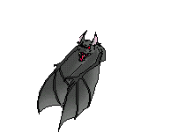
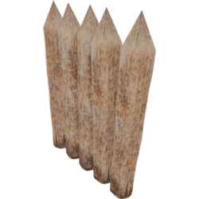
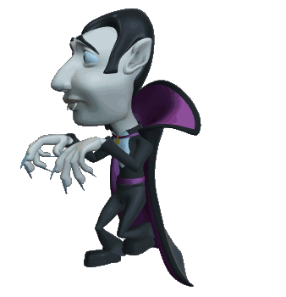
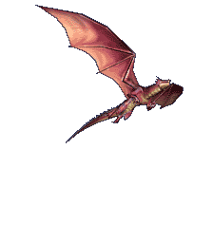
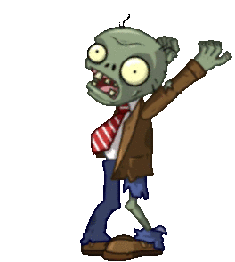
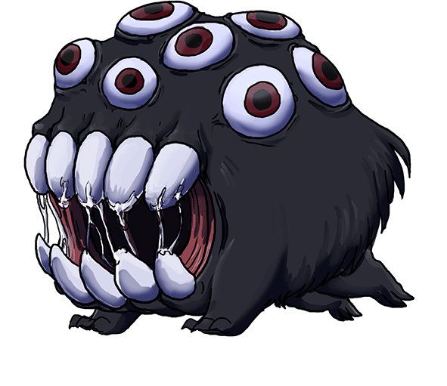
Shoot the monsters!

Slide 10
You lose!

Slide 11
You win

Slide 12
I ____ at the park yesterday
was
were
weren't

Slide 13
We ____ on holiday last year
goed
were
was

Slide 14
I ___ down the road this morning
runned
ran
running

Slide 15
I ____ all last night
sleeped
slept
sleepy

Slide 16
I _____ in last night
stayed
watch TV
stayt

Slide 17
I ____ the game
winned
wins
won

Slide 18
I couldn't ____ it
was
did
do

Slide 19
You win!

Slide 20
Shoot the monsters!

