Slide 1
Stop the monsters
Was/ Were

Slide 2
I ___ hungry yesterday.
was
were
weren't

Slide 3
We ____ tired last week.
wasn't
were
was

Slide 4
No, it ____ hard. It was easy!
weren't
wasn't
was

Slide 5
They ____ running, they were walking.
wasn't
weren't
was

Slide 6
John ____ happy!
was
were
weren't

Slide 7
The children ____ very smart.
wasn't
was
were

Slide 8
The students _____ listening!
wasn't
was
weren't

Slide 9
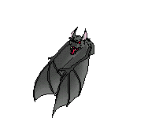
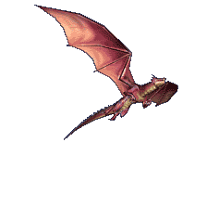
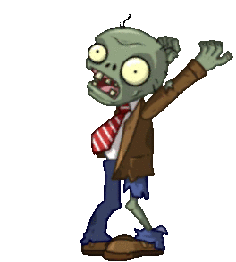
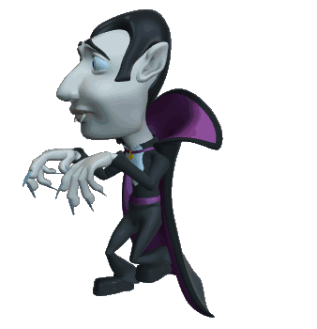
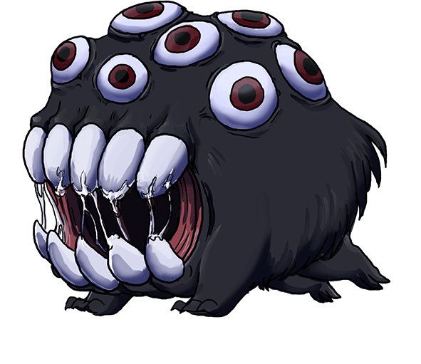
Shoot the monsters!

Slide 10
You lose!

Slide 11
You win

Slide 12
The dogs ___ barking
weren't
wasn't
was

Slide 13
The cat ____ meowing!
to
was
were

Slide 14
We ____ running towards it.
wasn't
were
was

Slide 15
Both of them ____ laughing!
wasn't
were
was

Slide 16
The people _____ hungry, we had eaten already!
weren't
were
was

Slide 17
I ____ a little worried!
were
weren't
was

Slide 18
They ____ smiling at the view.
wasn't
was
were

Slide 19
Shoot the monsters!

Slide 20
You win!

