Slide 1
Stop the zombies!
Start

Slide 2
GAME OVER!

Slide 3
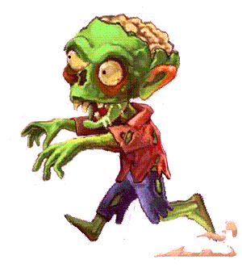
___ you speak any foreign languages?
May
Can
Have
Next

Slide 4
Liz ___ get tired of her job. It is so boring.
must
has to
should to
Next

Slide 5
Where's Nick? He ___ be in his office.
is to
mustn't to
might
Next

Slide 6
Take an umbrella. It ___ rain later.
need
might
has to
Next

Slide 7
Jack ___ go to hospital yesterday.
must
may
had to
Next

Slide 8
You look tired. You ___ go to bed.
should
ought
are to
Next

Slide 9
You ___ do it. I've already done it.
need not
must
may to
Next

Slide 10
___ it be true?
must
can
ought
Next

Slide 11
GAME OVER!

Slide 12
Level 2
Start

Slide 13
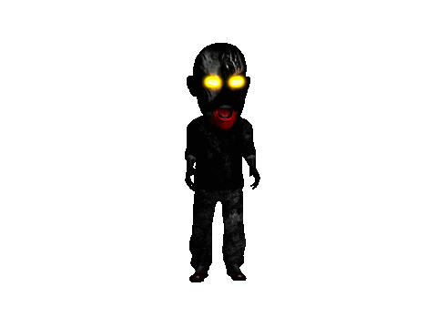
___ we stay or leave?
might
shall
can to
Next

Slide 14
Jane was so tired. She ___ have worked days and nights.
must
should
has
Next

Slide 15
wrong answer
wrong answer
Right answer
Next

Slide 16
Kate ____ swim very well, she is a great swimmer.
must
can
musn't
Next

Slide 17
You ______ wash dishes in cold water.
don't have to
may
shouldn't
Next

Slide 18
She ___ play the piano well. She is a musician.
can
ought
can't
Next

Slide 19
The doctor told him that he _ eat less. He’s too fat.
needs to
can't
,ustn't
Next

Slide 20
You ____ swim here; it's not allowed!
can
can't
should
Next

Slide 21
GAME OVER!

