Slide 1
Stop the zombies!
Start

Slide 2
GAME OVER!

Slide 3
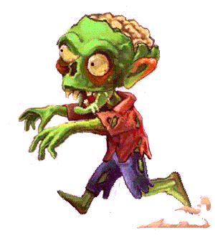
Where are you ____?
doing?
going?
go
Next

Slide 4
The horse was ____ over the fence.
jumping
jumped
jumps
Next

Slide 5
We were ____ pizza.
eated
ate
eating
Next

Slide 6
Sorry, what were you _____?
said?
saying?
saiding?
Next

Slide 7
He ____ sleeping.
was to
were
was
Next

Slide 8
We ___ eating noodles.
were
was
am
Next

Slide 9
You ___ running too fast!
were
was
wasn't
Next

Slide 10
He was ____ rude.
saying
being
doing
Next

Slide 11
GAME OVER!

Slide 12
Level 2
Start

Slide 13
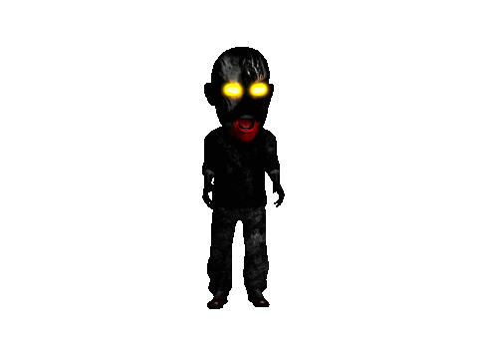
The car ___ ___ around
was turn
was turning
were turning
Next

Slide 14
She ___ _______ because she was happy.
was smiling
was smile
were smiling
Next

Slide 15
They ____ swimming quickly.
wasn't
was
were
Next

Slide 16
I ____ singing. I can't sing!
weren't
wasn't
was
Next

Slide 17
He was walking. He _____ ______.
weren't running
was walked
wasn't running
Next

Slide 18
They ___ _____ the piano really well.
were playing
was play
wasn't play
Next

Slide 19
Was he _____ football?
playing
play
running
Next

Slide 20
Were you _____ yesterday?
walked
walking
walks
Next

Slide 21
GAME OVER!

