Slide 1
Stop the zombies!
Start

Slide 2
GAME OVER!

Slide 3
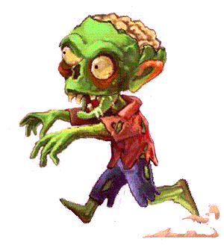
Jason and Jared took their bikes with ____.
they
them
this
Next

Slide 4
Please don't jiggle the book while I'm trying to read _____
it
us
them
Next

Slide 5
_____ were busy getting ready for Emily's party.
those
this
we
Next

Slide 6
_ was doing it on my own.
we
I
they
Next

Slide 7
___ did well today.
her
him
You
Next

Slide 8
It belongs to ___.
him
he
she
Next

Slide 9
It wasn't me, it was ___!
her
she
it
Next

Slide 10
Were ____ at home yesterday?
he
they
she
Next

Slide 11
GAME OVER!

Slide 12
Level 2: Sudden death!
Start

Slide 13
It belongs to her. It is ____.
she
hers
her
Next

Slide 14
GAME OVER!

Slide 15
It belongs to him. It is ___.
hers
hims
his
Next

Slide 16
GAME OVER!

Slide 17
The dog is chewing ___ bone
it's
hers
he
Next

Slide 18
GAME OVER!

Slide 19
___ didn't sleep last night.
she
her
him
Next

Slide 20
GAME OVER!

Slide 21
__ is here!
he
he's
him
Next

Slide 22
You win.

