Slide 1
Stop the zombies!
Start

Slide 2
GAME OVER!

Slide 3
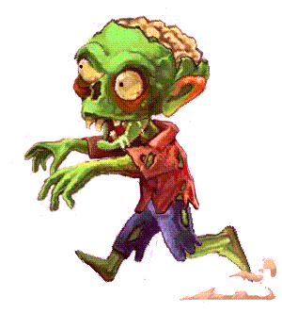
The swan is ____ ____ ____ the duck.
most beautiful
more beautiful than
so beautiful as
Next

Slide 4
The pigeon is ____ ____ ____ the parrot.
less colourful than
as colourful as
not colourful than
Next

Slide 5
It was ___ ____ ____ thing I've ever seen!
most amazing than
more amazing than
the most amazing
Next

Slide 6
He is ___ ____ _____ public speaker
as good as
the most incredible
more better than
Next

Slide 7
The vegetables are ___ ____ ____ the meat.
as yummy than
most tastiest
more delicious than
Next

Slide 8
They are the same height. He is __ ____ __ her.
as tall as
bigger than
smaller than
Next

Slide 9
This was the ___ ______ invention of the 20th century.
most ingenious
more clever
most best
Next

Slide 10
He is the ____ ______ man I have ever met.
best liar
most insidious
quite deceptive
Next

Slide 11
GAME OVER!

Slide 12
Level 2
Start

Slide 13
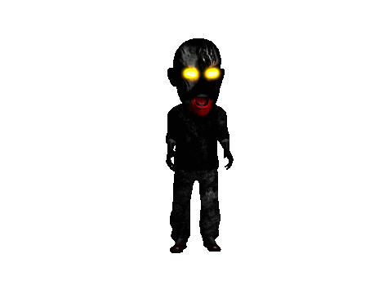
I find Shakespeare ____ ______ than Chaucer.
most inciteful
more inciteful
as incitefulest
Next

Slide 14
This test is ____ ____ ______.
the most difficult
the most harder
the hard
Next

Slide 15
Going out is ____ ____ than staying in.
less fun as
as fun
more fun
Next

Slide 16
He was so bad; he was ___ _____!
as bad
the worst
the baddest.
Next

Slide 17
I am feeling ____ _____ now, thank you!
the best than
as better
much better
Next

Slide 18
They are both __ _____ __ eachother.
as funny as
much funnier than
funny than
Next

Slide 19
I find this painting ____ _______ than that one.
more inspiring
most betterly
as better than
Next

Slide 20
She is ___ _____ __________ person I know.
most kindest person
the most kind-hearted
the most kindest
Next

Slide 21
GAME OVER!

