Slide 1
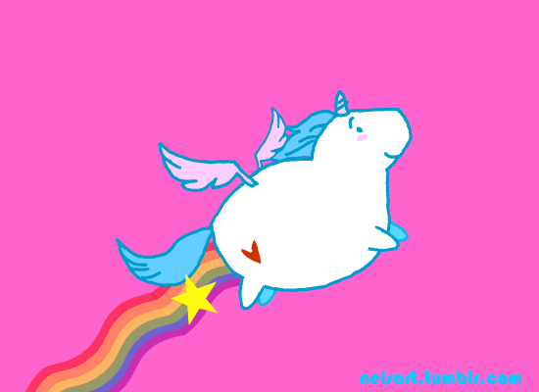
Unicorn racing Start!

Slide 2
You won the race!

Slide 3
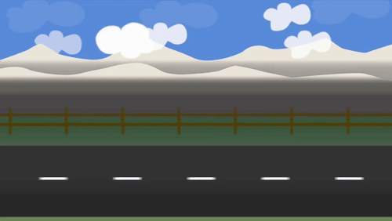
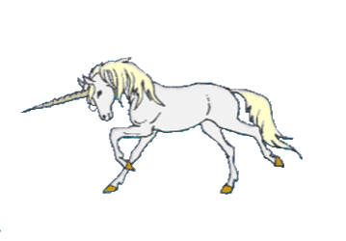
When I ____the clown, I was laughing.
saw
was see
seeing

Slide 4
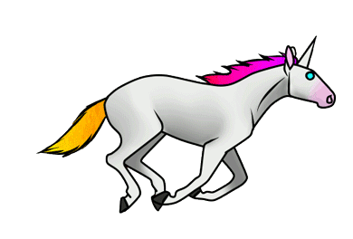
I ____ a scary dog and started screaming.
was see
saw
seeing

Slide 5
I saw some food, so I started _____ it.
eats
ate
eating

Slide 6
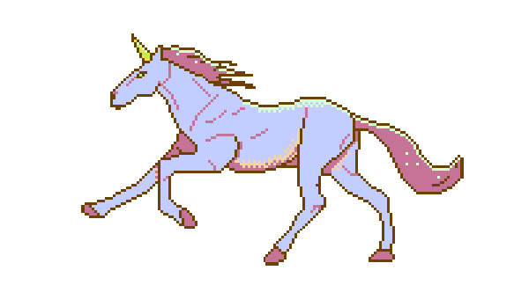
When I saw the clown, I was ______.
laughing
laugh
laughed

Slide 7
I saw a scary dog and started _______.
screams
screaming
screamed

Slide 8
I stopped ______ when I saw the mosnter.
eats
eating
ate

Slide 9
I was _____ and dancing at the same time.
sing
singing
sang

Slide 10
I ____ getting bored, but they ____ having fun.
am/am
is/are
was/were

Slide 11
He was running, while she was _______.
walked
walking
ran

Slide 12
I was ________ and dreaming.
sleeping
slept
sleeps

Slide 13
The unicorns were ______ quickly.
raced
is
racing

Slide 14
The pink fluffy unicorns were _______ on rainbows.
was dance
dancing
dance

Slide 15
I ____ eating a sandwich and thinking.
am
was
we

Slide 16
John and Ben _____ racing their unicorns.
were
was
are

Slide 17
They ____ jumping and shouting.
were
was
is

Slide 18
He ____ running and jumping.
were
was
am

Slide 19
We ____ singing and dancing
is
was
were

Slide 20
I ____ walking to school when I saw a bird.
were
was
am

Slide 21
YOU LOSE. NOW YOUR UNICORN IS SAD.

