Slide 1
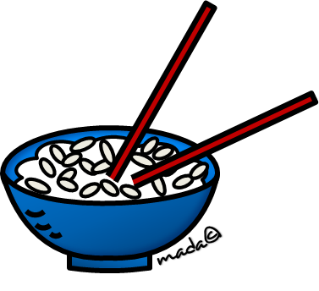
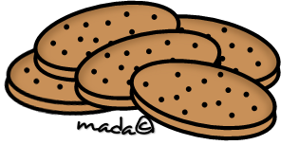
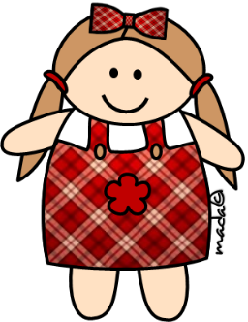
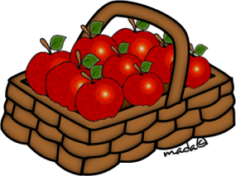
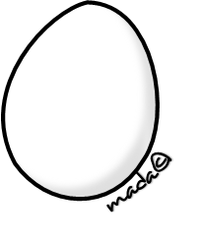
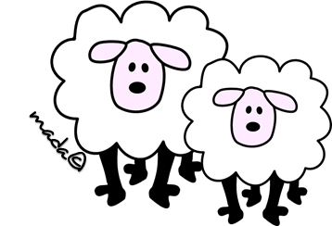
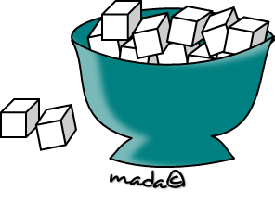

Slide 2
a
an
some
these
_____ bread
many

Slide 3
a
an
some
those
_____ apple
much

Slide 4
a
an
these
much
_____ cheese
many

Slide 5
a
an
these
much
_____ doll
some

Slide 6
much
many
that
an
_____ watering
pot
these

Slide 7
a
an
this
that
_____ biscuits
many

Slide 8
a
an
any
those
_____ jam
these

Slide 9
this
these
that
a
_____ plates
much

Slide 10
a
little
those
few
_____ rice
an

Slide 11
this
that
a
some
_____ sheep
much

Slide 12
little
few
an
_____
strawberries
a
much

Slide 13
a
an
those
some
_____ egg
many

Slide 14
ce
this
a
some
many
_____ juice
few
Notes:
‹#›

Slide 15
an
that
any
much
_____ lemon
some

Slide 16
ch
much
many
a
an
_____ butter
those

Slide 17
an
many
these
a
_____ sugar
little

