Slide 1
The big picture
Unit 1 Listening

Slide 2
Word Circle!
The first person says a word.
The next person must say a word that begins with the last letter of the last word.
If a person says a word that begins and ends with the same letter, we go backwards… (songs, tent, Eve, etc)

Slide 3
“Which one is…?”
Look at the picture, guess the answer

Slide 4
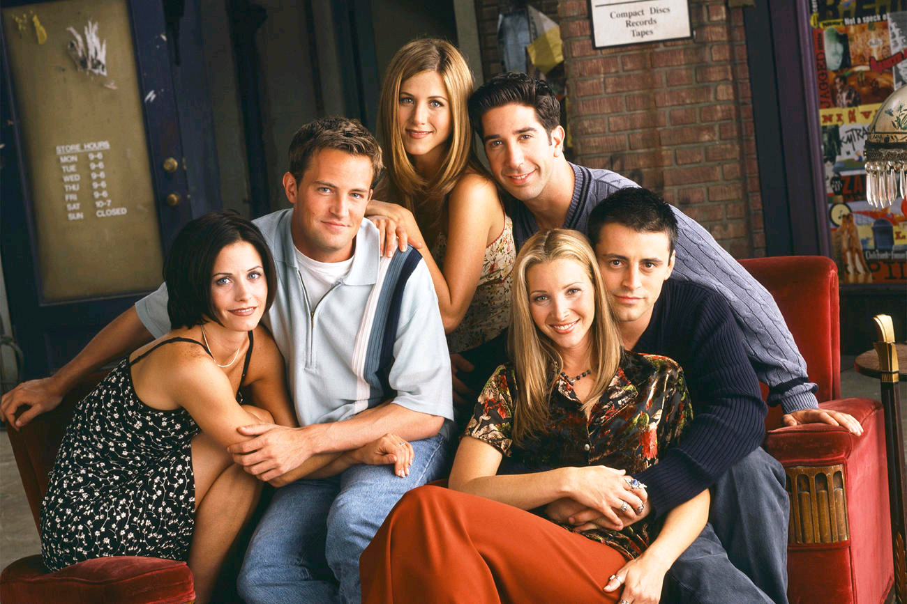
Which one is Phoebe?
She’s the one with the orange trousers

Slide 5
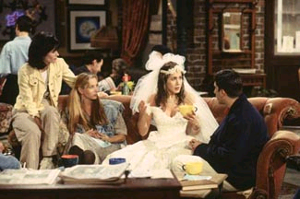
Which one is Rachel?
She’s the one in the wedding dress

Slide 6
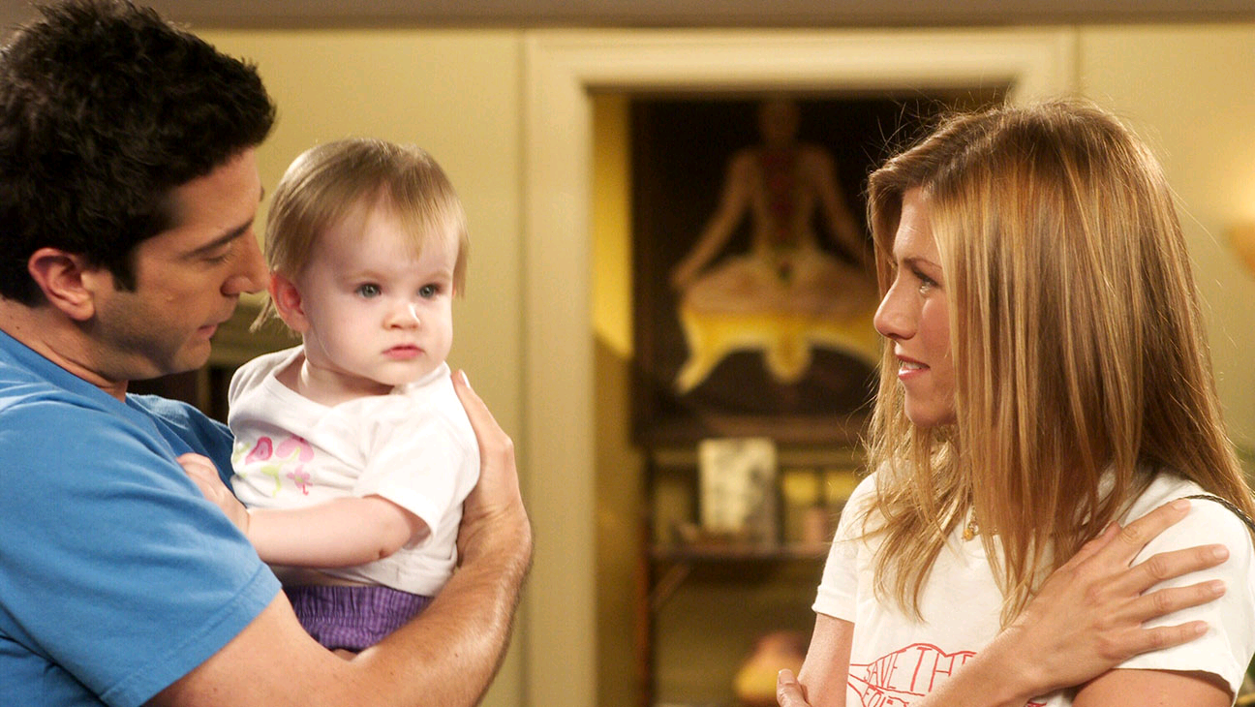
Which one is Ross?
He’s the one who’s holding the baby

Slide 7
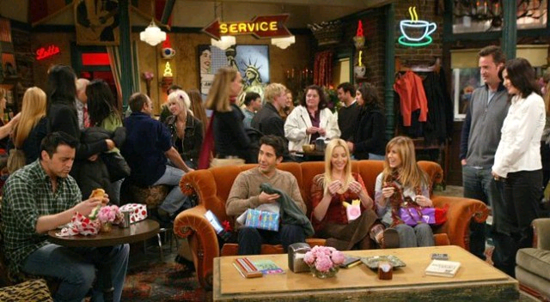
Which ones are your friends?
They’re the ones at the coffee shop

Slide 8
Which ones are your friends?
They’re the ones who are laughing

Slide 9
Ask & answer
WITH YOUR PARTNER

Slide 10
A: Which ones are your friends?
B: They're the _________ wearing baseball caps.

Slide 11
Is your sister the girl ________ is laughing?

Slide 12
A: Which one is Jeff?
B: He's the ______ wearing blue jeans.

Slide 13
A: Which one is Amy?
B: She's the one _____holding a camera.

Slide 14
A: ________ Kate like?
B: She's very talkative!

Slide 15
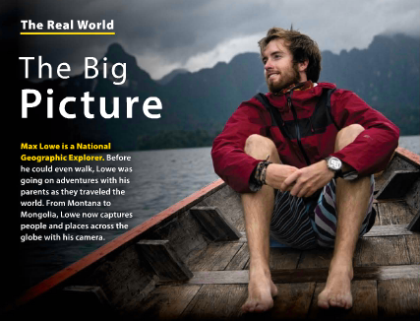

Slide 16
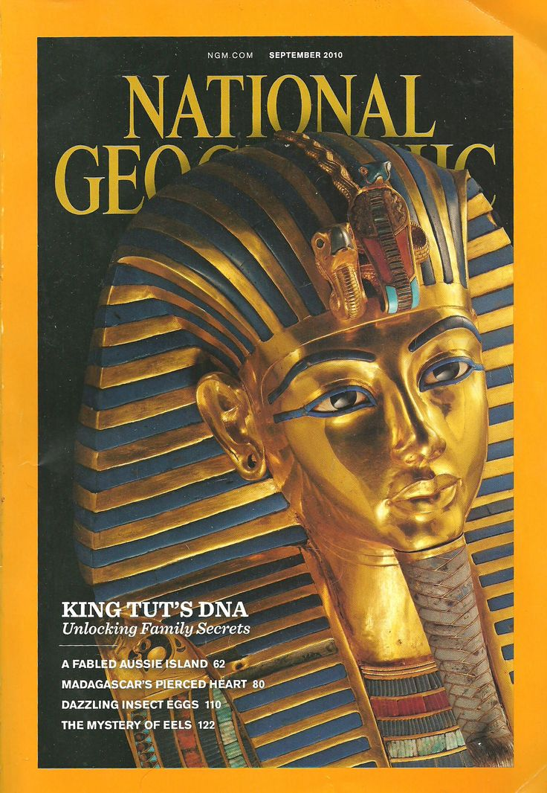
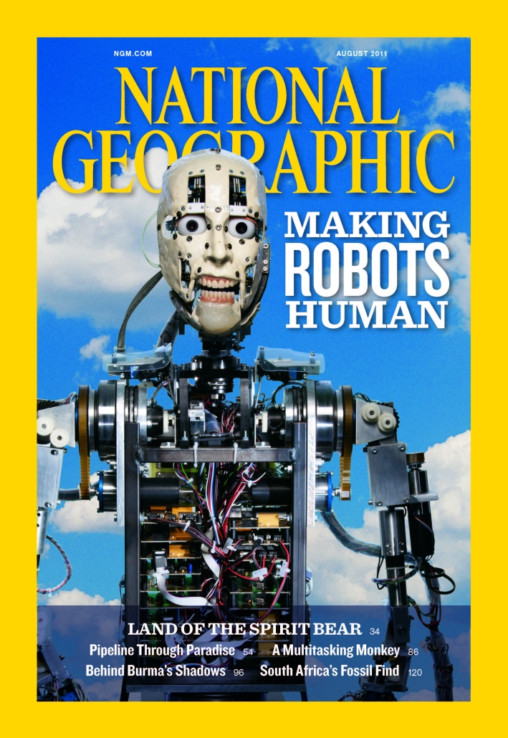
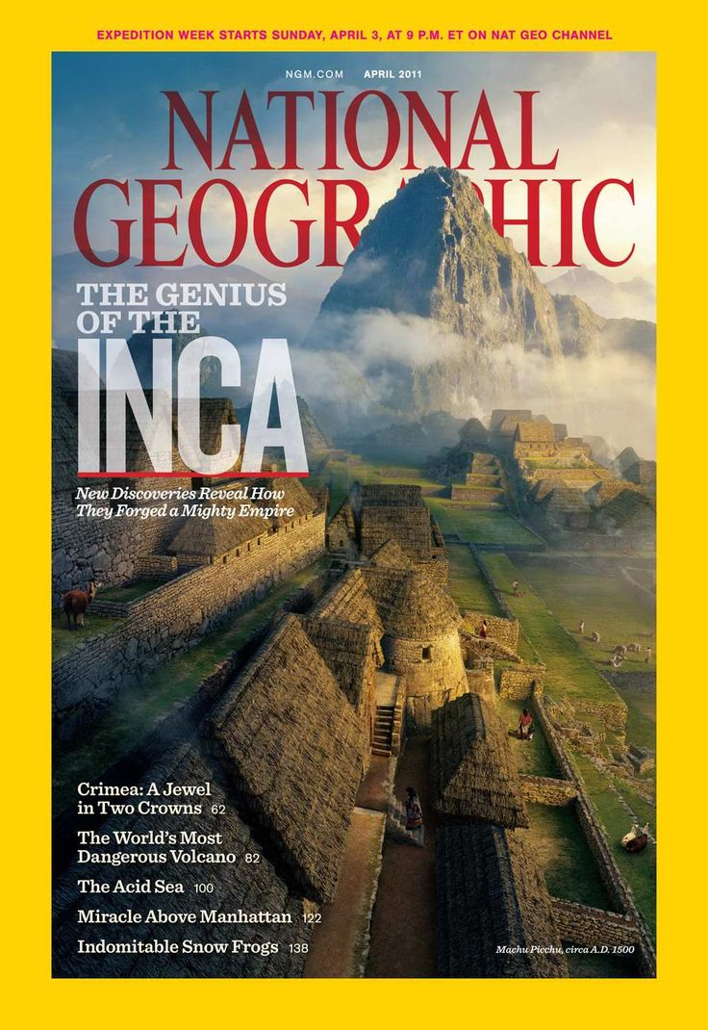

Slide 17
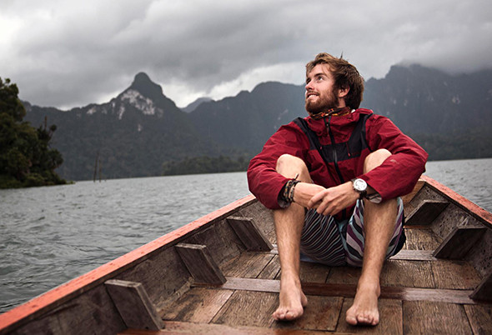

Slide 18
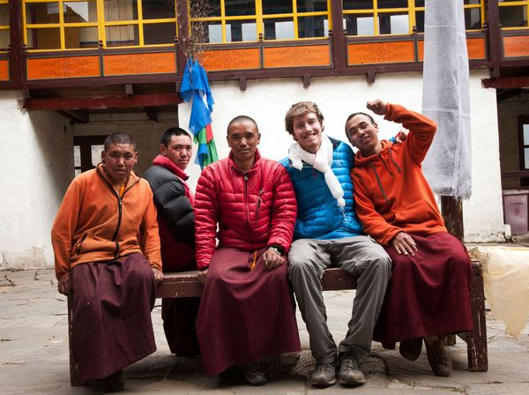

Slide 19
Back to the boards - drawing dictation!
Look at these pictures taken by Max Lowe. Describe what you see to your partner, they must try to draw the photo!

Slide 20
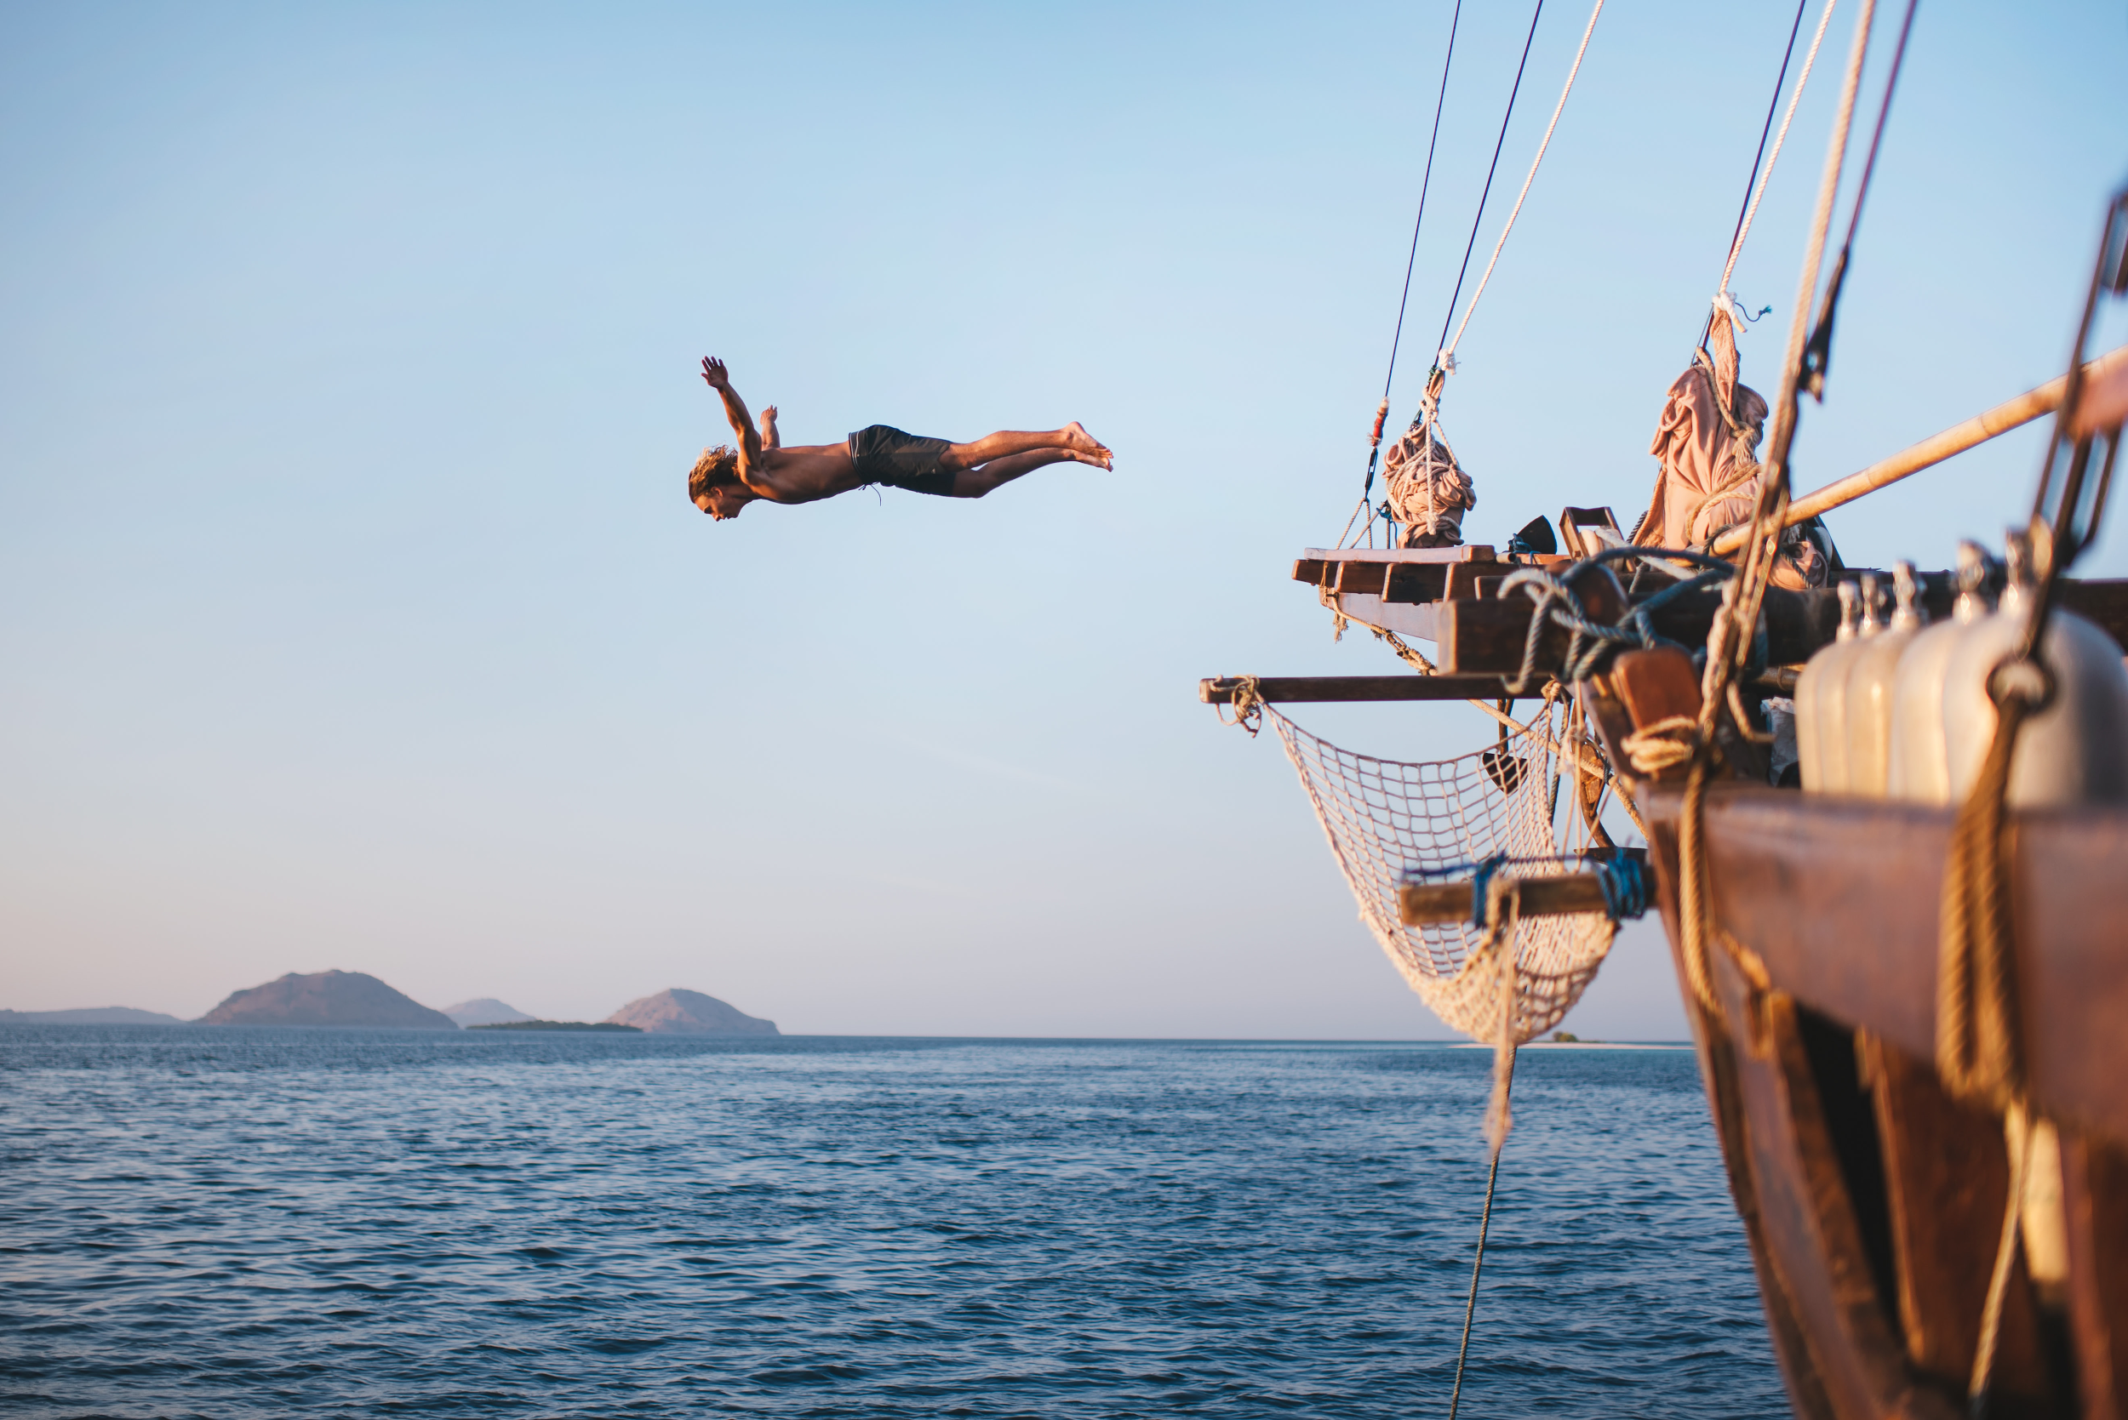

Slide 21
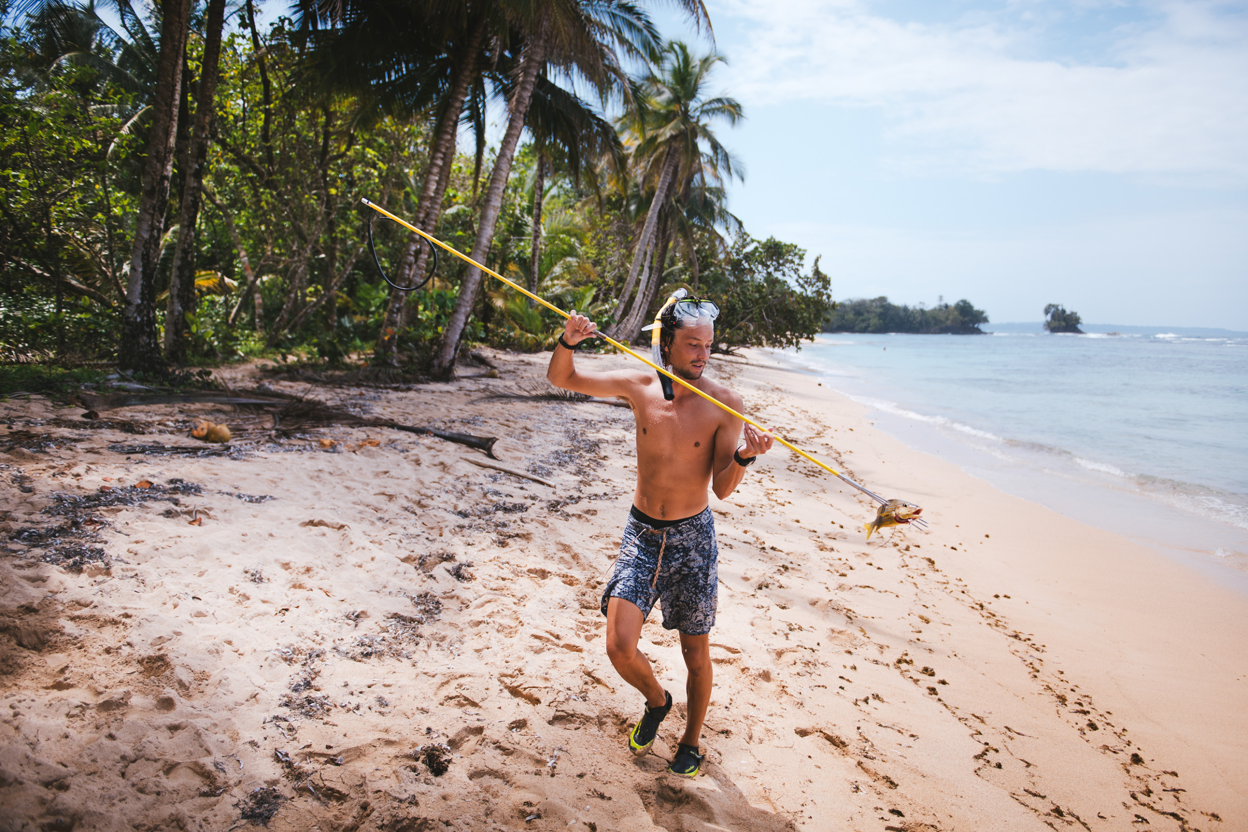

Slide 22
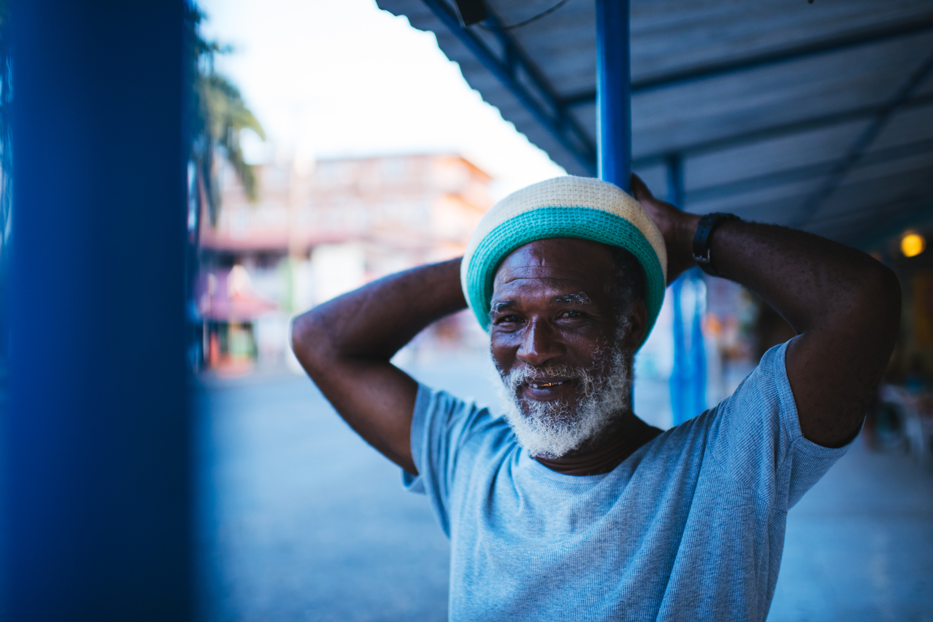

Slide 23
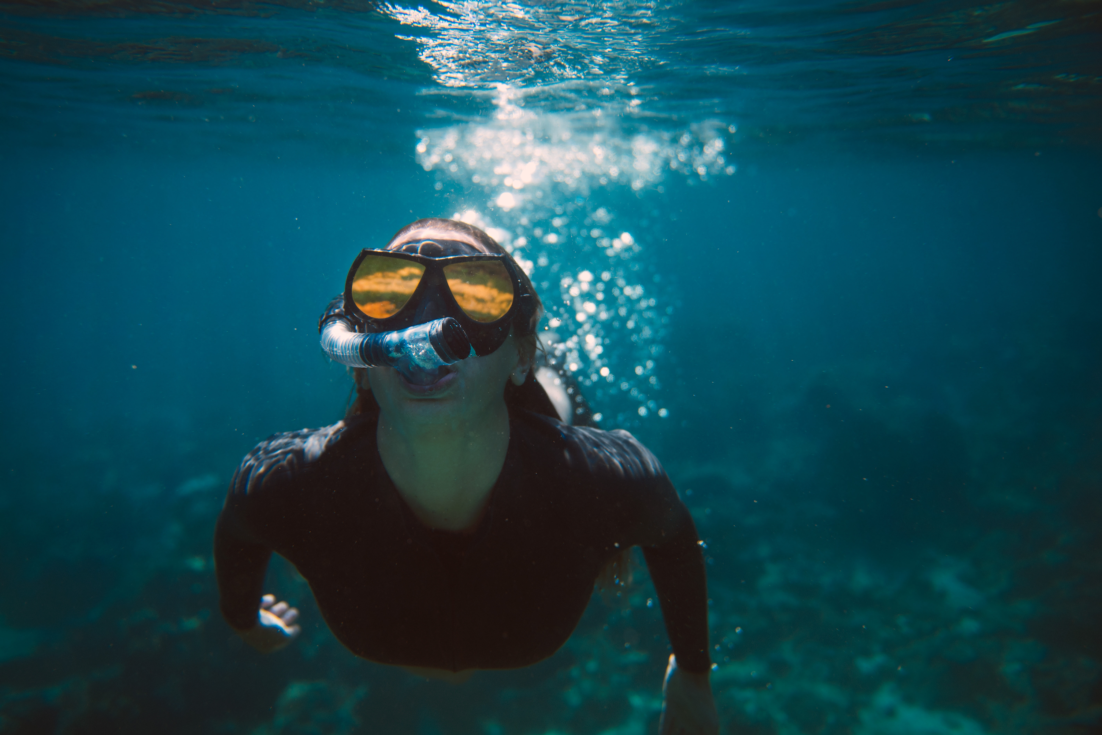

Slide 24
Describe the photo’s together with your partner :)

Slide 25
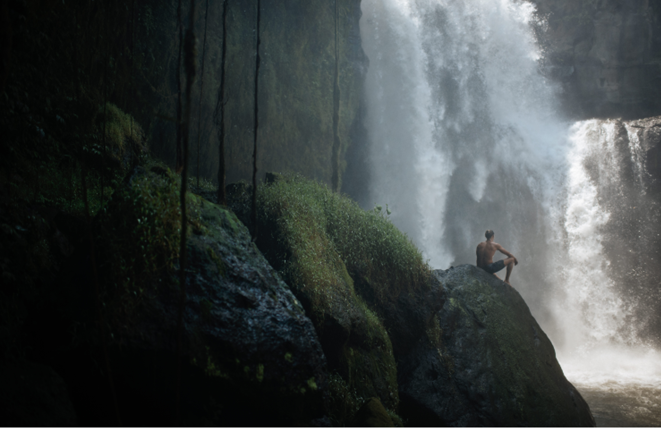

Slide 26
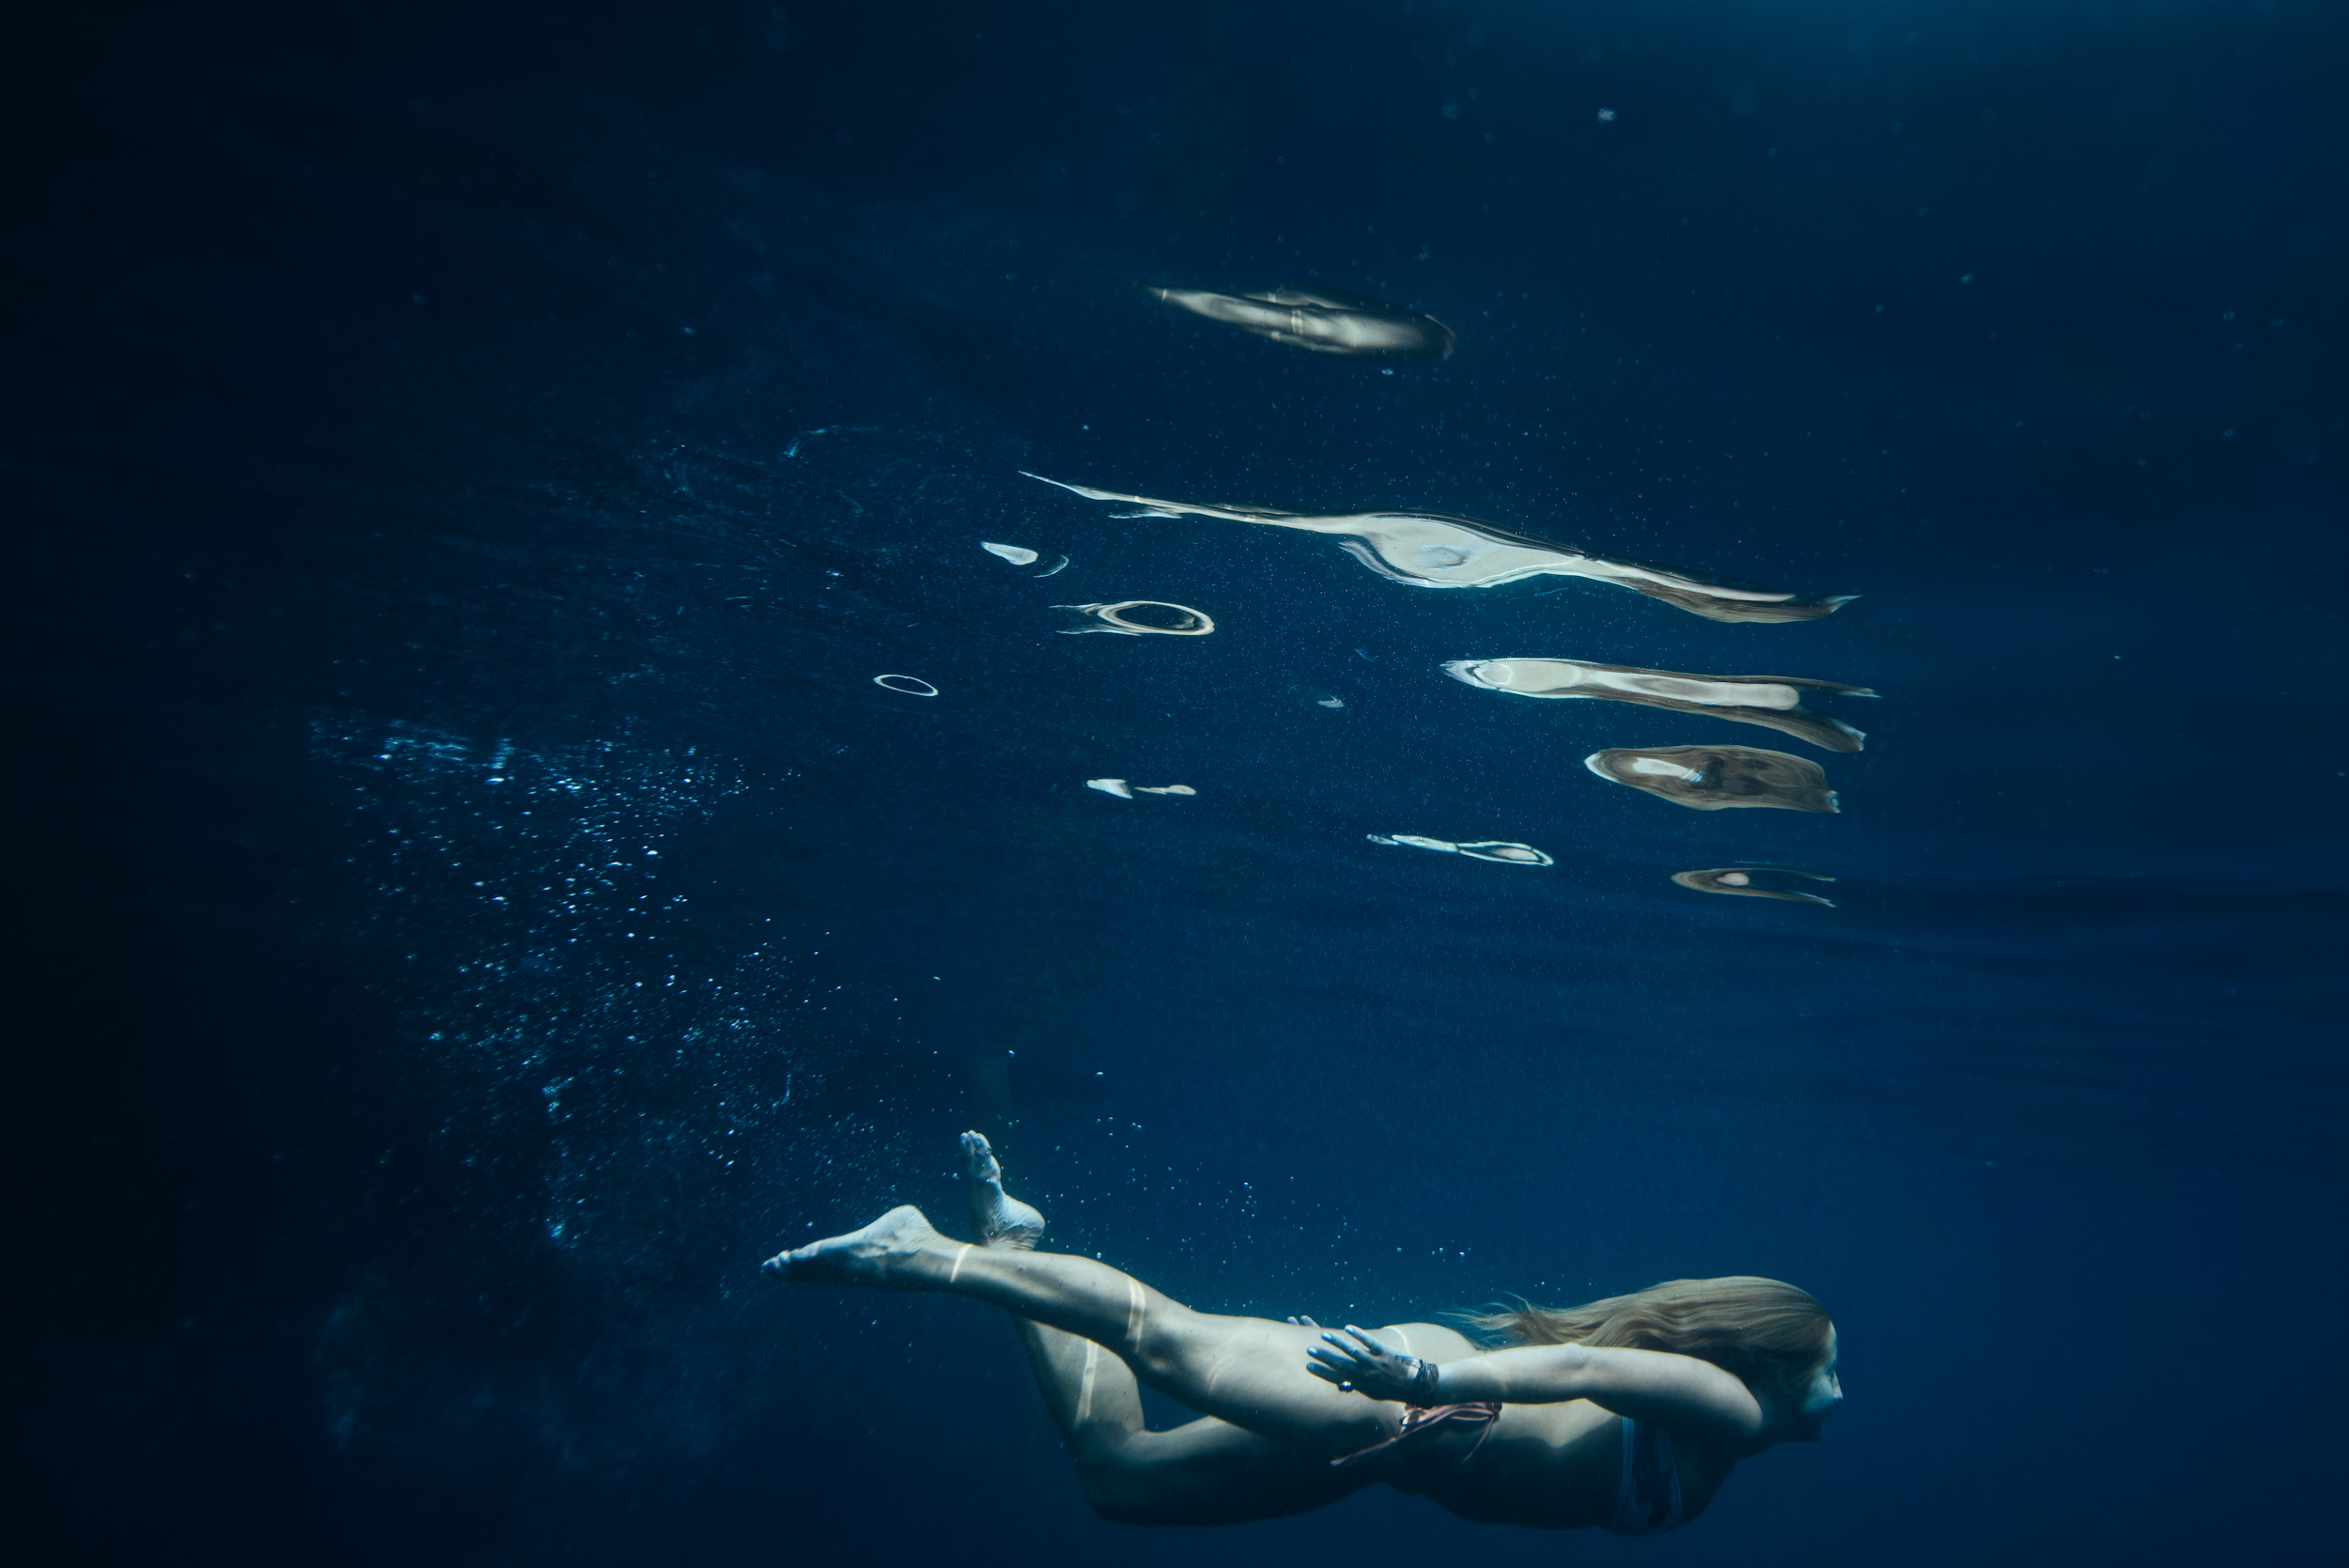

Slide 27
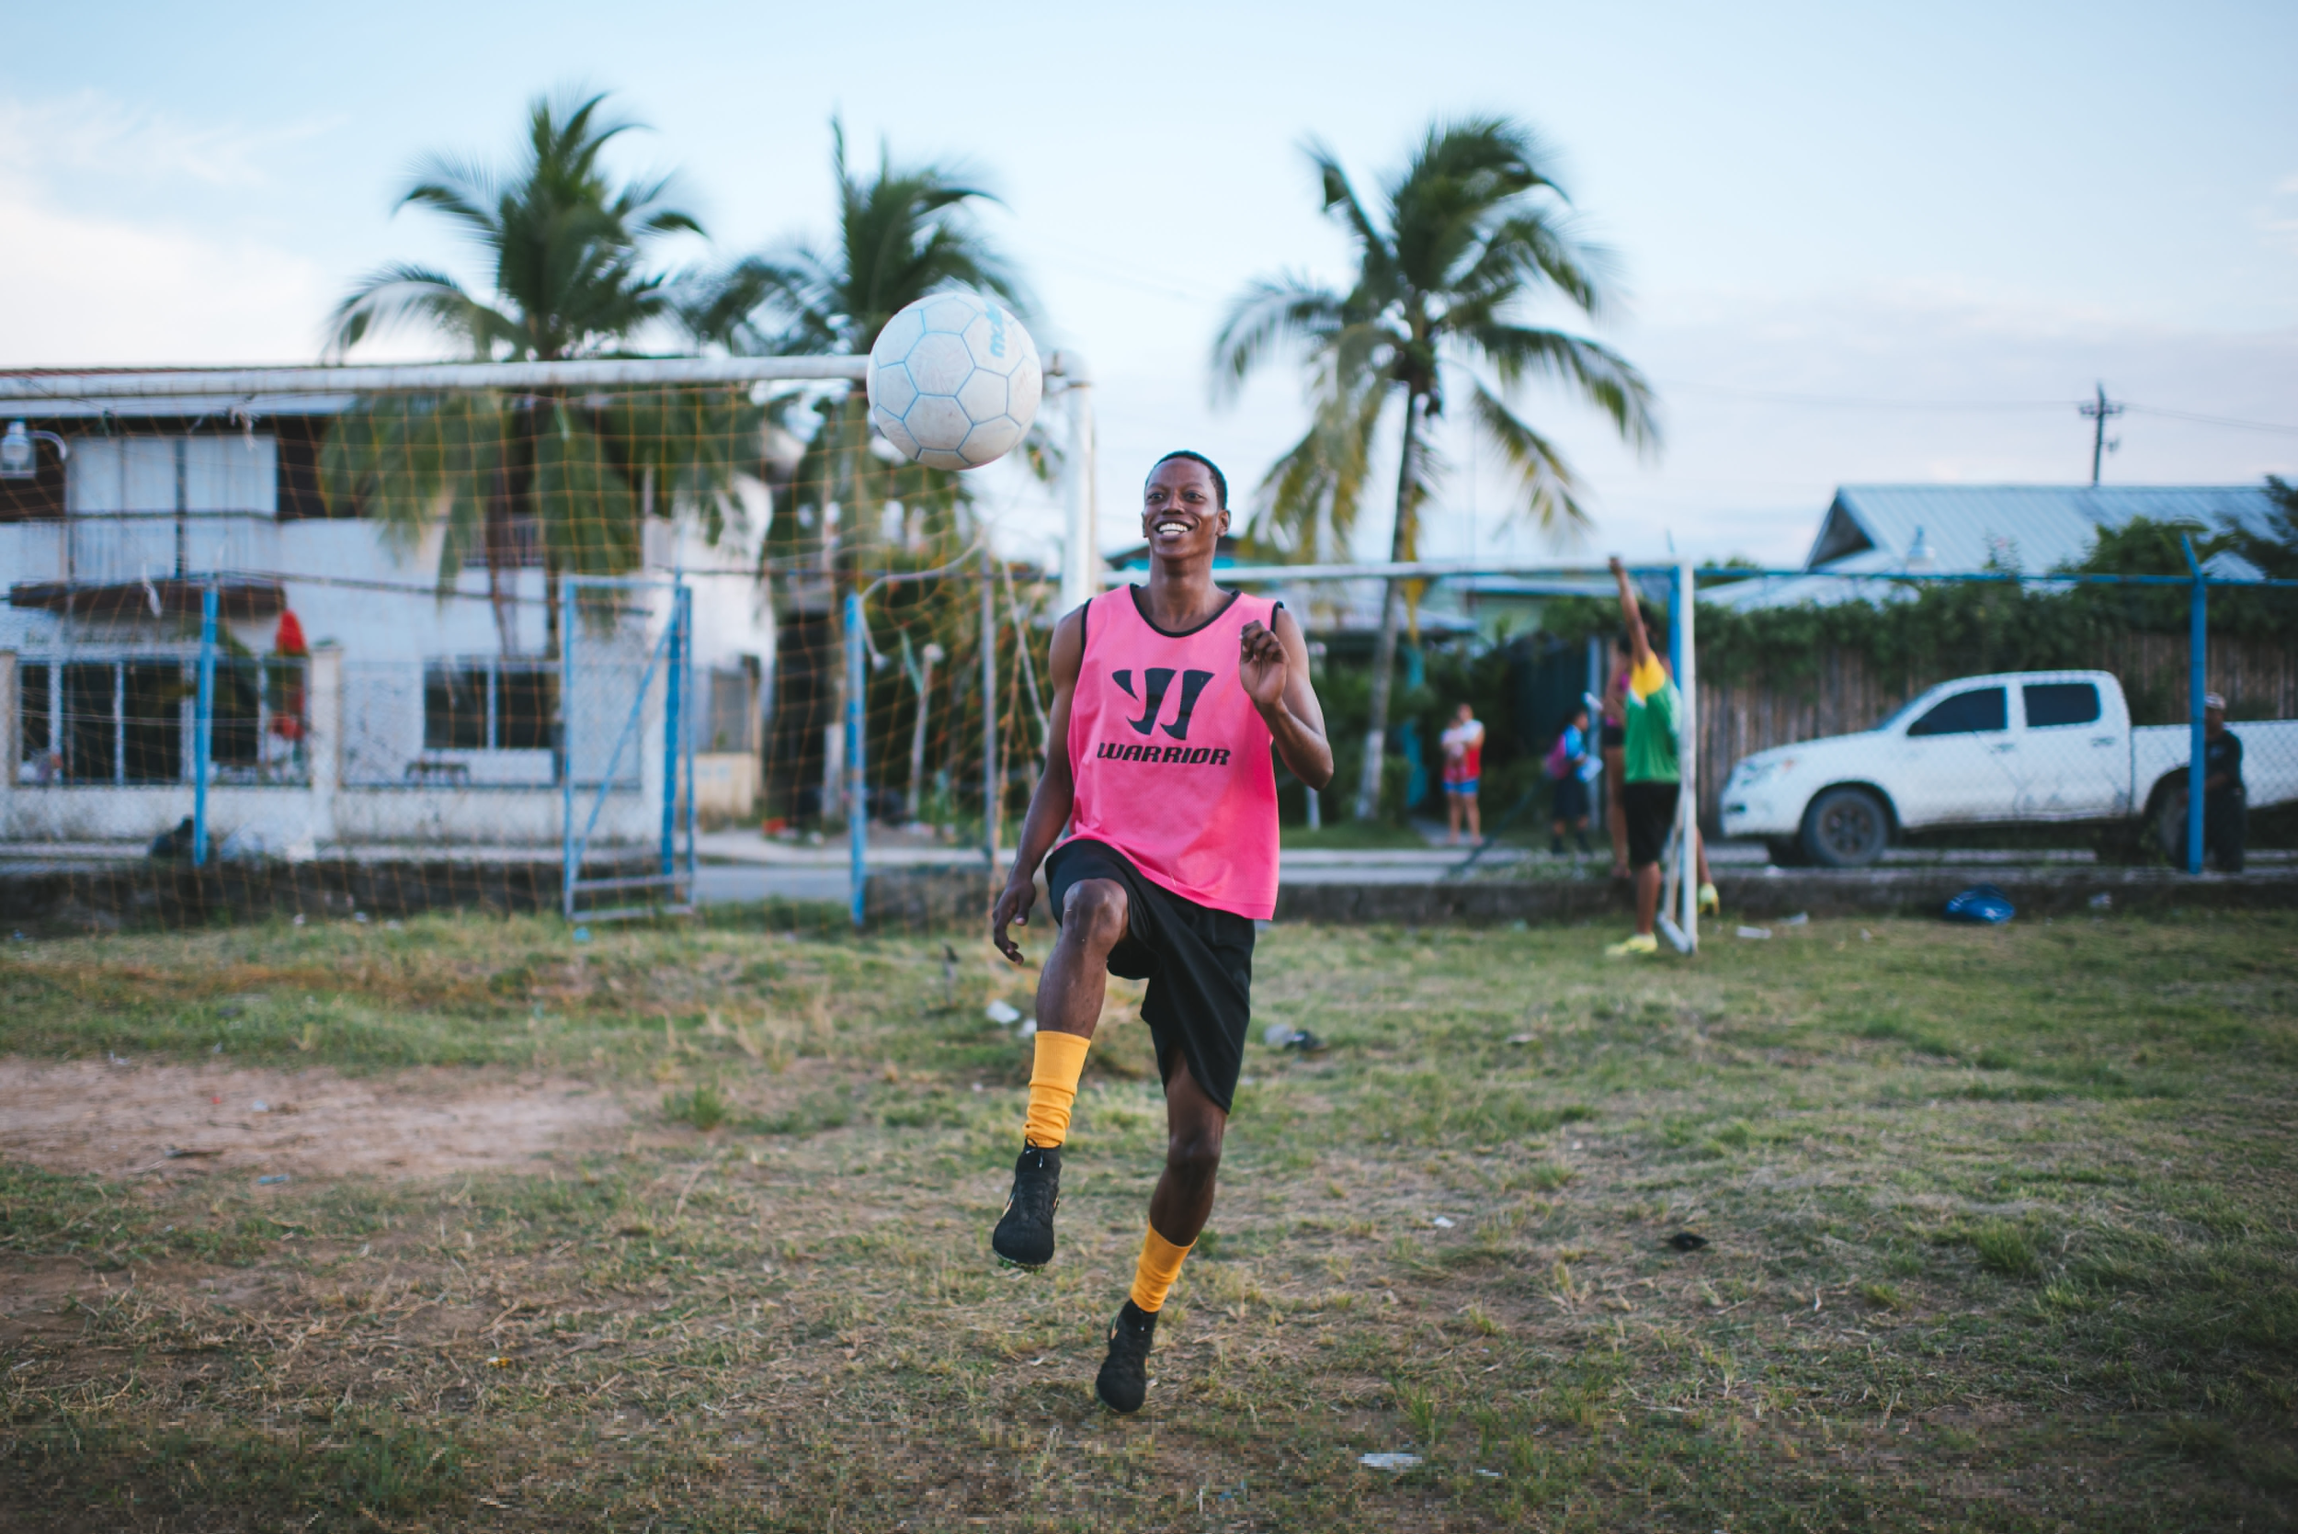

Slide 28
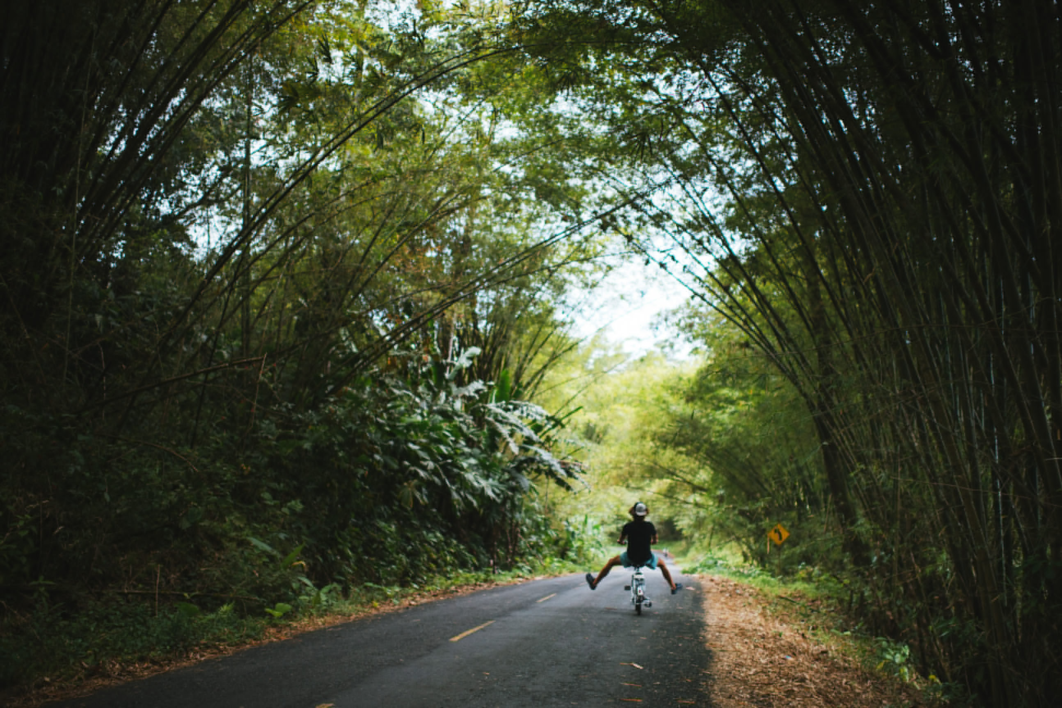

Slide 30
Watch this video with some of Max Lowe's photography
Talk to your friend.
What kind of personality do you think Max Lowe has?

Slide 31
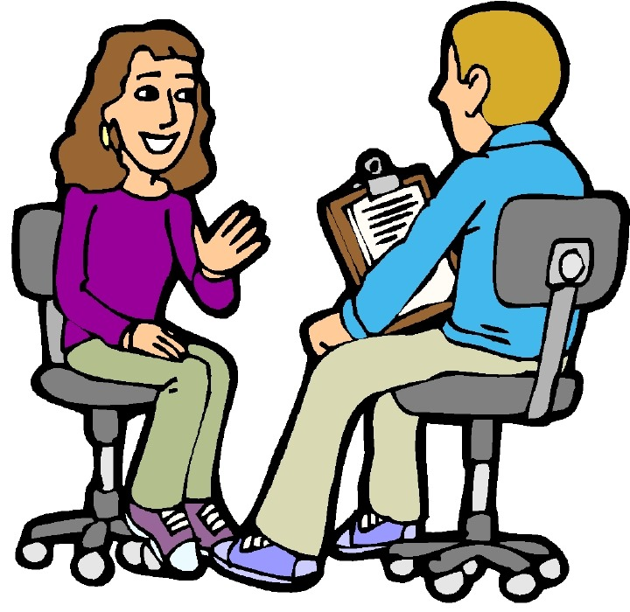
You’re going to listen to an...
with Max Lowe about his...
career.

Slide 32
Read the worksheet.
Worksheet A
Listen and check the things that Max Lowe talks about in his interview.
Put your name on the paper.
Check your neighbor’s answers.

Slide 33
Which places does Lowe talk about in his interview?
Nepal
Montana
The Himalayas

Slide 34
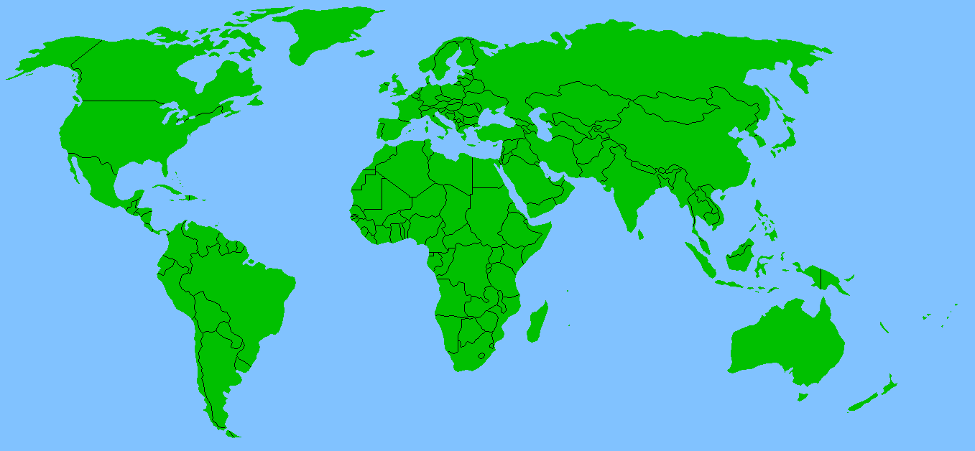
Montana
Which one is it? Montana, the Himalayas, or Nepal?
Nepal
The himalayas

Slide 35
Read the worksheet.
Worksheet B
Listen and circle T for true or F for false.
Check your neighbor's answers.

Slide 36
Check the answers.
Pass the worksheets to another team
Write the number correct on top of the paper.

Slide 37
Check the answers for worksheet A.
✔
✔
ロ his future plans
ロ his hometown
ロ his school life
✔
ロ his hobbies
ロ his heroes
ロ his first digital camera
✔
Write the correct score on top of the paper.

Slide 38
Check the answers for worksheet B.
Lowe studied journalism in college. T F
3. Lowe’s father is the one who introduced him to the outdoors. T F
2. Lowe mentions 3 people who are his heroes. T F
Lowe says it’s challenging to truly understand and tell someone’s story. T F

Slide 39
Give the worksheets back.
mother
Lowe studied journalism in college.
3. Lowe’s father is the one who introduced him to the outdoors.
business
Can you correct the false sentences on the worksheet?

Slide 40
Which three people does Lowe consider to be his heroes?
adopted father
mother
father

Slide 43
pronunciation

Slide 44
explorer

Slide 45
explorer

Slide 46
patient

Slide 47
patient

Slide 48
introduce

Slide 49
introduce

Slide 50
Page 11 - A
Read the words and put them in the boxes with the correct syllable. Work with your friend.
Correct the other team’s paper.
Put your name on the paper. Give it to the other team.

Slide 51
first syllable | second syllable | third syllable
patient
explorer
geographic
picture
psychologist
conversation
national
introduce
inspiring
patient
explorer
picture
psychologist
national
inspiring
geographic
conversation
introduce

Slide 52
right question mistake pollution

Slide 53
Page 11 - B
Put your name on the paper, and give it to the other team.
Underline the stress in the words in bold.
Look at your friends answers.
Listen and check. (1-07)
Check the other team’s answers.

Slide 54
Should a hero be dependable?

Slide 55
Should a hero be dependable?

Slide 56
Should a hero be dependable?

Slide 57
2. Are you an introvert or an extrovert?

Slide 58
2. Are you an introvert or an extrovert?

Slide 59
2. Are you an introvert or an extrovert?

Slide 60
3. Do you enjoy outdoor activities?

Slide 61
3. Do you enjoy outdoor actiities?

Slide 62
3. Do you enjoy outdoor activities?

Slide 63
4. Who’s someone who is easygoing and tlkative?

Slide 64
4. Who’s someone who is easygoing and talkative?

Slide 65
4. Who’s someone who is easygoing and talkative?

Slide 66
5. What information do you remember about Lowe?

Slide 67
5. What information do you remember about Lowe?

Slide 68
5. What information do you remember about Lowe?

Slide 69
Talk with your partner. Answer the questions on the page.

Slide 73
Watch this video with some of Max Lowe's photography
Talk to your friend.
What kind of personality do you think Max Lowe has?

Slide 74
You’re going to listen to an...
with Max Lowe about his...
career.

Slide 75
Read the worksheet.
Worksheet A
Listen and check the things that Max Lowe talks about in his interview.
Put your name on the paper.
Check your neighbor’s answers.

Slide 76
Which places does Lowe talk about in his interview?
Nepal
Montana
The Himalayas

Slide 77
Montana
Which one is it? Montana, the Himalayas, or Nepal?
Nepal
The himalayas

Slide 78
Read the worksheet.
Worksheet B
Listen and circle T for true or F for false.
Check your neighbor's answers.

Slide 79
Check the answers.
Pass the worksheets to another team
Write the number correct on top of the paper.

Slide 80
Check the answers for worksheet A.
✔
✔
ロ his future plans
ロ his hometown
ロ his school life
✔
ロ his hobbies
ロ his heroes
ロ his first digital camera
✔
Write the correct score on top of the paper.

Slide 81
Check the answers for worksheet B.
Lowe studied journalism in college. T F
3. Lowe’s father is the one who introduced him to the outdoors. T F
2. Lowe mentions 3 people who are his heroes. T F
Lowe says it’s challenging to truly understand and tell someone’s story. T F

Slide 82
Give the worksheets back.
mother
Lowe studied journalism in college.
3. Lowe’s father is the one who introduced him to the outdoors.
business
Can you correct the false sentences on the worksheet?

Slide 83
Which three people does Lowe consider to be his heroes?
adopted father
mother
father

Slide 86
pronunciation

Slide 87
explorer

Slide 88
explorer

Slide 89
patient

Slide 90
patient

Slide 91
introduce

Slide 92
introduce

Slide 93
Page 11 - A
Read the words and put them in the boxes with the correct syllable. Work with your friend.
Correct the other team’s paper.
Put your name on the paper. Give it to the other team.

Slide 94
first syllable | second syllable | third syllable
patient
explorer
geographic
picture
psychologist
conversation
national
introduce
inspiring
patient
explorer
picture
psychologist
national
inspiring
geographic
conversation
introduce

Slide 95
right question mistake pollution

Slide 96
Page 11 - B
Put your name on the paper, and give it to the other team.
Underline the stress in the words in bold.
Look at your friends answers.
Listen and check. (1-07)
Check the other team’s answers.

Slide 97
Should a hero be dependable?

Slide 98
Should a hero be dependable?

Slide 99
Should a hero be dependable?

Slide 100
2. Are you an introvert or an extrovert?

Slide 101
2. Are you an introvert or an extrovert?

Slide 102
2. Are you an introvert or an extrovert?

Slide 103
3. Do you enjoy outdoor activities?

Slide 104
3. Do you enjoy outdoor actiities?

Slide 105
3. Do you enjoy outdoor activities?

Slide 106
4. Who’s someone who is easygoing and tlkative?

Slide 107
4. Who’s someone who is easygoing and talkative?

Slide 108
4. Who’s someone who is easygoing and talkative?

Slide 109
5. What information do you remember about Lowe?

Slide 110
5. What information do you remember about Lowe?

Slide 111
5. What information do you remember about Lowe?

Slide 112
Talk with your partner. Answer the questions on the page.

