Slide 1
Personality Adjectives & Relative Clauses

Slide 2
WORD SHAKE!

Slide 3
Describe Three Animals
Think of three animals
Think of three adjectives (describing words) for each animal
One: cuddly, loyal, energetic
Two: lazy, easy-going, fluffy
Three: tiny, playful, vicious
Don’t tell anyone what your animals are
Read out the adjectives for each animal and begin the sentence with:
I think I am… cuddly, loyal, and energetic
My friends think I am… lazy, easy-going and fluffy
I am really… tiny, playful and vicious
What are my animals?

Slide 4
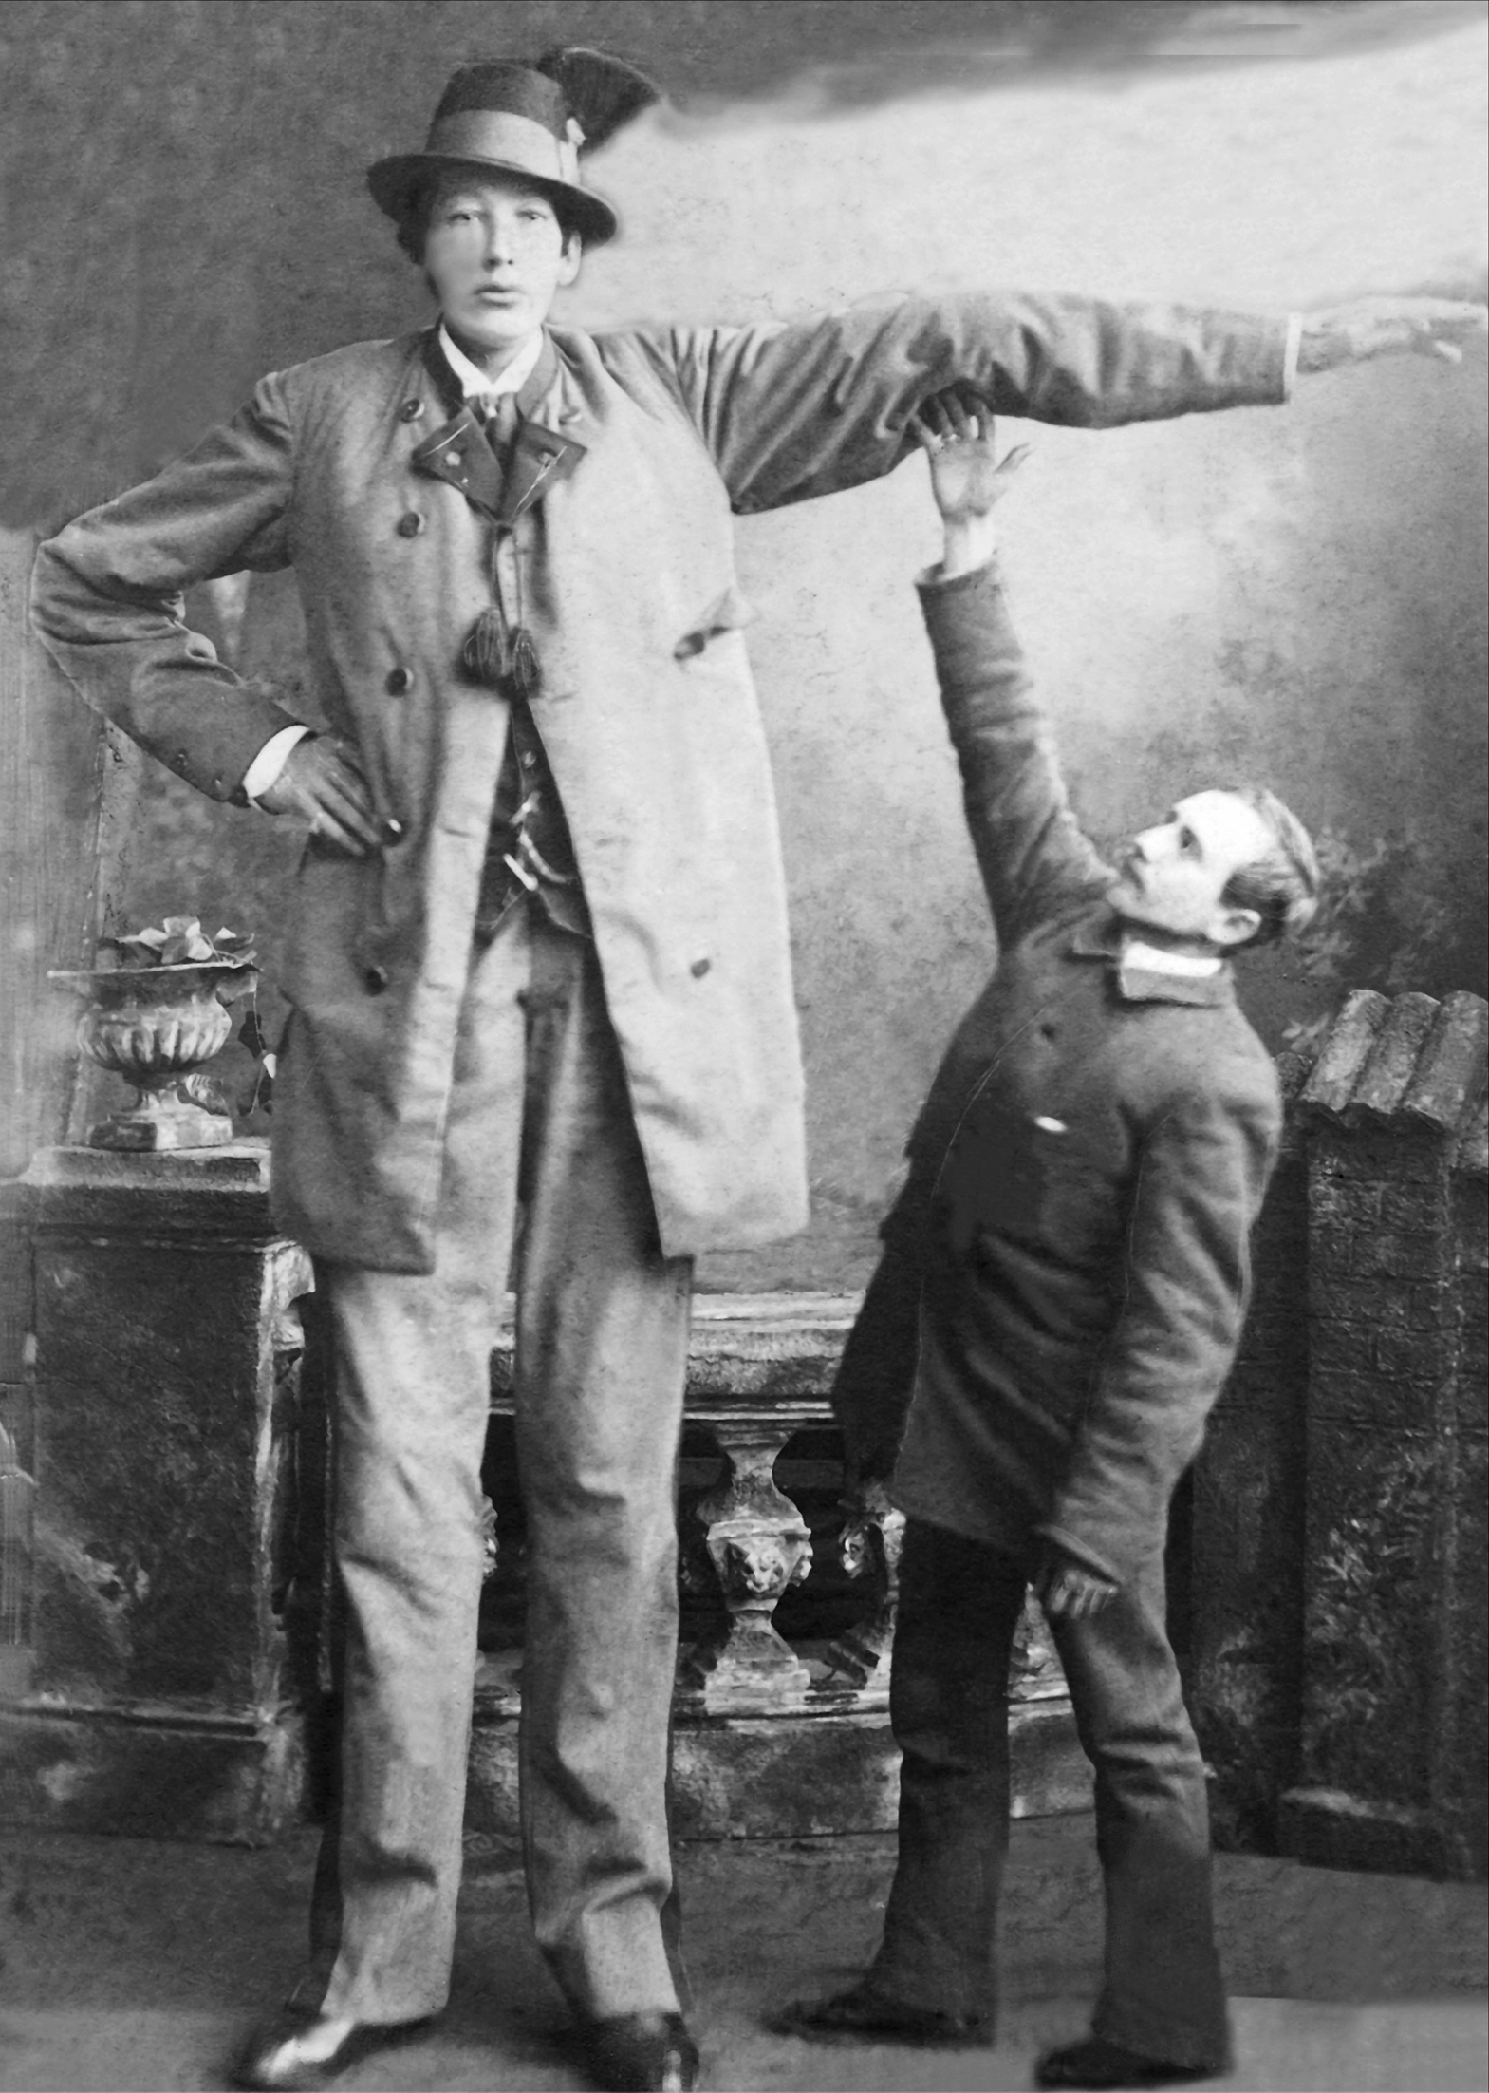
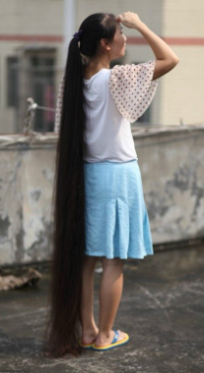
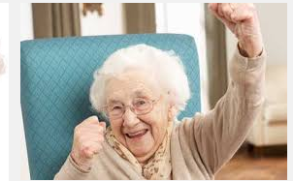
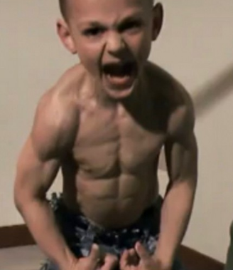
ADJECTIVES: What are they like?
We use adjectives to describe the way that people…
Look (their physical appearance)
Are (their character or personality)

Slide 5
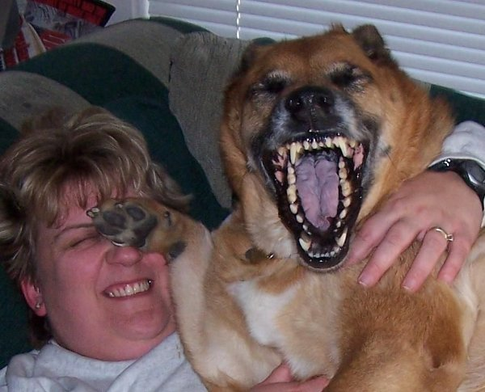
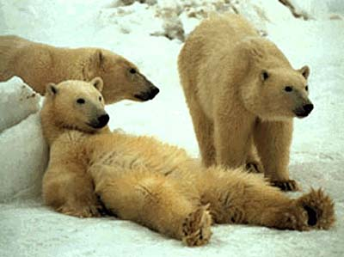
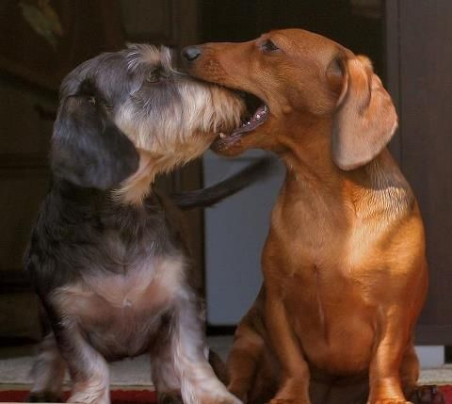
PERSONALITY ADJECTIVES:
Choose one of the words you have and hold it up!
Funny = causing laughter
Easy-going = relaxed; easy to approach
Quiet = making little noise; not talkative

Slide 6
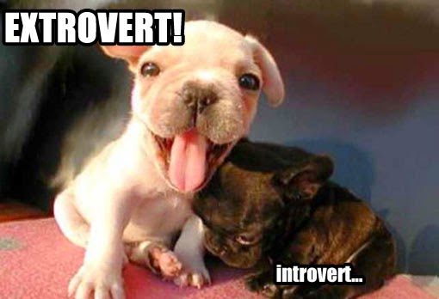
PERSONALITY ADJECTIVES:
Choose one of the words you have and hold it up!
Shy = nervous and quiet around other people
Hard-working = (of a person) working often and with energy
Outgoing = friendly and confident when talking to people

Slide 7
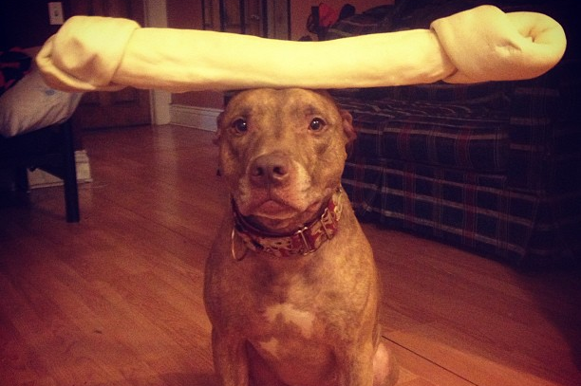
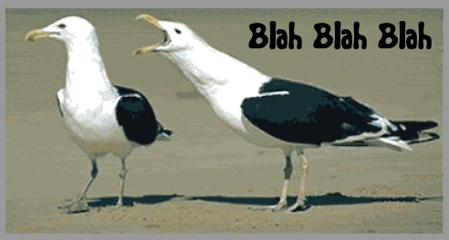
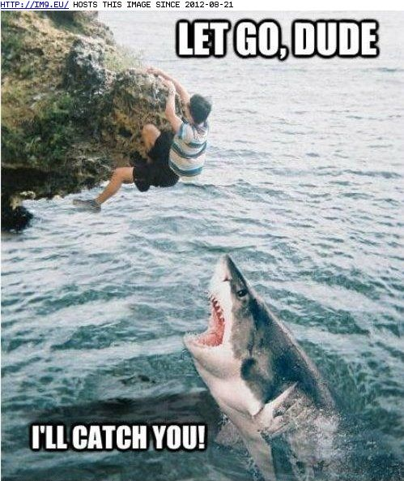
PERSONALITY ADJECTIVES:
Choose one of the words you have and hold it up!
Patient = able to accept problems without being annoyed
Chatty = (of a person) talking very often
Dependable = able to be trusted

Slide 8
LISTENING TIME!

Slide 9
DISCUSS:

Slide 10
RELATIVE CLAUSES:
Which one is she/he? Which ones are they?
Relative clauses: clauses starting with the relative pronouns who*, that, which, whose, where, when.
They are most often used to define or identify the noun that precedes (comes before) them.

Slide 11
Relative pronoun | use | example
who | Subject or object pronoun for people | I told you about that woman who lives next door.
which | Subject or object pronoun for animals and things | Do you see the cat which is lying on the roof?
that | Subject or object pronoun for animals and things | I don’t like the table that stands in the kitchen
whose | Possessive pronoun for people, animals and things | Do you know the boy whose mother is a nurse?

Slide 12
PRACTICE TIME!

Slide 13
RELATIVE CLAUSES: EXAMPLES
Write these sentences above you.
Circle the relative pronouns and underline the nouns.

Slide 14
BOARD RACE
Run to the board and correct the sentences
You will need to rewrite the sentences with who.

Slide 15
BOARD RACE
That’s Akio. He likes to sit in the first row.
Her name is Suzy. She’s sitting next to Akio.

Slide 16
BOARD RACE
That’s Eric and that’s Michael. They like to ask a lot of questions.
Her name is Sonia. She always brings her tablet to class.

Slide 17
BOARD RACE
Her name is Kerry Ann. She hates spiders, and wears bug-stomping boots wherever she goes.
His name is Robert. He saved the kid.

Slide 18
BOARD RACE
Brian said goodnight to his roommate Justin. Justin continued to play video games until his eyes were blurry with fatigue.

Slide 19
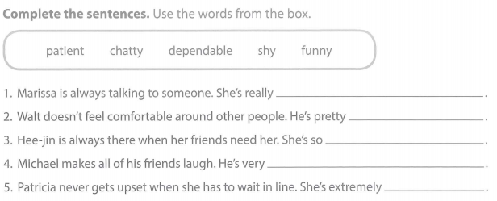
PRACTICE TIME!

Slide 20
CELEBRITY HEADS
Write the names of 3-5 people on the paper you have
E.G. Famous people or people in the class
Put the names in the bag when you’re done
Describe the people to your teammates using relative clauses and answer the same way.
E.G.“He’s the one who rides bicycles without a helmet!”
E.G. “I think he is Huy”

Slide 21
CELEBRITY HEADS

Slide 22
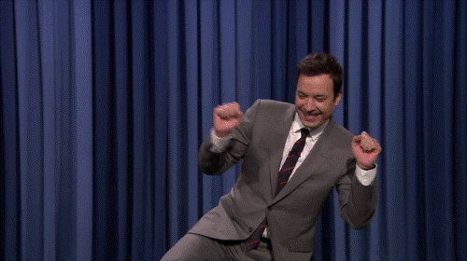
PERSONALITY ADJECTIVES ROLE-PLAY
In groups, create a conversation using the cards
Pretend that you are meeting each other for the first time
Don’t show your teammates the cards!
Act it out until your teammates guess what it is!
Keep going until all the cards have been used
Ask for help if you need it!

Slide 23
EXTRA TIME? RELATIVE CLAUSES BOARD GAME!
Finish the sentence with the correct relative clause pronouns - who, which, that, whose
When do we use each one? (e.g. for which types of nouns)

