Slide 1
S3A Lesson 3 Unit 1
Listening & Speaking

Slide 2
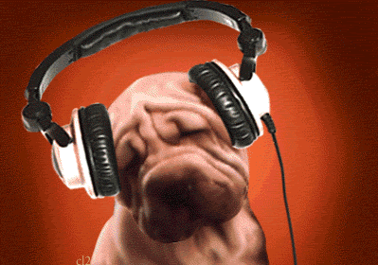
PART ONE: LISTENING

Slide 3
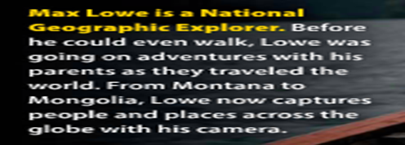
The Big Picture: Who is he?
Discuss with a partner:
What does he do? (What is his job?)
Where is he?
What is he doing?
Does he look happy? Why/why not?
Write your answers on the board behind you!

Slide 4
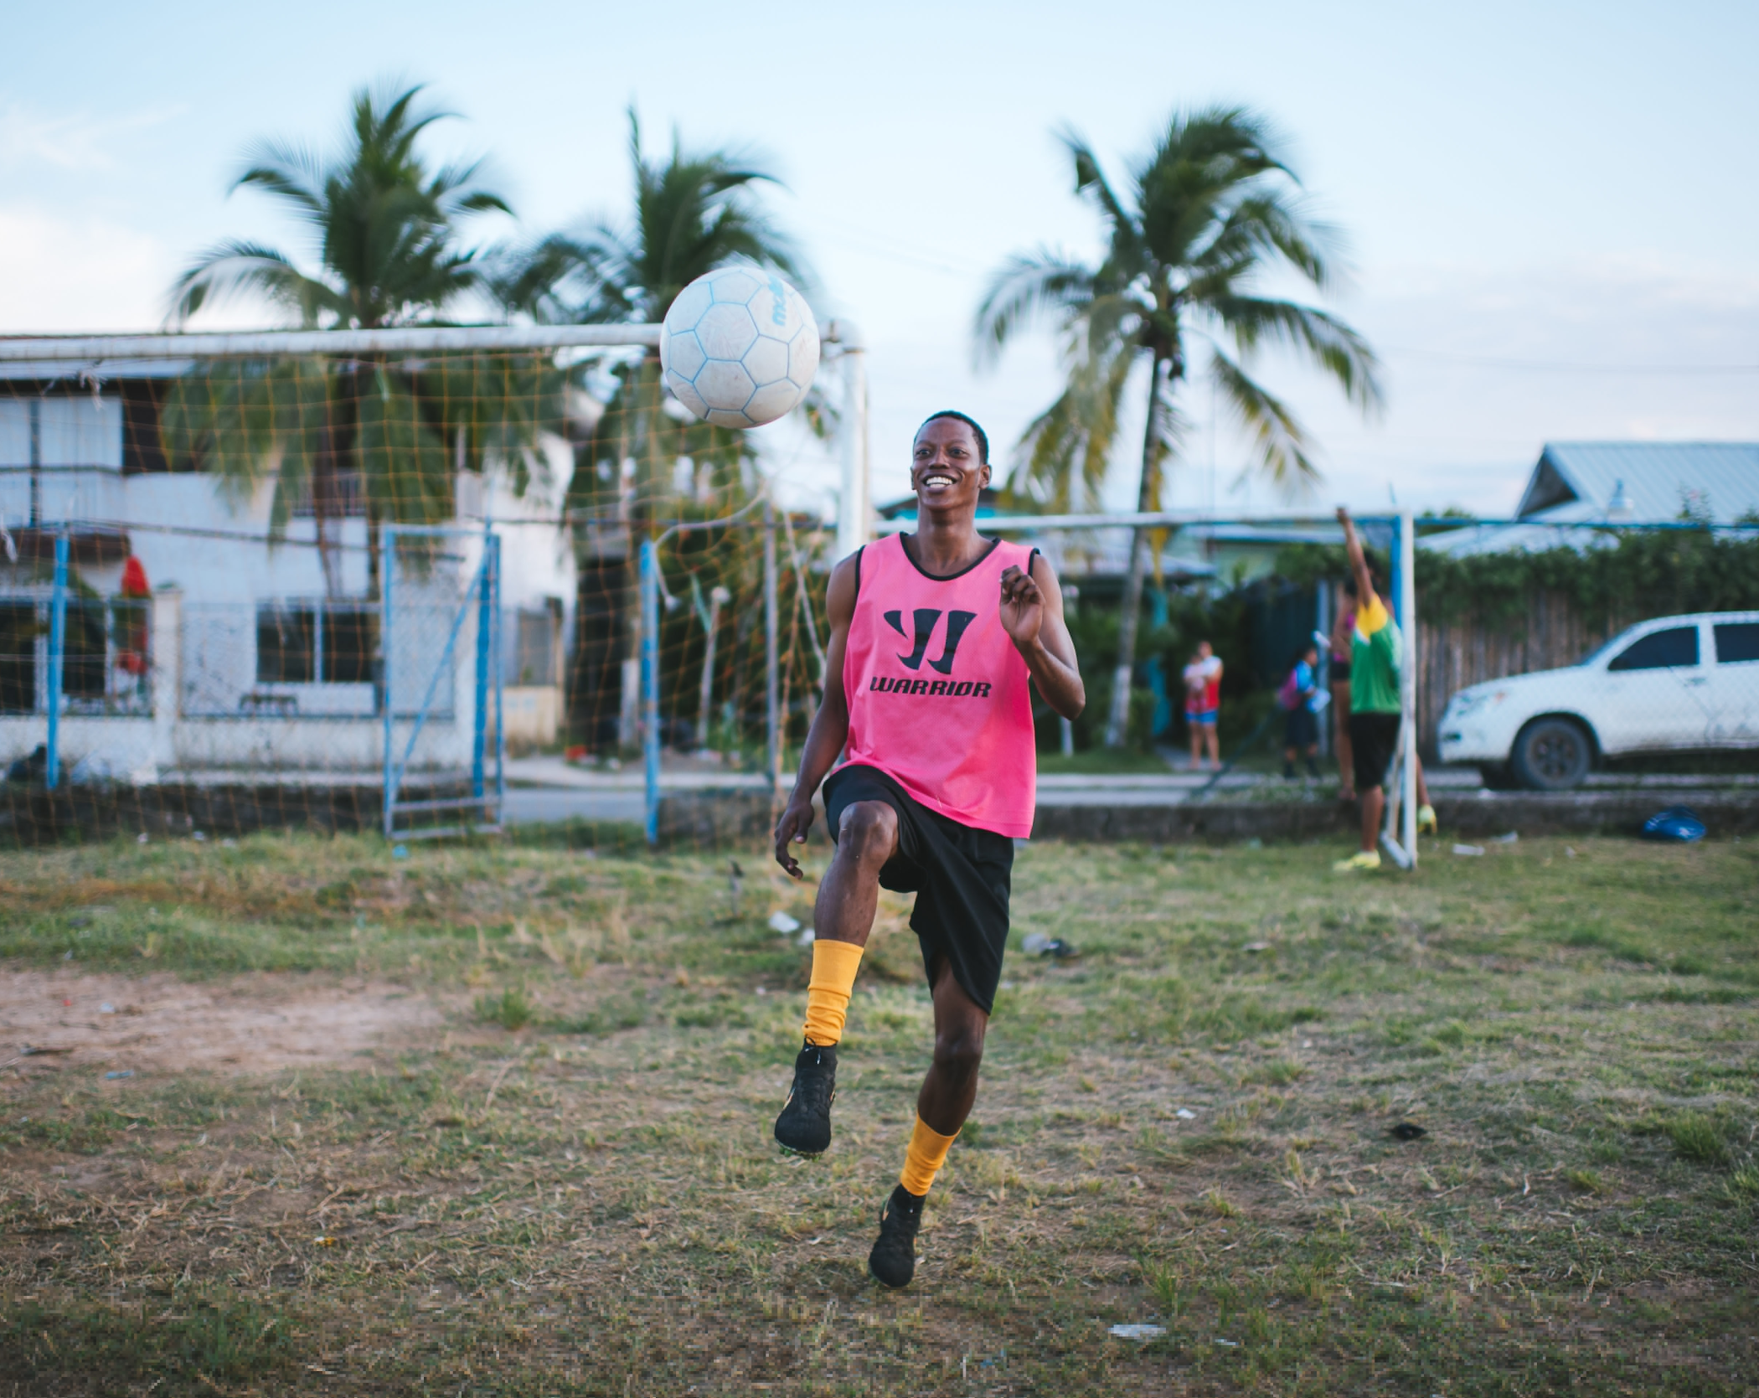
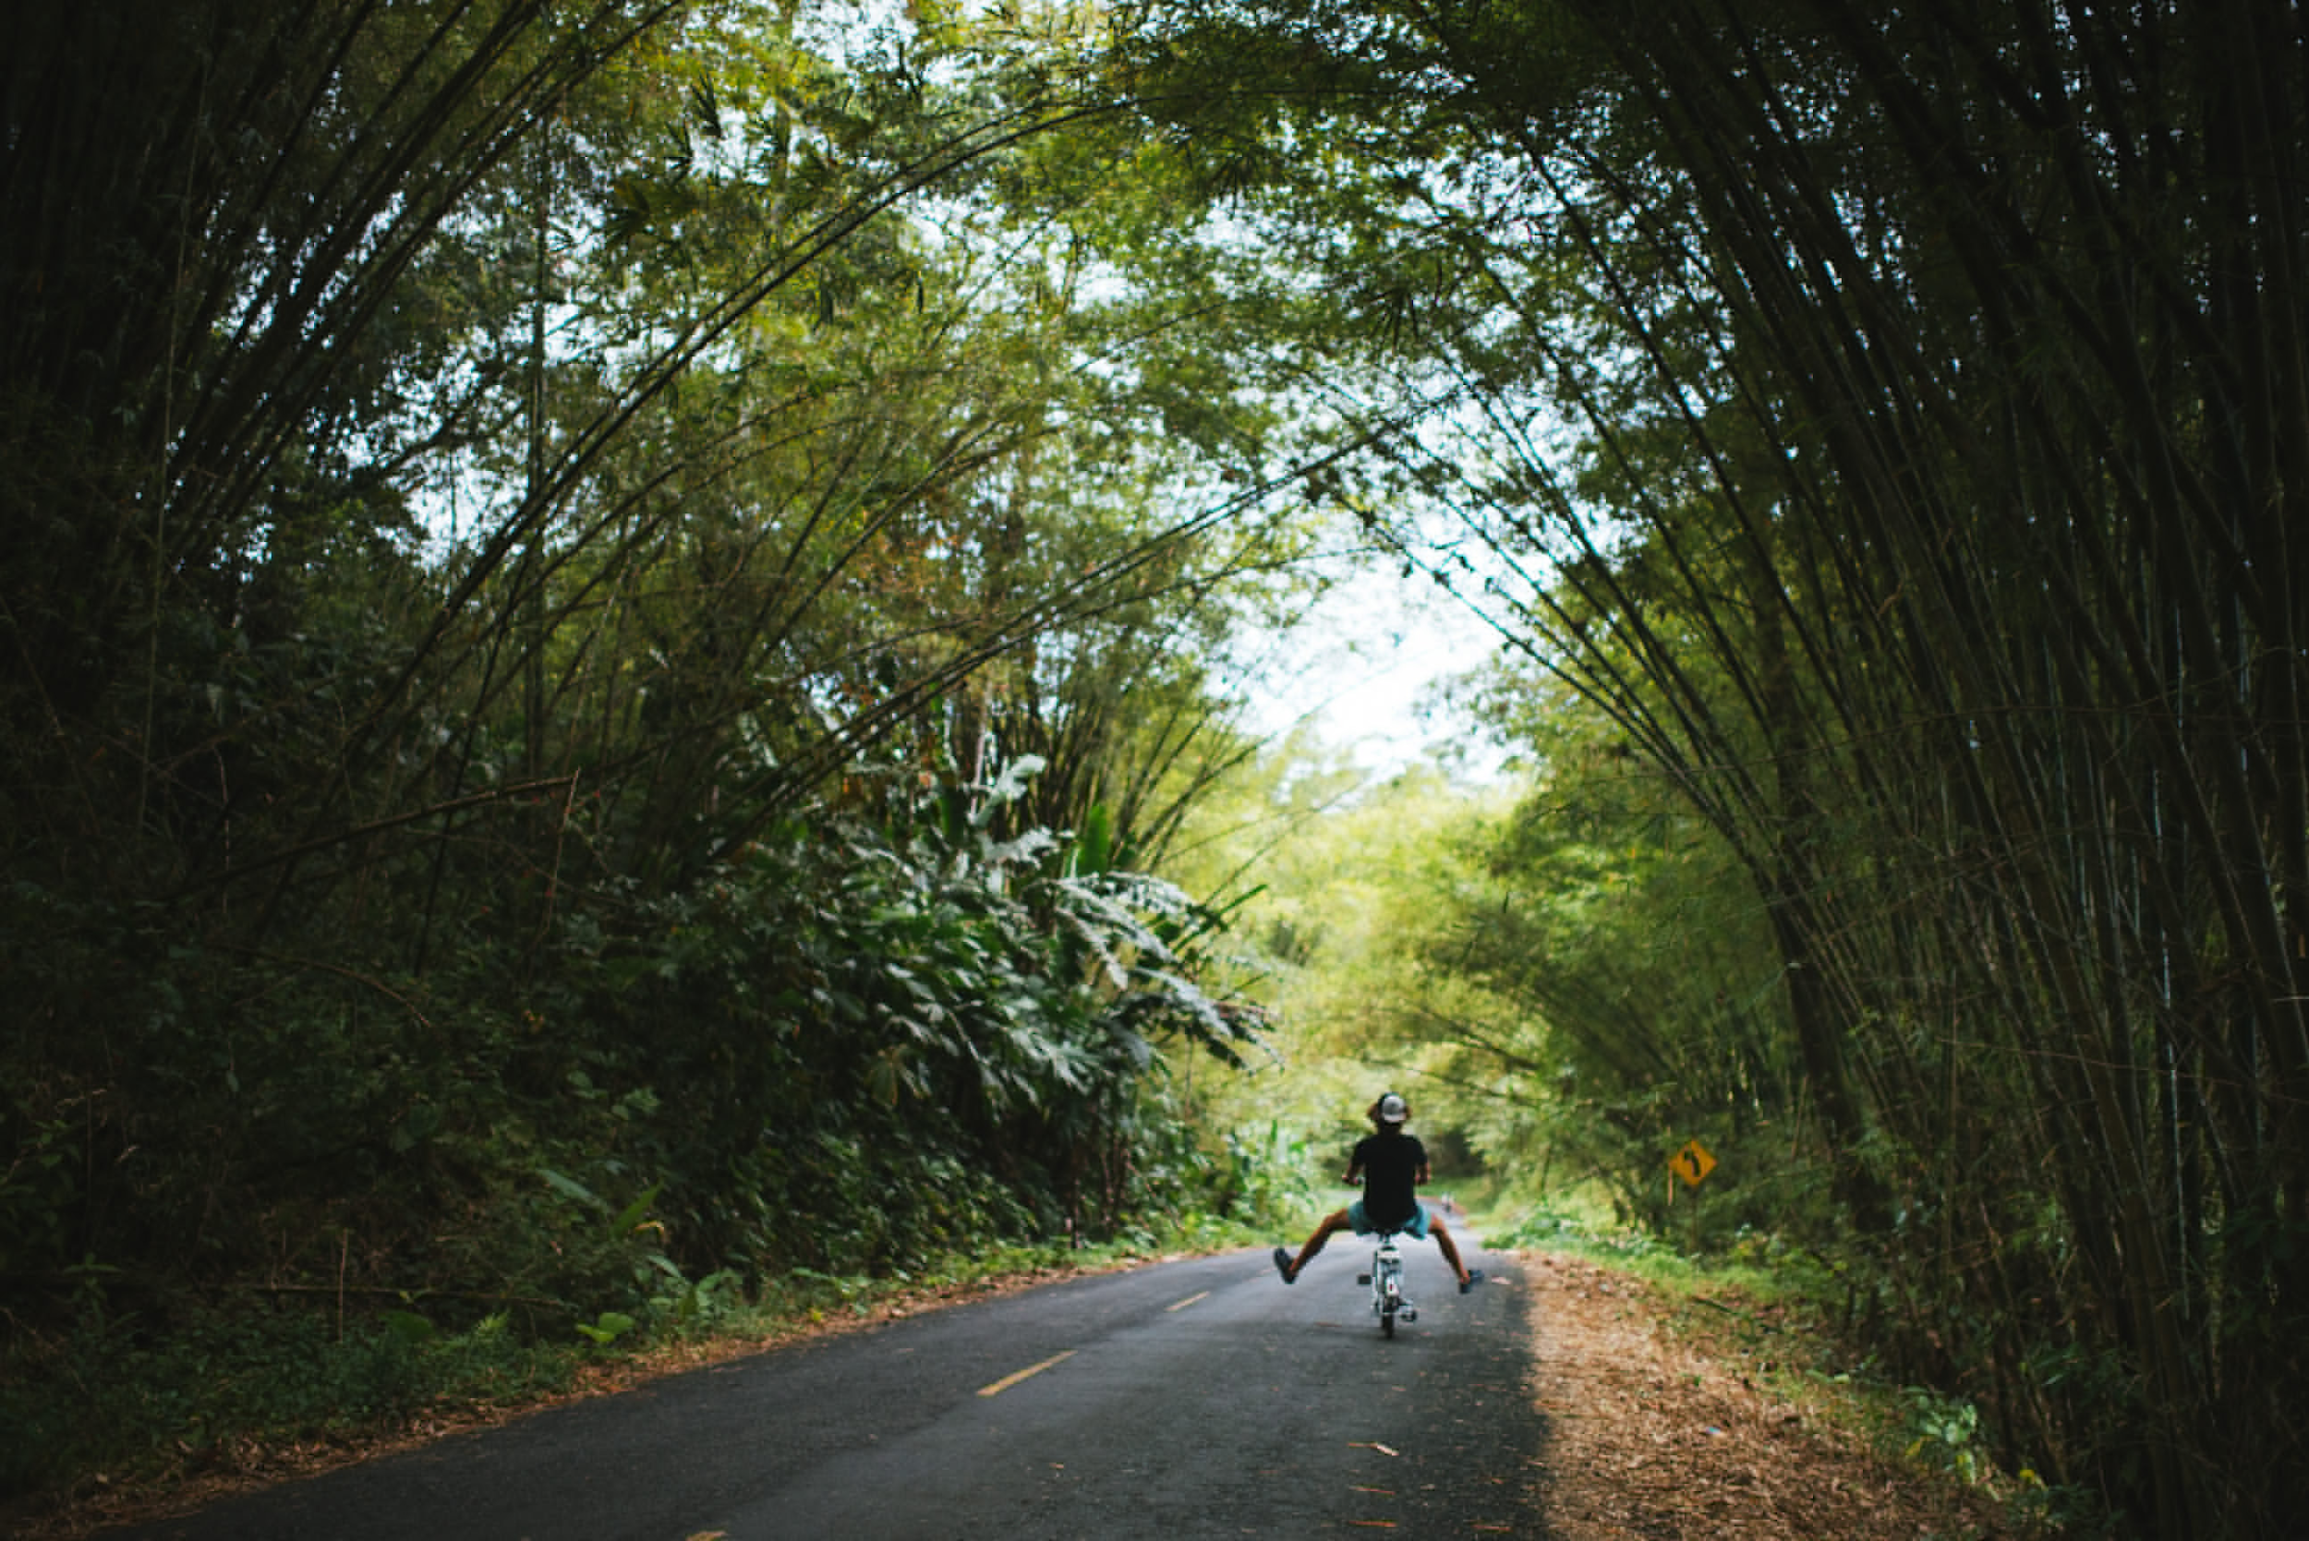
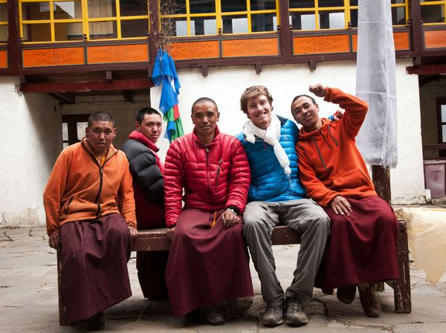
What do you see? Which one do you like the most and why? What would you take photos of if you were Max? Why?

Slide 5
NEW VOCABULARY

Slide 6
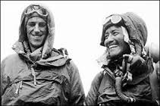
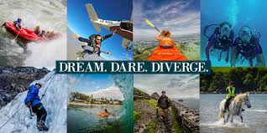
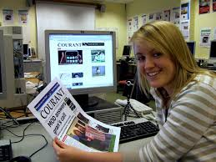
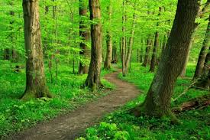
Adventures
Explorers
Journalist
Outdoors

Slide 7
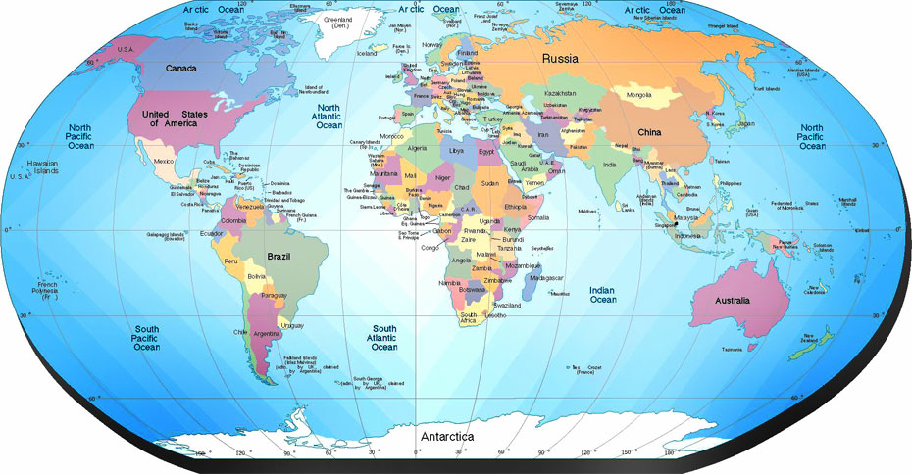
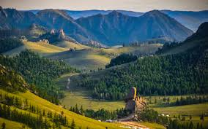
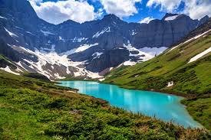
Globe
Mongolia
Montana

Slide 8
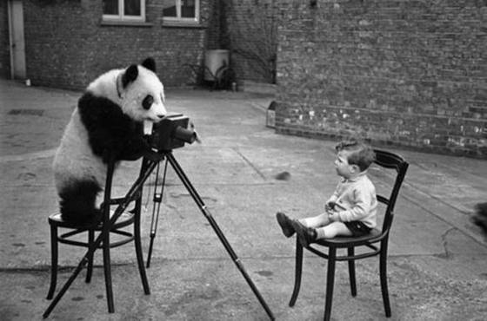
Photography
Capture
Camera (Lens)

Slide 9
Listening Part One:
Listen and tick the correct answers
Discuss these three topics with a partner: hobbies, heroes, future plans.
Brainstorm your own ideas for each one
Write 2 - 3 questions for each topic
Join with another pair and interview each other!
Do you have anything in common?
Notes:
https://drive.google.com/drive/folders/0B6jZ1TST9GtKbUJ0U01LQUR6T0U

Slide 10
Listening Part Two:
Listen and circle the correct answers
Discuss with a partner

Slide 11
POST-LISTENING: What are the characteristics of heroes?
One minute: Write five personality adjectives to describe a ‘hero’
Here is a list of common words to describe a ‘hero’. Each group will have two minutes to find a definition for three words and write it on the boards.
Brave
Courageous
Humble
Selfless
Patient
Caring
Clever
Passionate
Honest
Do you agree with these words?
Why/why not?

Slide 12
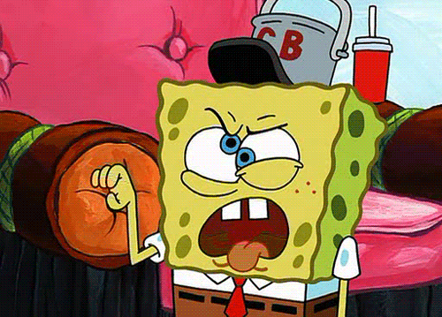
PART TWO: PRONUNCIATION + SPEAKING

Slide 13
SYLLABLE STRESS
A stressed syllable combines five features:
It is l-o-n-g-e-r - com p-u-ter
It is LOUDER - comPUTer
It has a change in pitch from the syllables coming before and afterwards. The pitch of a stressed syllable is usually higher.
It is said more clearly -The vowel sound is purer. Compare the first and last vowel sounds with the stressed sound.
It uses larger facial movements - Look in the mirror when you say the word. Look at your jaw and lips in particular.

Slide 14
SYLLABLE STRESS
Stress the first syllable of:
Most two-syllable nouns (e.g. CLImate, KNOWledge)
Most two-syllable adjectives (e.g. FLIPpant, SPAcious)
Stress the last syllable of: Most two-syllable verbs (e.g. reQUIRE, deCIDE)
Stress the second-to-last syllable of:
Words that end in -ic (e.g: ecSTATic, geoGRAPHic)
Words ending in -sion and -tion (e.g: exTENsion, retriBUtion)
Stress the third-from-last syllable of:
Words that end in -cy, -ty, -phy and -gy (e.g: deMOCracy, unCERtainty, geOGraphy, radiOLogy)
Words that end in -al (e.g: exCEPtional, CRItical)

Slide 15
SYLLABLE STRESS - Underline the stress and write the number of syllables in each word
patient | explorer | introduce | picture | inspiring
national | psychologist | geographic | conversation | introvert
extrovert | enjoy | activities | dependable | hero
information | remember | easygoing | talkative | right

Slide 16
STRESS SNAP!

Slide 17
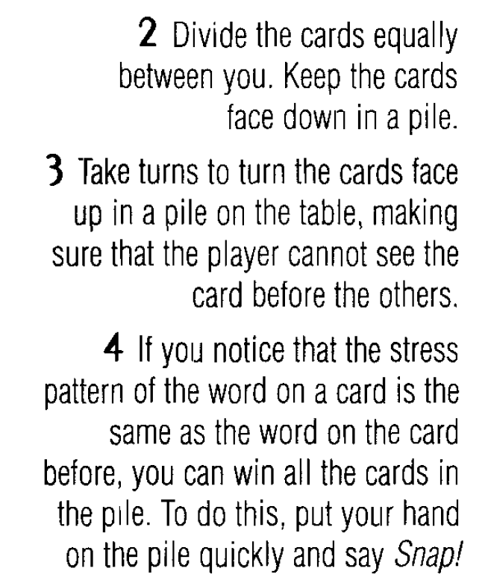
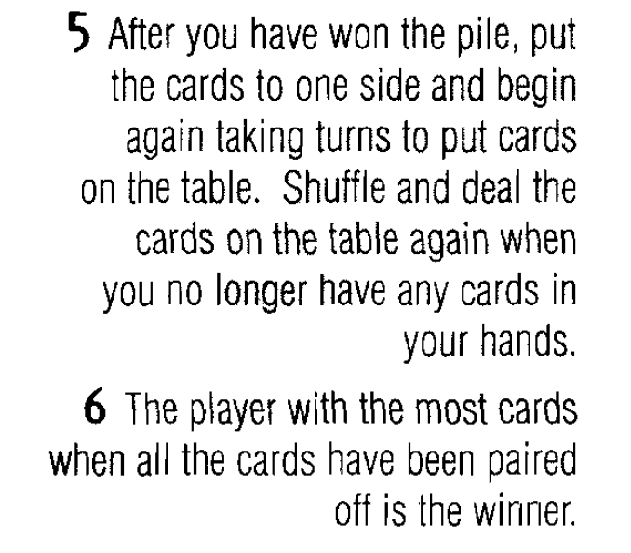
STRESS SNAP!

Slide 18
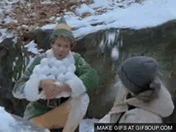
COMMUNICATION TASK: SNOWBALL
Using the topics from the listening activity, write 6 things about yourself
No more than 2 things per topic
When the teacher tells you, throw it!
If you find a “snowball”, guess who it is!
Remember to say:
“I think…is the one who…”

