Slide 1
S3A Unit 1
Reading, Vocabulary & Writing

Slide 2
Word chain - vocabulary game
First student writes a word (4 or more letters).
Second student writes a word beginning with the last letter of the previous word.
First team to get to the bottom wins!
Notes:
15 mins

Slide 4
PART ONE: READING PRACTICE

Slide 5
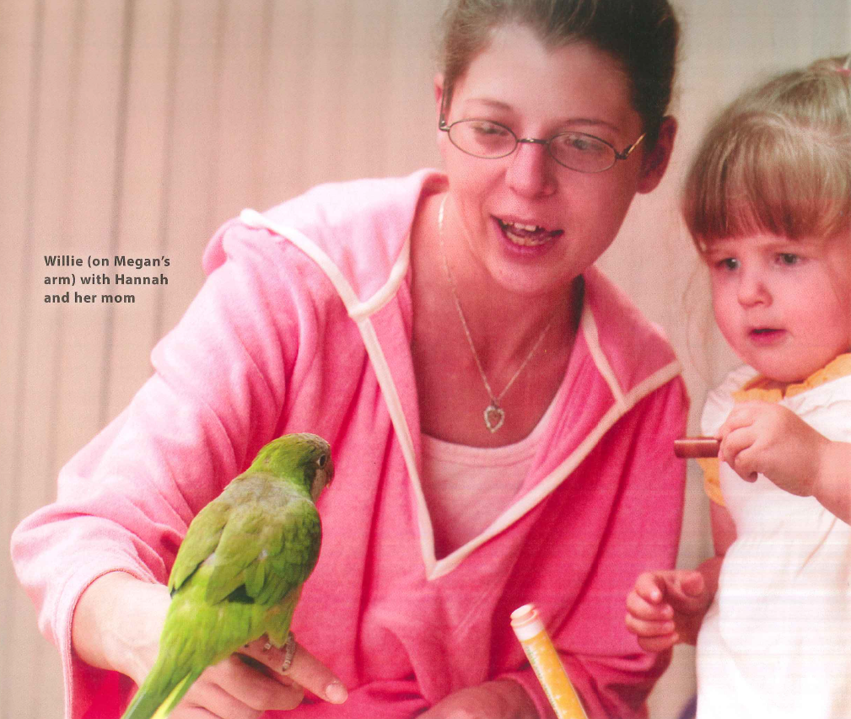
READING: LIFE-SAVERS
What is this article about?
What is a “life-saver”?

Slide 6
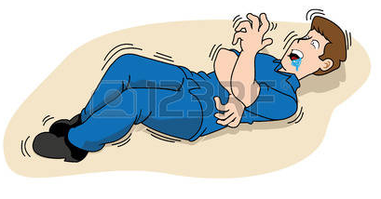
seizure

Slide 7
stuck

Slide 8
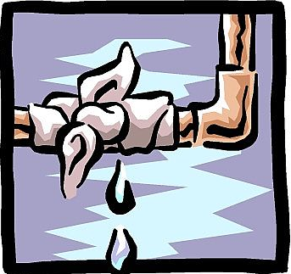
leak

Slide 9
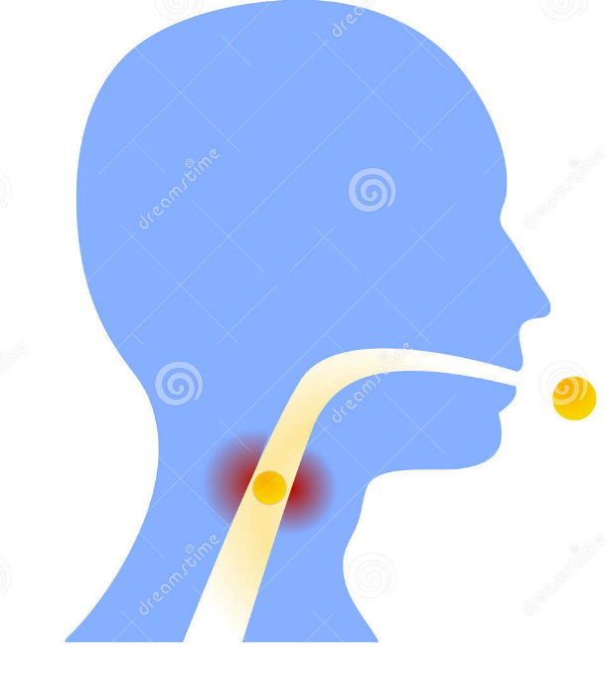
throat

Slide 10
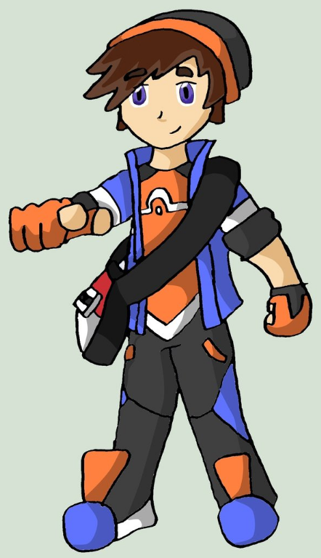
heroic

Slide 11
Emergency (noun)

Slide 12
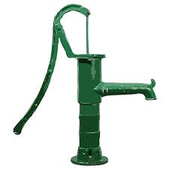
Water pump (noun)

Slide 13
Babysitter (noun)

Slide 14
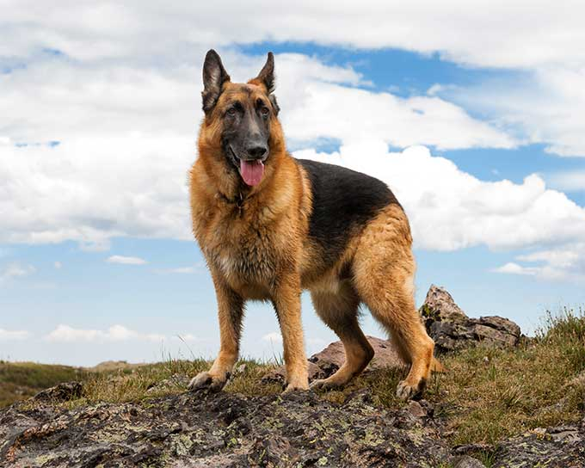
German Shepherd

Slide 15
Experience

Slide 16
Breathe

Slide 17
VOCABULARY CROSSWORD
Find the clues around the room
Write the vocabulary in the crossword
Check with me when you’re done

Slide 18
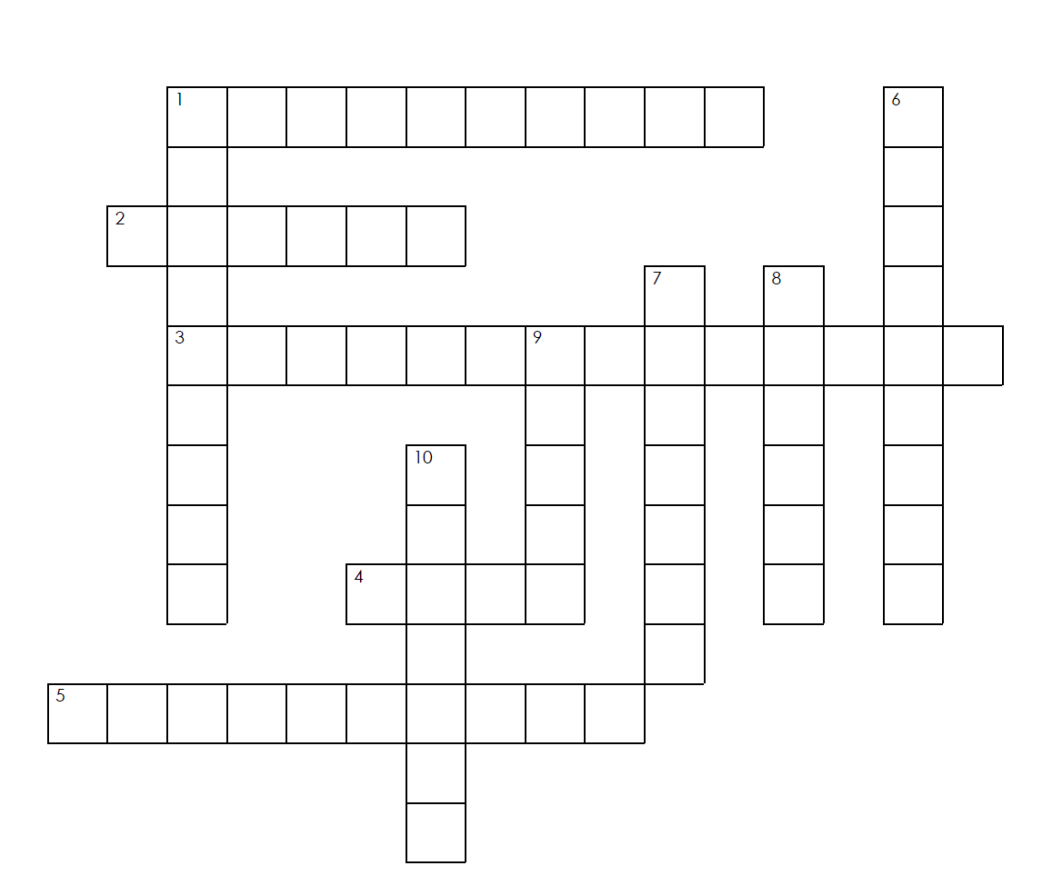
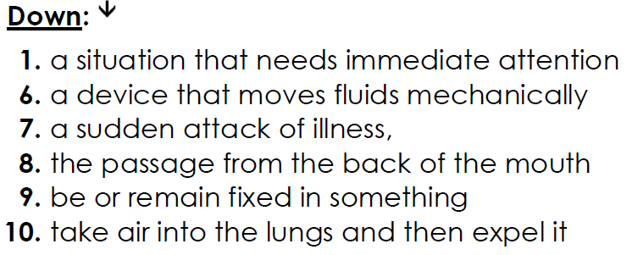

Slide 19
PRE-READING: HOW TO SKIM FOR INFORMATION
Read the title.
Look at the pictures.
Notice where things are talked about in the text.
In longer texts, read the first and last sentences of each paragraph.
Try to notice keywords

Slide 20
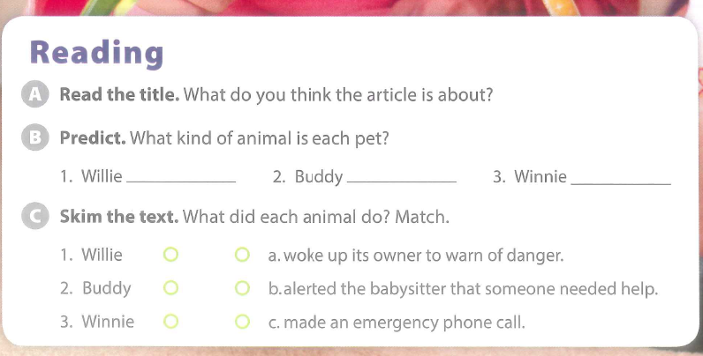
SKIM:

Slide 21
SCAN:
Find and underline the answers to these questions:
What adjectives are used to describe the animals?
What phrase is used instead of ‘repeated’ or ‘said many times’?
According to the article, what are seizures?
Why was Cathy feeling sick when she woke up?

Slide 22
READING TIME!
Read the article on page 13.
DON’T look at the questions yet!

Slide 23
RUNNING DICTATION!
Find the questions outside the room
Run back and tell your partner
Discuss the answer and write it down
Bring your work to your teacher when you’ve finished.

Slide 24
RUNNING DICTATION: ANSWERS

Slide 25
SEQUENCE THE EVENTS (Whiteboards)

Slide 26
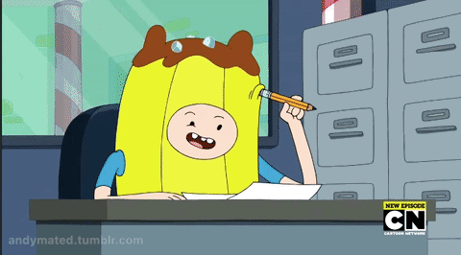
PART TWO: WRITING PRACTICE

Slide 27
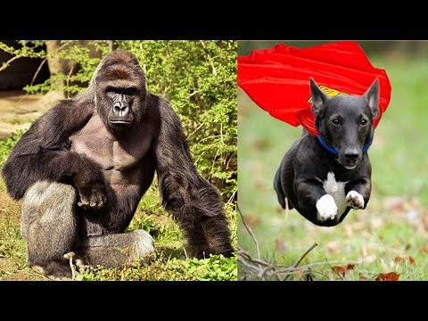
Watch the video and decide which animal is most heroic and why.
Describe them

Slide 28
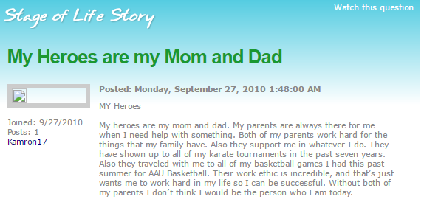
WHAT IS THIS CALLED?

Slide 29
READ AND ANSWER THE QUESTIONS:
Who is this blog about?
What words are used to describe this person?
What did he/she do?

Slide 30
WRITE ABOUT SOMEONE WHO INSPIRES YOU!
You have 10 minutes to write a blog about your hero!
Read it to a partner when you are finished
Ask your teachers for help!

Slide 31
BACK TO THE PROJECT - RESEARCH!!

