Slide 1
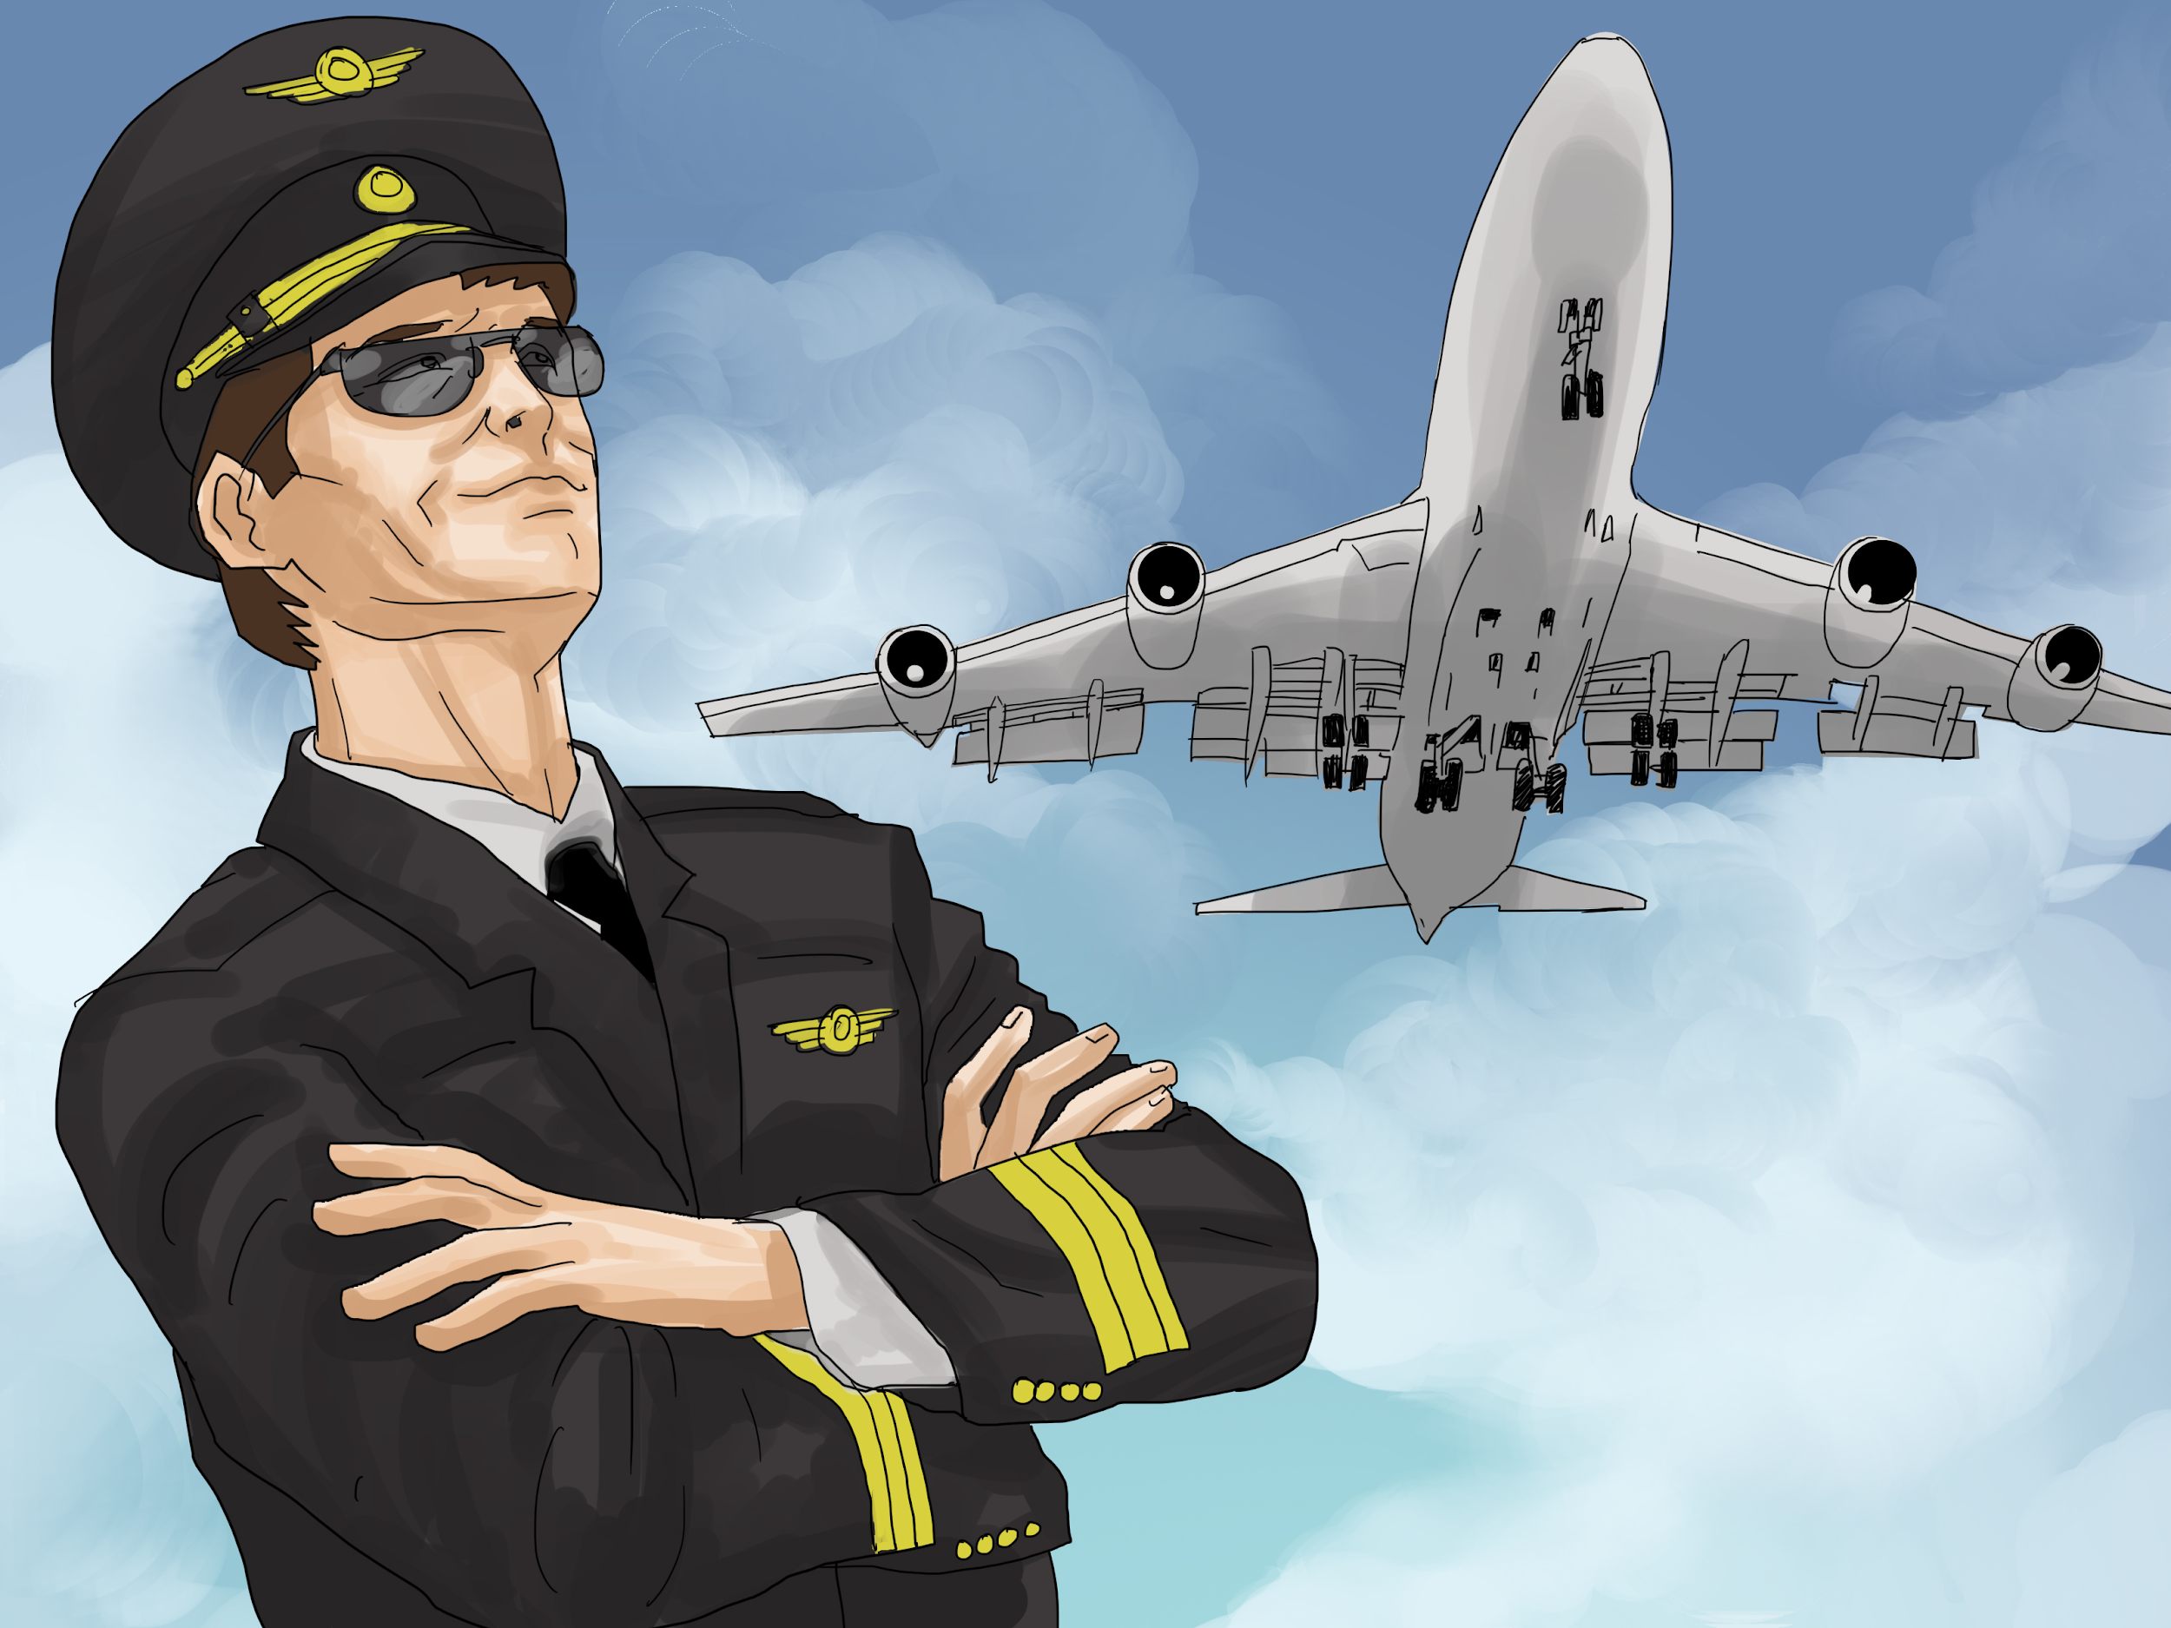
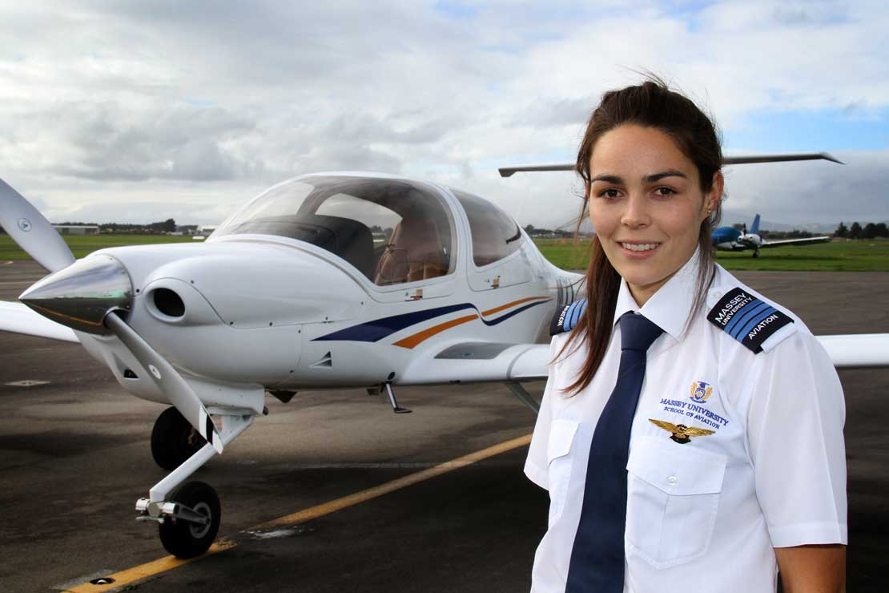
S3A Unit 2:
I’d like to be a pilot.

Slide 10
What are all of these things?

Slide 11
Alphabet job race
Try to write down a job that begins with each letter of the alphabet.
You have 5 minutes.

Slide 12
Your ideal job
What do you want to do in the future?
Write it down on the piece of paper.
Give the paper back to me.
I will mix up the papers and give you one back.
You need to find the person who wrote the job on the piece of paper I gave you.

Slide 13
Interview your partner - listen carefully
What job do you want to do in the future?
Why?

Slide 14
Feedback
Tell me what job your partner wants to do and why.

Slide 15
Comic strip -
running dictation
Find the comic strip outside.
Look at it and tell your partner what the missing words are.
When you have finished, practice reading the comic strip together.

Slide 16
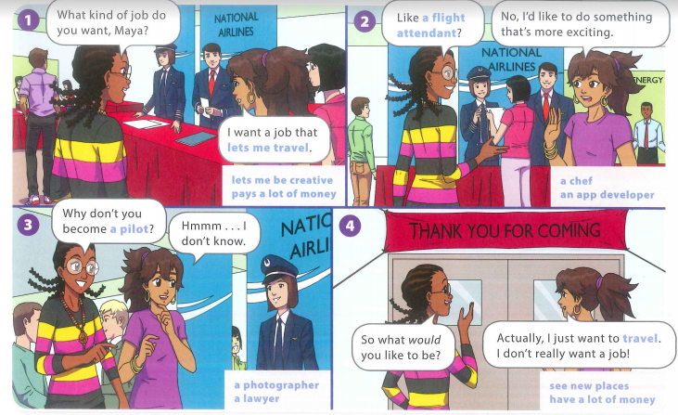

Slide 18
Team race, page 19
Complete each sentence.
Show me and I will give you the next sentence.
The first team to finish all the sentences wins.

Slide 19
Use these phrases

Slide 20
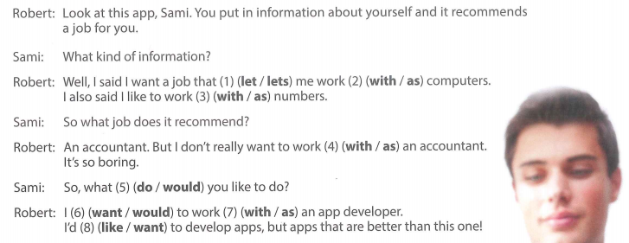
Write the correct answers on your whiteboard.

Slide 21
20 Questions
Think of a job.
Everyone will ask questions and try to guess the job.

Slide 22
Project Work!

