Slide 1
S3A First Lesson
Stairway to Nowhere!

Slide 2
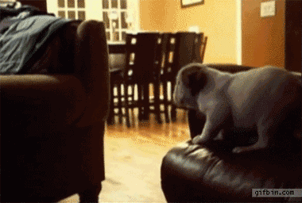
CHANGE CHAIRS!
If you have…
If you can…
If you want…
If you will...

Slide 3
STAIRWAY TO NOWHERE
You will hear a woman talking about a picture called ‘Stairway to Nowhere’
What do you think it means?
Discuss it with the person next to you then draw the picture you expect to see.

Slide 4
LISTENING TIME!
First listening: Listen and then discuss the questions
When did she take the photo?
What was the name of the town?
What did she see that made her laugh?
How did she feel about it?
What does the photo make her remember?
Second listening: Listen again and fill in the missing words
What types of words are missing?
Notes:
Link to recording: https://www.teachingenglish.org.uk/article/stairway-nowhere-lower-level

Slide 5
CHECK YOUR ANSWERS

Slide 6
Draw the picture again with this new information….
Here it is…..
Talk to your partner:
What do you think of this picture? (I think it is….because…..)
Why did she take it?
What would you take a picture of if you were on holiday? Why?

Slide 7
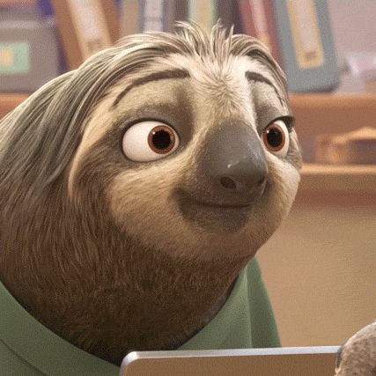
DICTOGLOSS!
There will be 2 listening stages...
STAGE 1: Listen first (put your pen down!)
STAGE 2: Pick up your pens, listen and write only the key words!
What are the key words?
Nouns? Adjectives? Prepositions? Verbs? Short connecting words? (eg.and)
Notes:
For stage 1: Encourage students to listen and let the meaning of the text wash over them. Don’t focus on individual words. Read at a natural speed.
For stage 2: As you read, Ss will write down all the keywords they here. Tell them how many sentences there will be, and get to Ss to write 1, 2, 3, 4, 5, 6 (for each sentence) etc… so that they can organise their notes.

Slide 8
Now get into groups.
Choose ONE person to be the writer.
Use everybody’s notes to try to recreate the text.
You have 10 minutes!
Notes:
1.Once they have finished their recreation, give each group a (different colour) pen, and get them to write their sentences on the board at the front of the room.
There are different variations of this, but I usually don’t let the writer have the paper, so that their group must DICTATE the sentences to the writer. Take turns sentence by sentence to be the writer. (give them a time limit for this)
2.Once they have finished writing their sentences on the board. Compare and analyse each group’s sentences (with the group).
Get a red pen, and underline any parts of the sentences that need changing in order to improve grammaticality, vocab or cohesion. (it doesn’t matter if the sentences are not the same as the original paragraph… all that matters is that their sentences work as stand alone pieces)
3. Now groups work together to correct their mistakes that the teacher has highlighted. (perhaps use a different colour pen to do this to highlight their errors). The teacher can monitor and guide students through this phase but try to give the learners as much autonomy as possible here.
Once they have finished, the teacher checks again, and congratulates students on their success and teamwork! Perhaps you could now show them the original text to see how it compares with what they have written. You could also potentially act as a judge to see which group worked the best.

Slide 9
TIME’S UP!
CHANGE POSITIONS!
Choose one person to write your answers on the board above.
NO paper! You have to dictate it to each other!
Swap with another group. Use the original to correct any mistakes. Two points = correct tense, characters (nouns), describing words (adjectives) One point = correct spelling of unfamiliar words
BONUS POINTS FOR BEING CLOSEST TO THE ORIGINAL!

Slide 10
BRAINSTORM
Think about a day trip or a holiday that you have had recently.
Where did you go?
Who did you go with?
What did you see and do?
Did anything unexpected happen?
What was it?
How did you feel?

Slide 11
OVER TO YOU!
Choose a partner.
You will draw a picture about your day and write a short story about it.
You should write ten lines.
Now tell your story to another pair. Don’t show them your picture. Listen for keywords and draw your version of the picture. Swap pictures and see who was closer!

