Slide 1
S3A Project 2
How can we make our city safer?

Slide 2
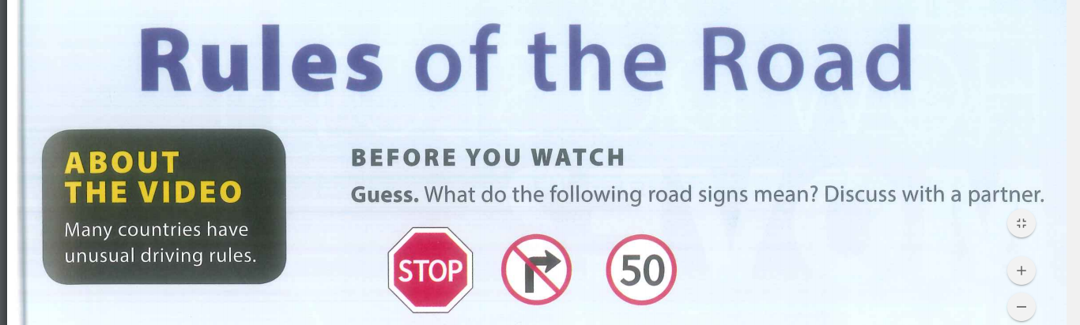
ENTRY EVENT:

Slide 3
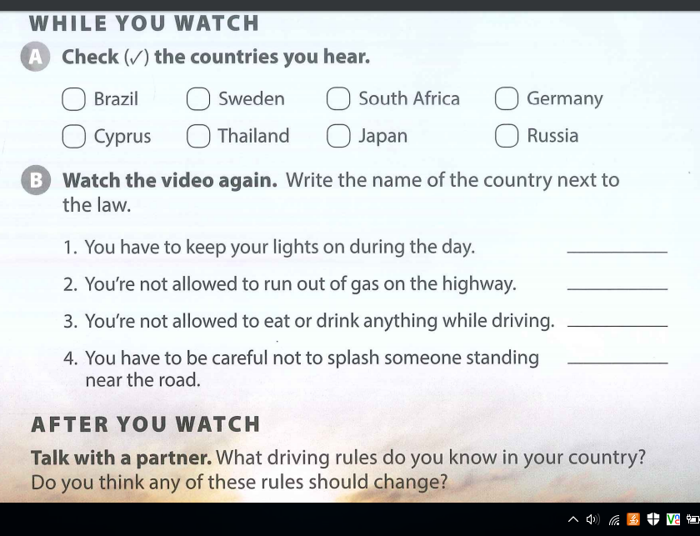
Rules of the Road
https://drive.google.com/drive/folders/0B6jZ1TST9GtKNnpyWnktTl9iS0k

Slide 4
The next project is about……. Making Vietnam safer!!

Slide 5
Project Outcomes
By the end of this project, you will have:
Learned and practised grammar for rules, obligations and permission as well as language skills and vocabulary for public, general and unusual rules.
Researched and learned about a how cities in Vietnam could be made safer and created rules in order to help to make the cities in Vietnam safer
Used a tool to spread safety awareness to the public, on their chosen city safety topic.
Presented their project to the class in a format of their choice.

Slide 6
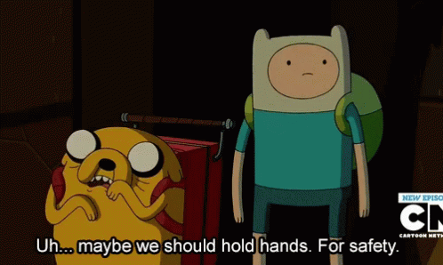
Planning and Research:
You will choose one issue that you think needs to be addressed
You will complete your project plans and show me once it is done.
THEN, you can begin your research
As always, ask me if you need any help :)

Slide 7
Present your plan: A proposal!
Tell the class about your presentation!
You should include the following information:
What your definition of a hero is.
How you will address each question.
What each person will say and do (e.g. research, make poster, etc)
Why you think it is important.
You will have 15-20 minutes to prepare.

Slide 8
Mid-Project Peer Feedback.
Listen to each group present their project
Write your feedback on the sheet provided
Use the feedback to make your project even more amazing!
 | What you liked | What you would change | What you learned
Group:

Slide 9
TODAY: POST-FEEDBACK AND PREPARATION
Read over the feedback from your peers and teacher
Finalise your presentation !
Come to me for any assistance that you need before the presentation!

Slide 10
TODAY: PRESENTATIONS
Each group will give their presentation
Write down one thing they liked, would change, and learned
I will randomly choose people to give feedback so you better have something to say!!

Slide 11
PORTFOLIO AND SELF-REFLECTION TIME!
Read the feedback given to you by your peers (5 minutes)
Write down the following things (10 minutes):
One thing that you/your group did well (or liked)
One thing that you/your group didn’t do well (or would change)
One thing that you learnt (from your own and from another project).

