Slide 1
PROJECT THREE
How can we make rubbish more useful?

Slide 2
WATCH THE VIDEO AND ANSWER THE QUESTIONS:
What are the light bulbs made from?
What materials has Mr Diaz used to create electricity?
How much does it cost to make?
What are the bottles filled with?
How do they work?

Slide 3
WATCH THE VIDEO AND ANSWER THE QUESTIONS:
How long do they stay lit up for?
How have these inventions helped the people living in poverty?
What is Mr Diaz’s bigger plan (e.g. other than light bulbs)?
Does he do it for money?
Do you think that is work is important? Why/Why not?

Slide 4
NOW…… WATCH AND LISTEN CAREFULLY!
https://drive.google.com/file/d/0B89SggH_uiVSUXZiRXdCMlRmWXM/view

Slide 5
PROJECT OUTLINE
QUICK BRAINSTORM!
Name five dangers that face the Earth (e.g. environment)
Name five dangers that face Vietnam

Slide 6
TODAY: PROJECT PLANS!

Slide 7
TODAY: PROJECT PLANS!

Slide 8
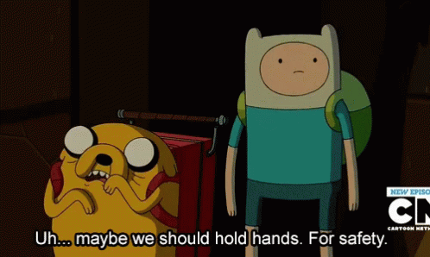
Planning and Research:
You will choose one issue that you think needs to be addressed
You will complete your project plans and show me once it is done.
THEN, you can begin your research
As always, ask me if you need any help :)

Slide 9
Present your plan: A proposal!
Tell the class about your presentation!
You should include the following information:
What recycling and reusing rubbish means.
How you will address each question.
What each person will say and do (e.g. research, make poster, etc)
Why you think it is important.
You will have 15-20 minutes to prepare.

Slide 10
Mid-Project Peer Feedback.
Listen to each group present their project
Write your feedback on the sheet provided
Use the feedback to make your project even more amazing!
 | What you liked | What you would change | What you learned
Group:

Slide 11
TODAY: POST-FEEDBACK AND PREPARATION
Read over the feedback from your peers and teacher
Finalise your presentation !
Each group will show me their presentation and send it by the end of break.
Write your speeches!

Slide 12
TODAY: PRESENTATIONS
Each group will give their presentation
Write down one thing they liked, would change, and learned
I will randomly choose people to give feedback so you better have something to say!!

Slide 13
PORTFOLIO AND SELF-REFLECTION TIME!
Read the feedback given to you by your peers (5 minutes)
Write down the following things (10 minutes):
One thing that you/your group did well (or liked)
One thing that you/your group didn’t do well (or would change)
One thing that you learnt (from your own and from another project).

