Slide 1
S3A Project One
What makes a hero?

Slide 2
Driving Question:
What personality qualities or actions make a hero?
List at least five words that describe a hero
Finish this sentence: “A hero is…..”
Discuss with the people next to you.
A hero is…. is someone who is brave and noble in character
A hero should be…. Selfless, Courageous, Humble, Caring What do these words mean?

Slide 7
What makes a hero?
Watch the video about Malala Yousafzai
Discuss these questions in your groups:
Who is Malala?
What happened early in her life?
What did she do?
What words can you use to describe them?
Would you call her a hero? Why/why not?

Slide 8
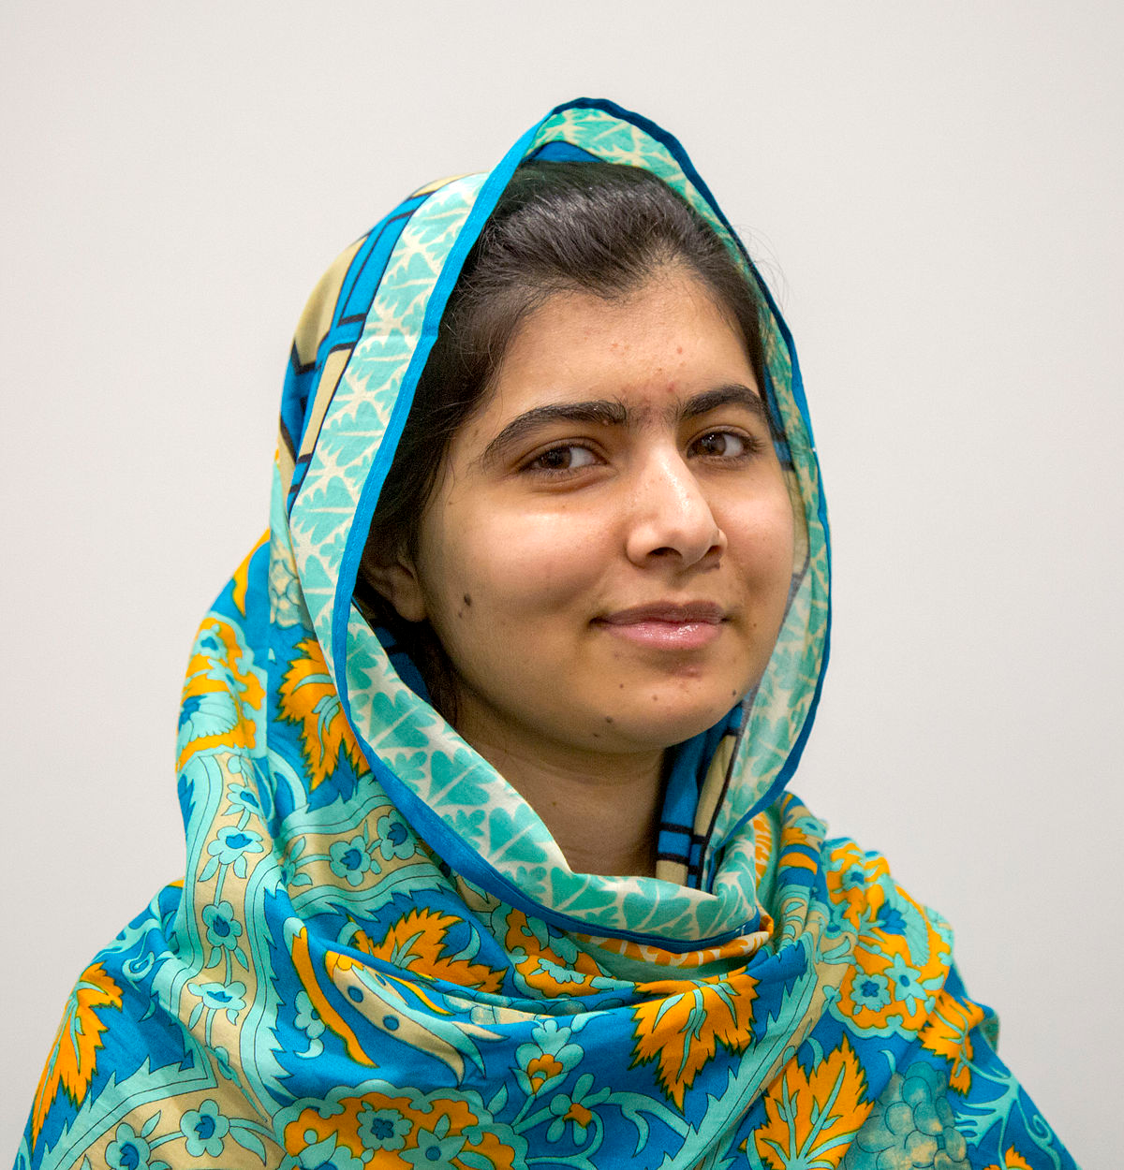
My Hero: Malala Yousafzai
I think a hero is someone who is brave and noble in character
A hero should be….
Selfless
Courageous
Humble
Caring
Shot in the head for work and she still continued to fight for what she believed in (15 years old, 2012)
Advocate for female education and human rights with her charity organisation, The Malala Foundation
Youngest Nobel Peace Prize winner (17 years old, 2014)

Slide 9
Project Plan:

Slide 10
Project Plan:

Slide 11
Project Plan:

Slide 12
Functional Language
I think a hero is someone who….
A hero should be…..
My hero is ……
Who is your hero?
What do you think makes a hero?

Slide 13
Planning and Research:
Write your Project Plan:
Answers to each question
Tasks to be done (e.g. research, create poster, etc)
Who will complete each task
When each task will be completed

Slide 14
Present your plan: A proposal!
Tell the class about your presentation!
You should include the following information:
What your definition of a hero is.
How you will address each question.
What each person will say and do (e.g. research, make poster, etc)
Why you think it is important.
You will have 15-20 minutes to prepare.

Slide 15
Mid-Project Peer Feedback.
Listen to each group present their project
Write your feedback on the sheet provided
Use the feedback to make your project even more amazing!
 | What you liked | What you would change | What you learned
Group:

Slide 16
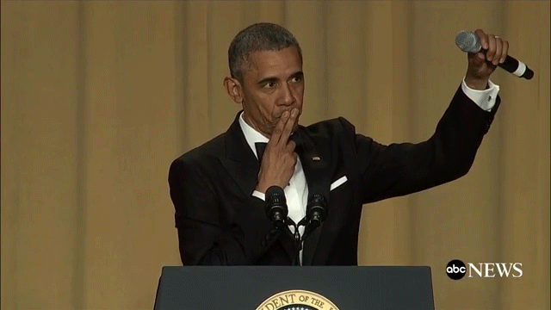
PROJECT WORK AND PREPARATION!

Slide 17
PROJECT WORK AND PREPARATION
By the end of this session you will:
Finalise you poster / powerpoint
Bring it to me for feedback
Practice your speeches (Hint: use cue cards)
Send your final product to - elleangeloni@ilavietnam.edu.vn

Slide 18
Presentation time!

