Slide 1
S3A Project Skills
With a mini-project!

Slide 2
Name 5 things that…..
Are Made of Glass
Are Made of Plastic
Are Made of Wood
Are Naturally Round
Are Flat

Slide 3
Name 5 things that…..
Are Exciting
Are Terrifying
Burn
Cost a Lot
Do Not Break When Dropped

Slide 4
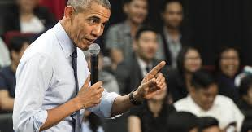
WHAT ARE THEY DOING?
Think of the best or worst presentation you’ve ever given. What was good/bad about it? Why?

Slide 5
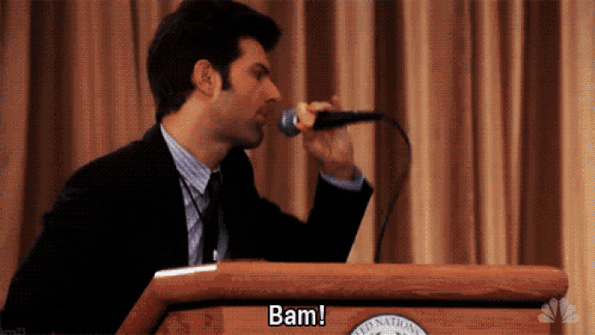
What makes a good presentation?
Watch the videos and take notes on:
Examples of a bad presentation
Examples of a good presentation
What are the three most important aspects of giving a good presentation?
Were they good or bad speakers? Why?
Notes:
https://drive.google.com/file/d/0B89SggH_uiVSZS15MzFsWEVLUEE/view

Slide 6
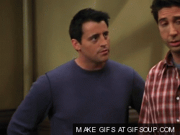
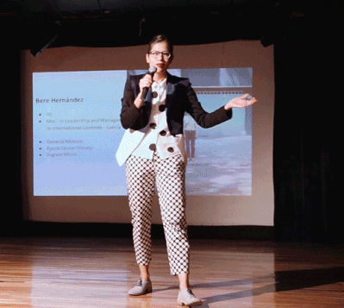
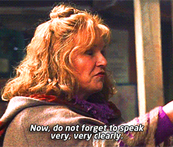
PRESENTATION GAME
Remember: The three most important parts of a good presentation are…..
Pick a partner
Talk to them about a topic of your choice for one minute
Make sure that you are maintaining eye contact, speaking clearly, and using the correct body language!

Slide 7
PROJECT OUTLINE:
In your groups, brainstorm and research:
What makes a good presentation?
What make a bad presentation?
What skills can you use when you present in class?
Why are these skills important?
What advice would you give someone for dealing with nerves (3-5)?
You have 5 minutes to write down as much as you can.
Have a look at what the other groups have written.

Slide 8
PROJECT OUTLINE:
You have 30 minutes to prepare to present your ideas
Poster, powerpoint, role-play - whatever you like!
Present all the information that you think is relevant
Some important language to consider:
When you present you should…
It doesn’t look/sound good when you…
I don’t think it is it good if you…./I think it is better if you…
In my next presentation I will…
You have 5 minutes to rehearse!
Make notes
Decide who will present what information

Slide 9
PRESENTATION TIME!
Each group will have 3-5 minutes to present
Other groups should take notes on:
How well the group presented - eye contact, body language, clear voice
How well each person presented
What you liked about the presentation
What you would change about the presentation
What you learned about the presentation

