Slide 1
Jobs & Professions

Slide 2
ABC BOARD RACE - JOBS

Slide 4
VOCABULARY AROUND THE ROOM
Look at the pictures and answer the questions:
What is the job?
What kind of job do you want to? (out of the ones you see)
Why do you want to do that job?
Write your answers on a piece of paper and discuss.

Slide 5
Accountant

Slide 6
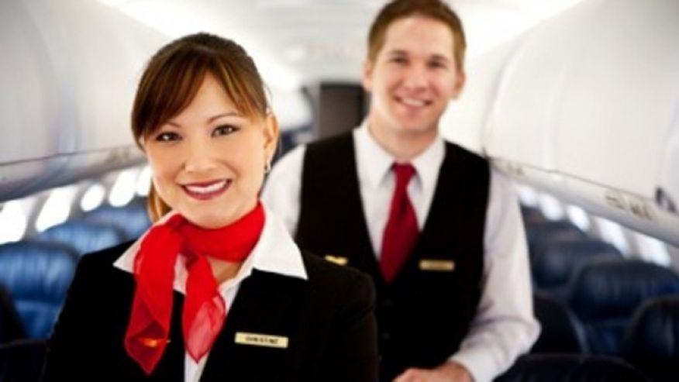
Flight attendant

Slide 7
Chef

Slide 8
App developer

Slide 9
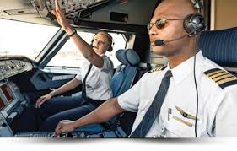
Pilot

Slide 10
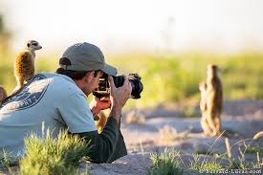
Photographer

Slide 11
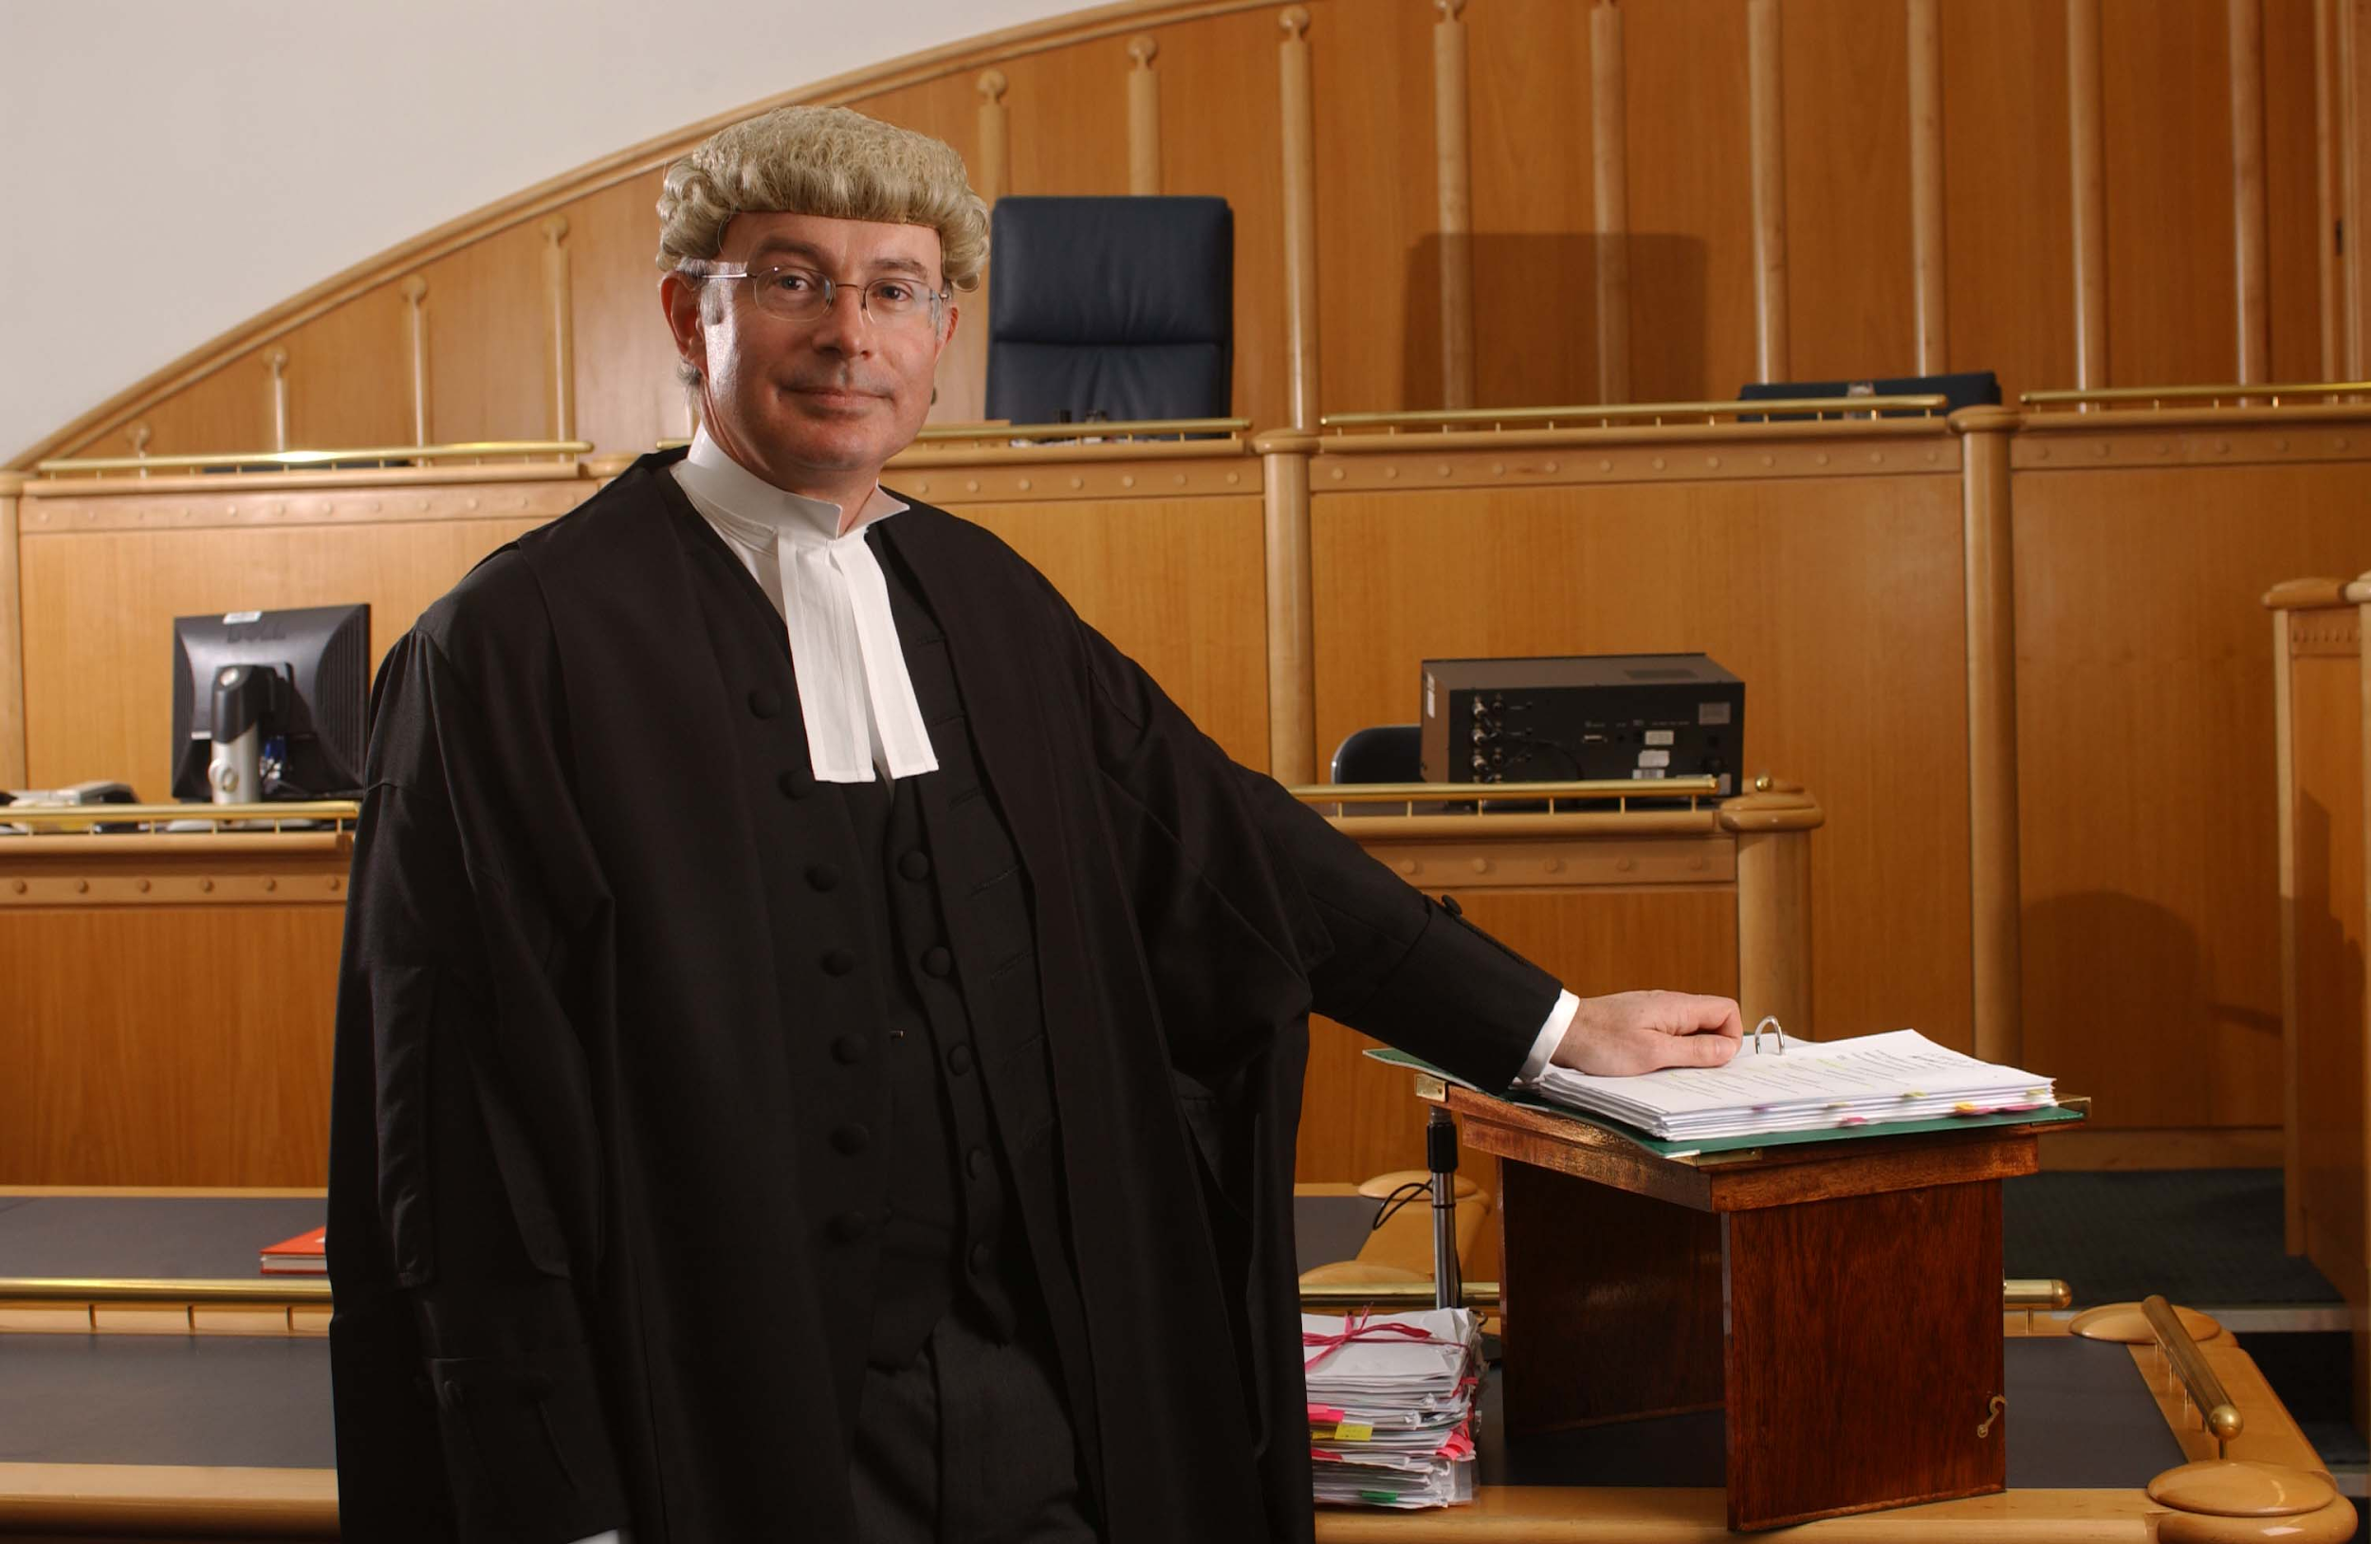
Lawyer

Slide 12
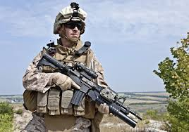
Soldier

Slide 13
Singer

Slide 14
Dancer

Slide 15
DESCRIBE THE PERSON AND THE JOB:
Use the words below to describe the jobs to your partner
E.g. A teacher is someone who helps people. Teaching can be challenging.
Challenging
Dangerous
Creative
Perform on stage
Exciting
Boring
Pays well
Help people

Slide 16
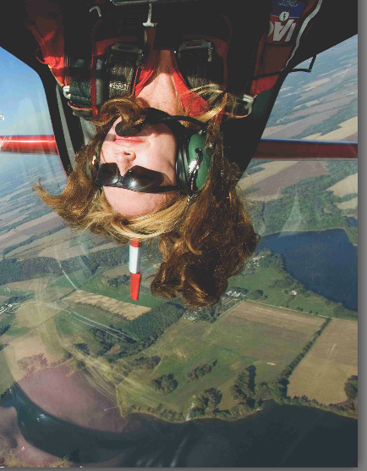
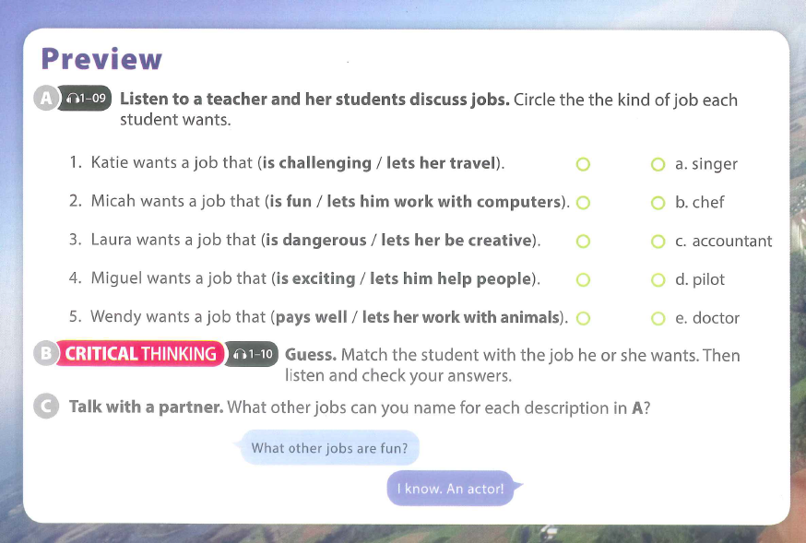
What do you want to be someday?

Slide 17
WRITE THE ANSWERS ABOVE YOU!

Slide 18
CLASS MINGLE AND INTERVIEW:
Write your ideal job on a piece of paper and give it to your teacher
Walk around and ask your classmates about their ideal job to find out who it is! = What do you want to be in the future? I want to be a/an…..
Interview your classmate about their future job!
What do you want to be in the future?
What kind of job do you want to have?

Slide 19
LANGUAGE FOCUS

Slide 20
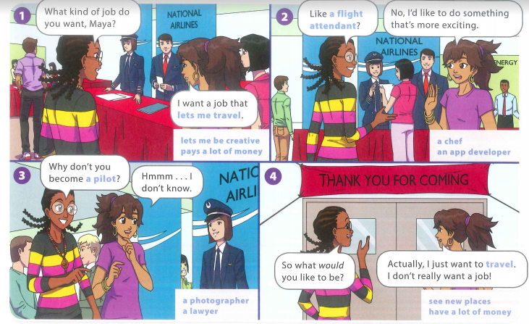

Slide 21
GRASS SKIRTS!
Run outside and find a question
Give it to your partner and fill in the missing words
Bring it to your teacher before you get the next one!
Here are your missing answers:

Slide 23
TEN QUESTIONS
Split into 3 groups
Think of a job
Guess the job that each person is thinking of!
Use the language below:
...lets you work in an office?
Is it a job that …..
Is the job dangerous? Creative … scary …. Boring …. Interesting
...uses computers?
...pays a lot of money?
...lets you help people?
...lets you travel?
...lets you work in an office?

Slide 24
JOB ADVERTISEMENTS - What kind of job do you want?
Look at the job advertisement:
What are they advertising for? (e.g. the job)
What personality qualities would a person need for that job?
Match the applicants to the jobs.
Nina | Magazine writer | Studying English, sociable, interested in fashion and music
Dave | Trainee hairdresser | Sociable, cares for appearance, working with hands, full-time
Dewel | Social worker | Helping people, make a difference, learn new things
Sarah | Model | Part-time, not a cafe, beautiful and tall
Sam | Cafe Worker | Friendly, sociable, restaurant experience, part-time

Slide 25
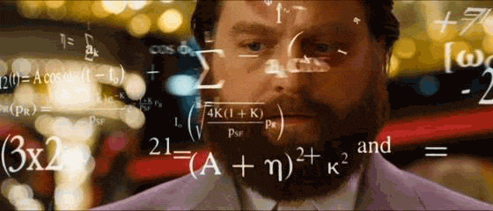
CREATE YOUR OWN JOB ADVERTISEMENT!
Choose any job and create an advertisement for it.
Use the examples to help you fill in the mind-map.
First you should decide what information you will need to include.
Let’s brainstorm!

Slide 26
PERSONALITY QUALITIES:
EDUCATION & EXPERIENCE:
JOB TITLE:
JOB REQUIREMENTS:
JOB DETAILS:

Slide 27
PROJECT WORK & PRESENTATION PREPARATION
You have 10 minutes to finalise your presentation plan
You will create your presentation today!
You will give your presentation next week so work hard!
You will send it to your teacher for feedback
You will write and practice your speeches today!
What are some important presentation skills?

