Slide 1
Listening & Speaking

Slide 2
BACKS TO THE BOARD!

Slide 3
FUN JOBS!!
Watch the videos and decide:
What are they doing?
Is it a “fun” job? Why/why not?
Which job would you like to have? Why?

Slide 4
BRAINSTORM MORE FUN JOBS!
What are some other fun jobs? (At least 5 jobs)
Why are they fun jobs?
What qualities do you think people with these jobs should have?

Slide 5
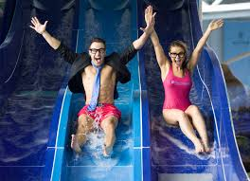
NEW VOCABULARY
WATER SLIDE TESTER
about $30,904

Slide 6
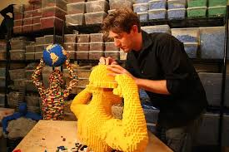
NEW VOCABULARY
LEGO ARTIST
about $37,500

Slide 7
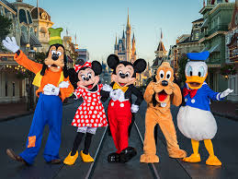
NEW VOCABULARY
Character performer
about $18,000

Slide 8
NEW VOCABULARY: GUESS THE MEANING
FLEXIBLE
FRIENDLY
HARD-WORKER
CONFIDENT
CREATIVE
WRITES WELL

Slide 9
NEW VOCABULARY: GUESS THE MEANING
FLEXIBLE | (of a person) ready and able to change so as to adapt to different circumstances.
FRIENDLY | (of a person) kind and pleasant; on good or affectionate terms.
HARD-WORKER | (of a person) tending to work with energy and commitment; diligent.
CONFIDENT | feeling or showing positivity about oneself; self-assured.
CREATIVE | relating to or involving the imagination or original ideas.
WRITES WELL | Someone who has a clear message that is expressed well or legible.

Slide 10
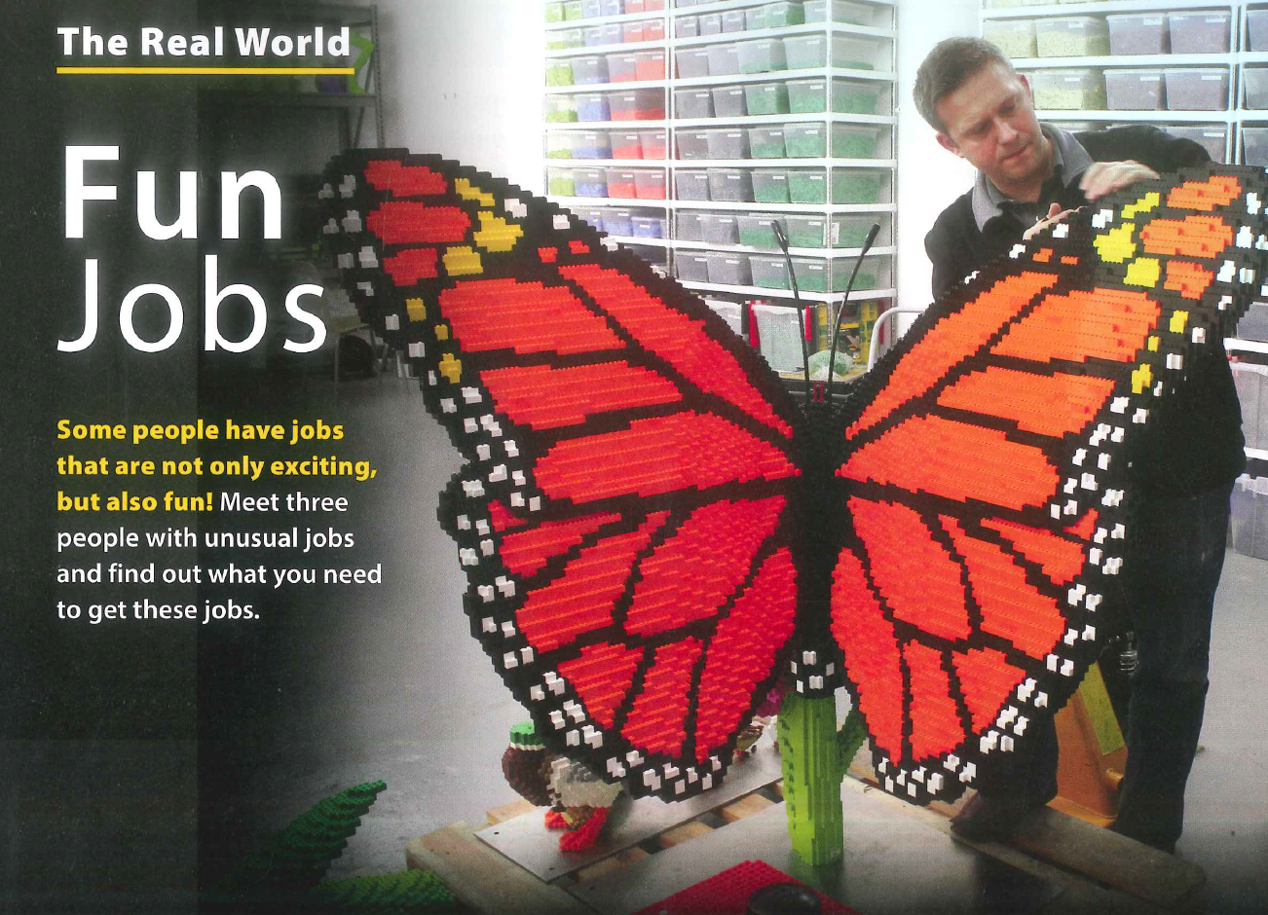
WHAT IS HAPPENING HERE?

Slide 11
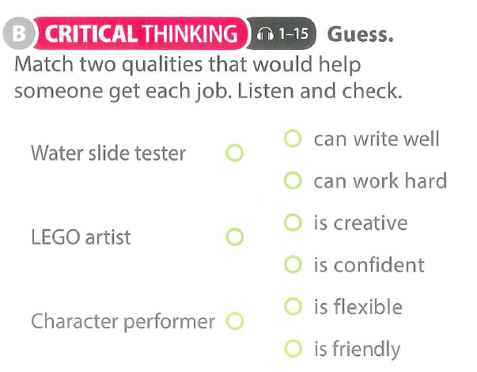
LISTENING:

Slide 12
Game #9: Shooting Stars
KL SJ ST
Notes:
https://www.youtube.com/watch?v=ZnHmskwqCCQ
Preparation:
Create a star flashcard if your classroom does not have a whiteboard opposite the main board. For younger Super Junior or Jump Start classes, bring hoops to add a physical obstacle to the starting positions for each team (players must go through the hoop before they run to touch the star).
How to play:
Split the class into teams (three are used in the example slide that follows). Assign a question to each of the players in each team.
Countdown to the first question, which should be chosen at random (e.g. Three, two, one… Question 4!).
The players assigned Q4 must stand up, run and touch the star before running to the board and writing the answer.
The first team to write the correct answer scores a point. Highest points win.
Pro Tip:
This activity works best for questions requiring short answers, e.g. multiple choice or matching tasks.

Slide 13
A
B
C
1.
2.
3.
4.
5.
6.
1.
2.
3.
4.
5.
6.
1.
2.
3.
4.
5.
6.
Notes:
https://www.youtube.com/watch?v=ZnHmskwqCCQ

Slide 14
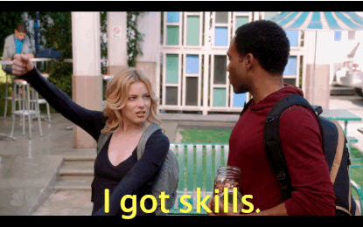
WHAT IS YOUR IDEAL JOB?
Ask yourself: What is my ideal job?
Write it down
Find someone that you don’t normally talk to and interview them about their ideal job!

