Slide 1
Can Animals be nice?
Reading

Slide 2
Write ten things...
...that are blue
...that smell bad.
Irregular verbs.
...that smell good
...that are round
Adjectives.
...that are yellow.
Adverbs.

Slide 3
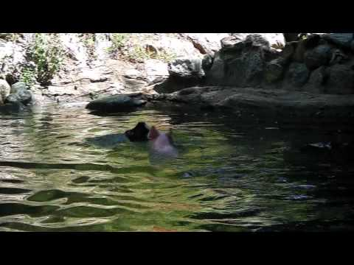
What’s happening in the video? Think of adjectives to describe the pig.

Slide 4
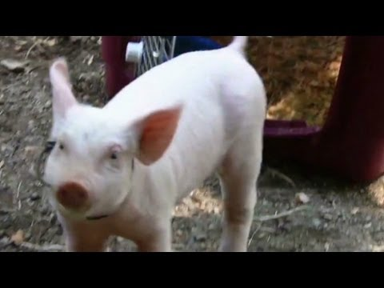
What do you think of the pig now? Were your adjectives correct?

Slide 5
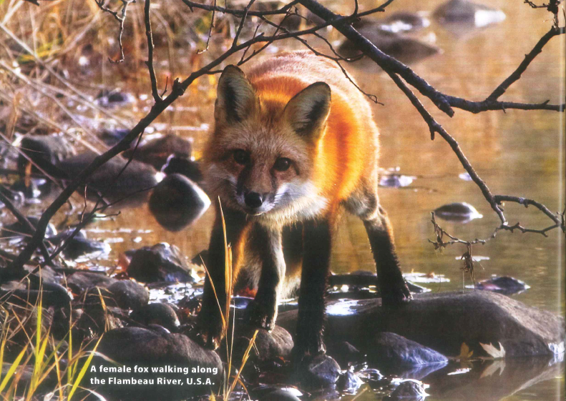
Talk to your partner:
Do you think animals can be nice? If so, give an example.

Slide 6
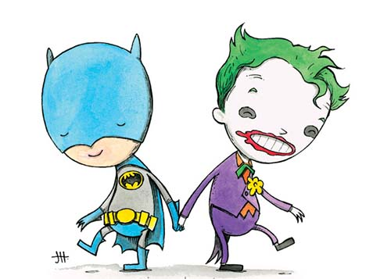
get along

Slide 7
female / male

Slide 8
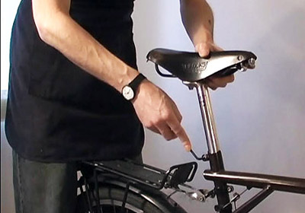
lower

Slide 9
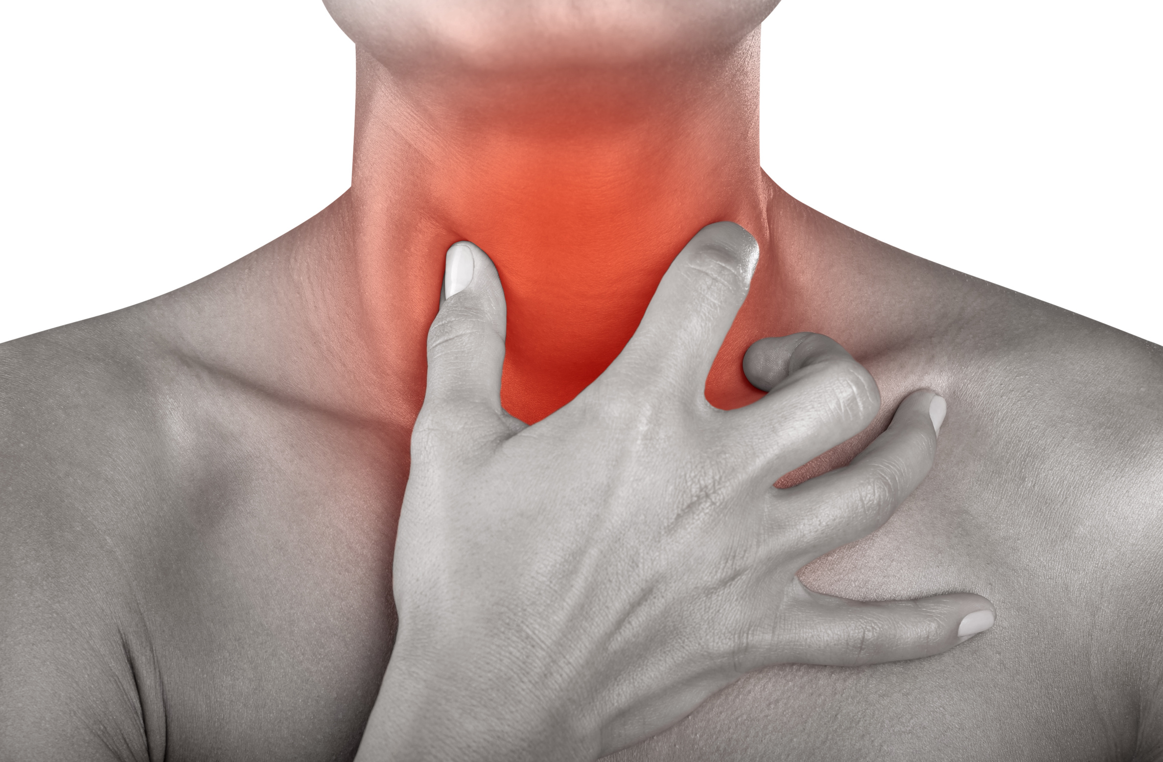
sore

Slide 10
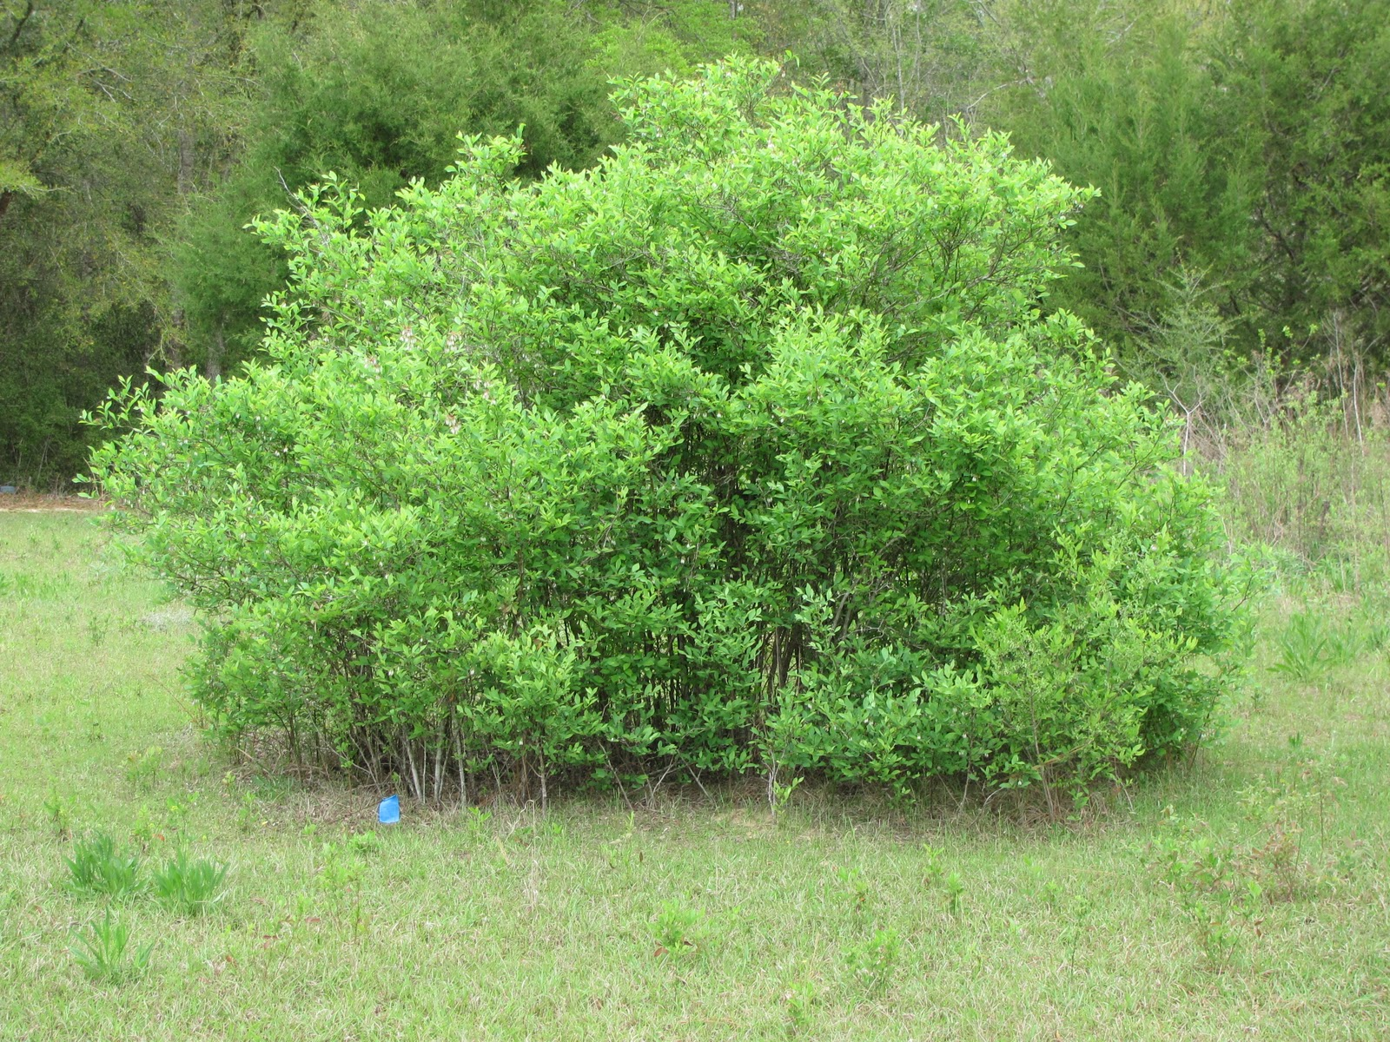
bush

Slide 11
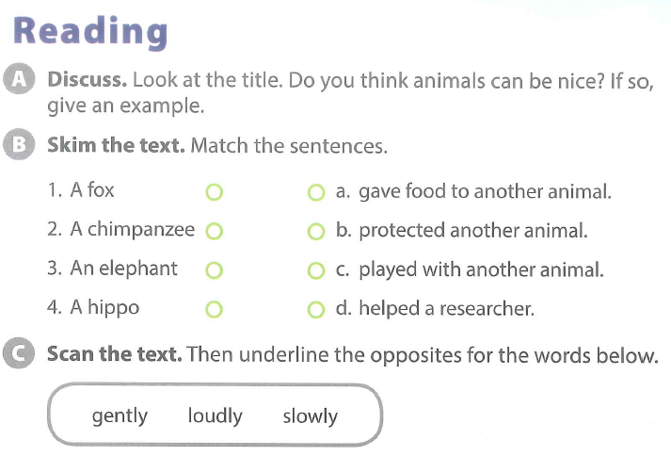

Slide 12
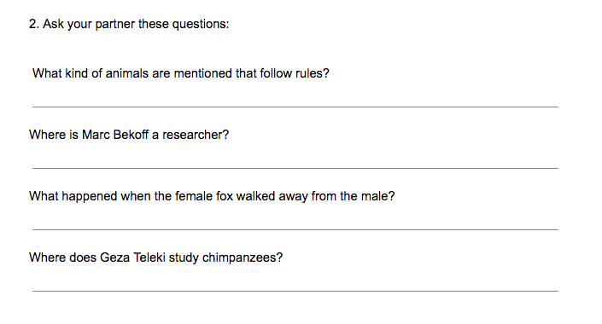

Slide 13
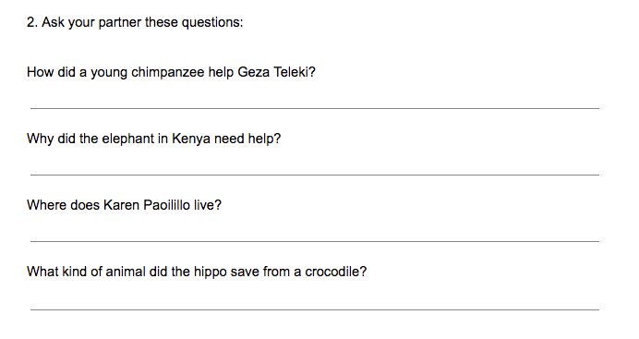

Slide 16
BREAK TIME

